Slide 1
PROJECT UPDATES
Deschutes County and City of Bend Joint meeting
1-28-22

Slide 2
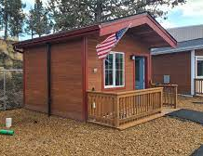
Veterans Village – 15 tiny homes
Location-Public Safety Campus
Community building
Case management services
County investment
10-year no cost lease
$100k for construction
$100k operational funding for 10 years

Slide 3
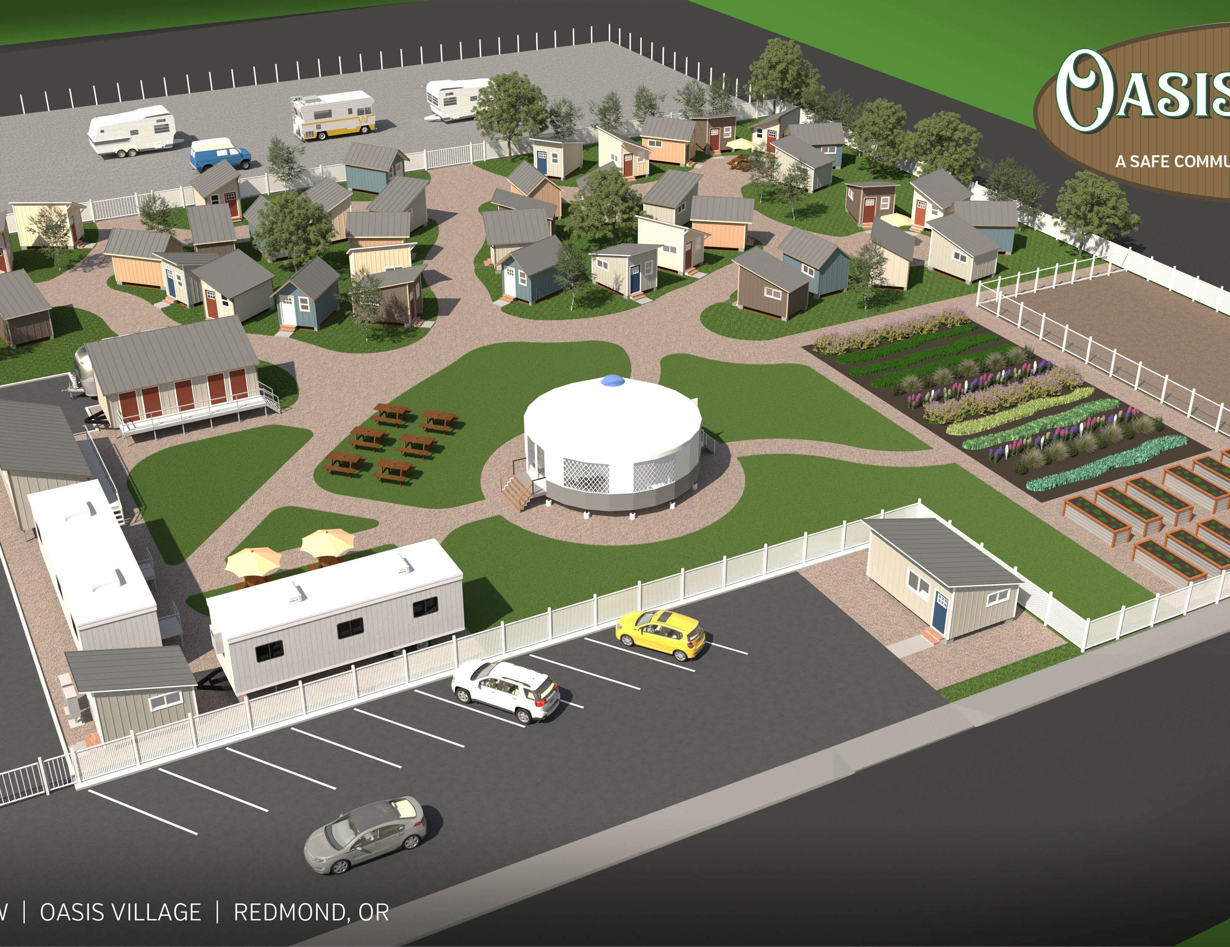
OASIS VILLAGE
$ 32,050
Rogue Retreat consulting: training, outreach, and conceptual development of site
$ 367,500
Towards initial capital expense: 10 shelter units, shower/restroom unit, dining unit, kitchen and laundry

Slide 4
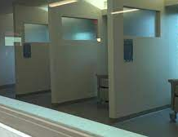
Wrap Around Services
-Homeless Outreach
-Health Services Crisis Services
Stabilization Center
MCAT

