Slide 1
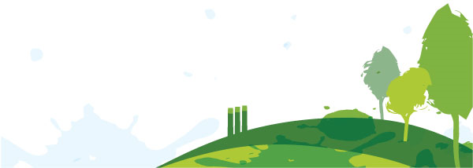
Sharing Water

Slide 2
Part I: Watersheds and Water Users

Slide 3
How do you connect with water?
After visiting each photo, choose one that represents your personal connection to water
Stand by the photo

Slide 4
What kind of water user are you?
What water users do you depend upon?

Slide 6
What is a watershed?

Slide 7
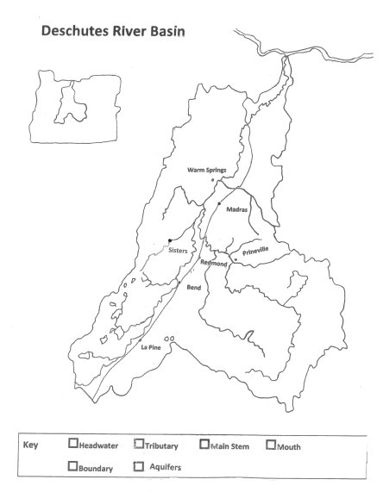

Slide 8
Who are the water users of Central Oregon?

Slide 9
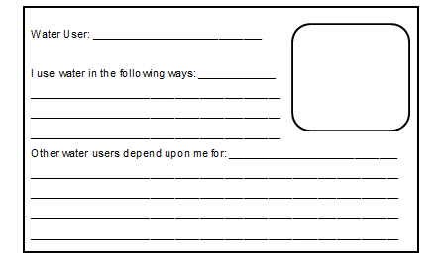
Creating a water user profile

Slide 10
Water user profile sample

Slide 11
Discussion:
1. What do our results suggest we value as a classroom?

Slide 12
Discussion:
2. Are there water users who did not receive tokens? How might this affect other water users?

Slide 13
Discussion:
3. What should happen when a water user negatively impacts water quality or consumes too much?

Slide 14
Discussion:
4. Is one water user more important than all the others? What values or attitudes shape that belief?

Slide 15
Discussion:
5. When decisions about water allocation have to be made, do you think it’s possible to please every water user in our region?

Slide 16
Discussion:
6. What responsibilities do water users have if they are given water?

Slide 17
Part II:
Water Conservation

Slide 18
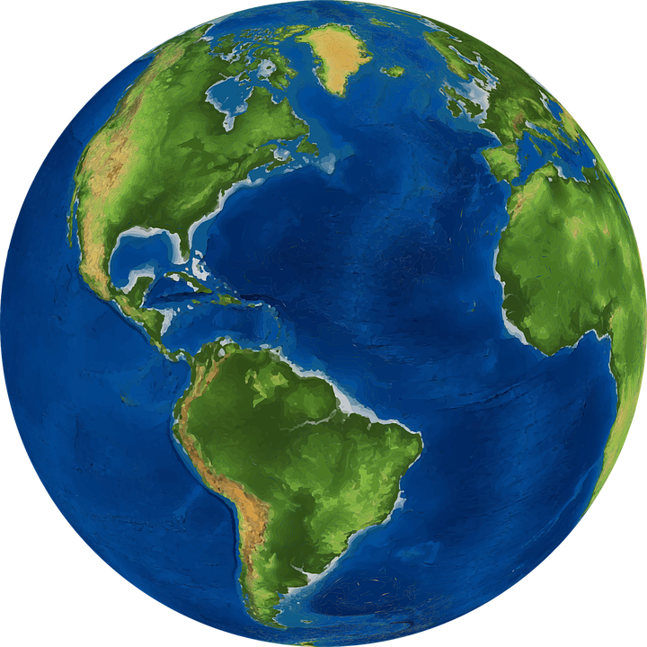
How much?

Slide 19
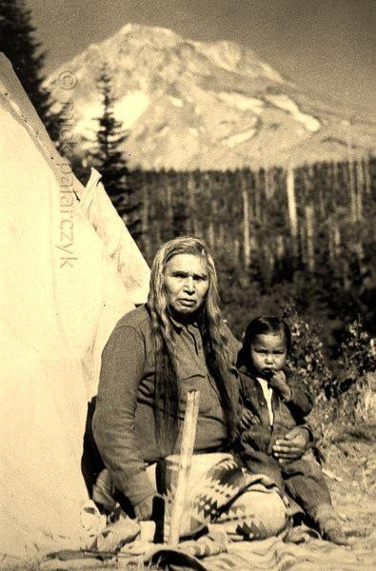
The state of our basin
8,000 BCE
American Indians use the Deschutes River as a travel route to the Columbia. Grounds are used for hunting and gathering.

Slide 20
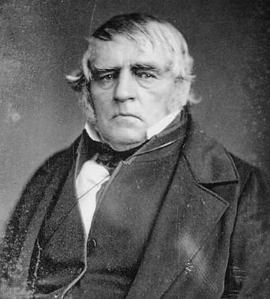
The state of our basin
1813
Peter Skene Ogden (Hudson’s Bay Company) sends fur trappers to Central Oregon.

Slide 21
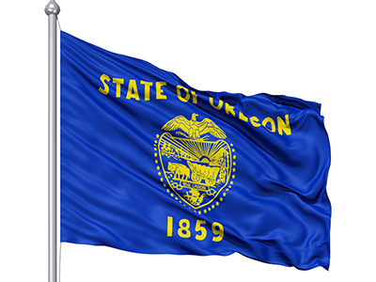
The state of our basin
1859
Oregon becomes a state

Slide 22
The state of our basin
1870
The first euro-american settlers arrive

Slide 23
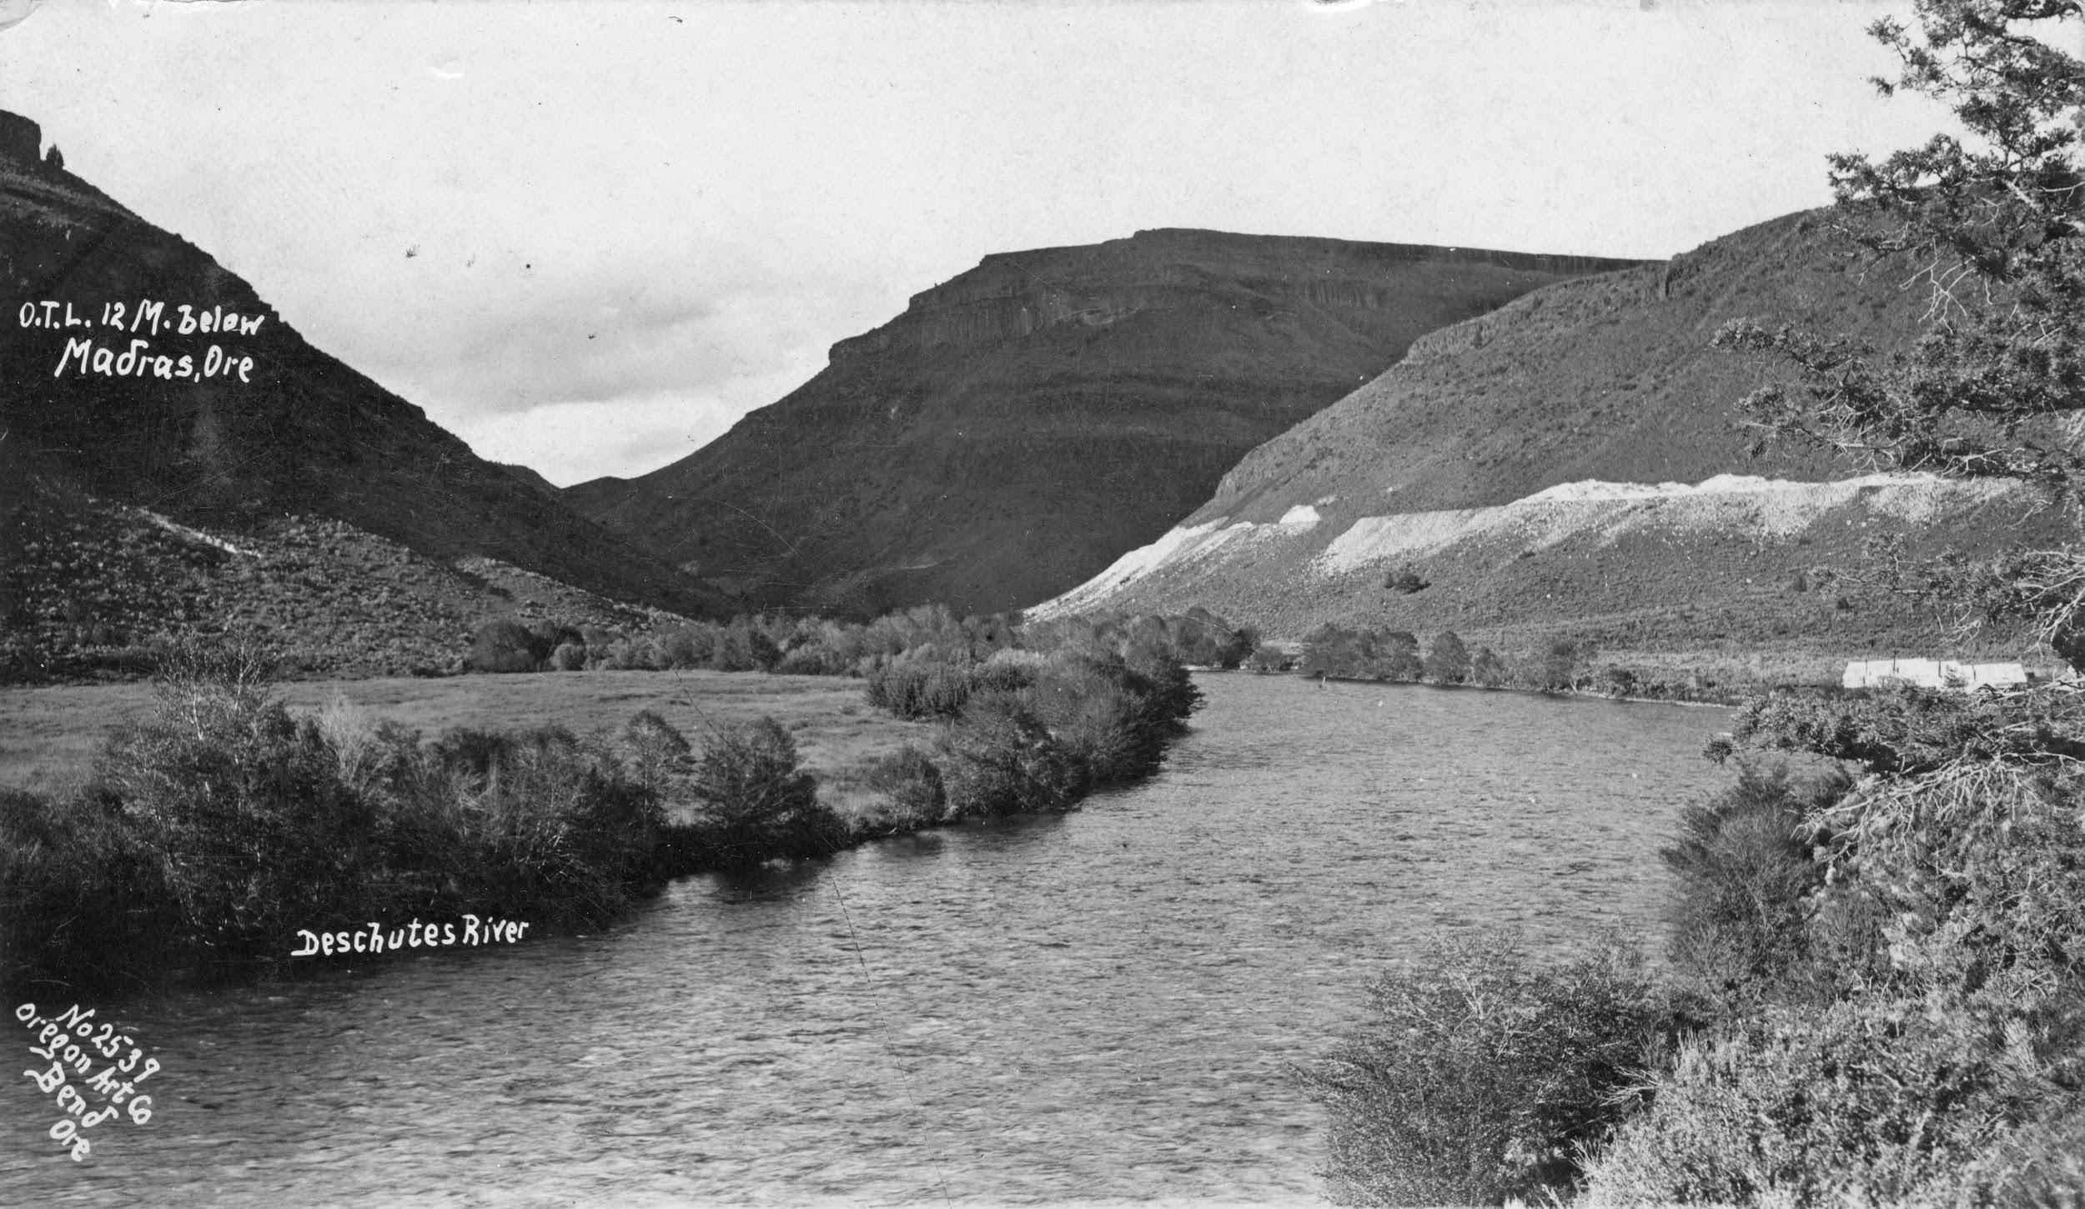
The state of our basin
1894
The Carey Act establishes the use of the Deschutes River for irrigation purposes

Slide 24
The state of our basin
1904
Several irrigation companies complete canals to irrigate thousands of acres of Central Oregon farmland

Slide 25
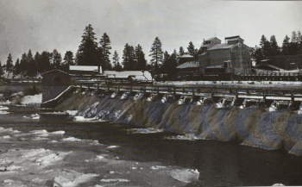
The state of our basin
1910
The Deschutes River is dammed, creating Mirror Pond. Downtown Bend residents receive electricity from this project

Slide 26
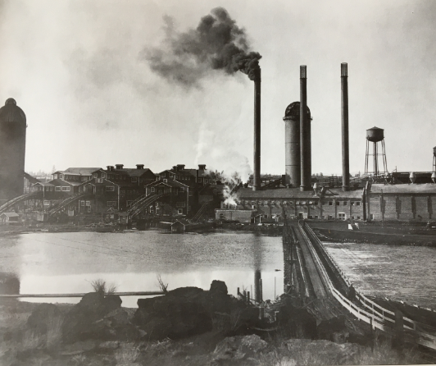
The state of our basin
1911
Brooks-Scanlon and Shevlin-Hixon set up mills along the Deschutes River

Slide 27
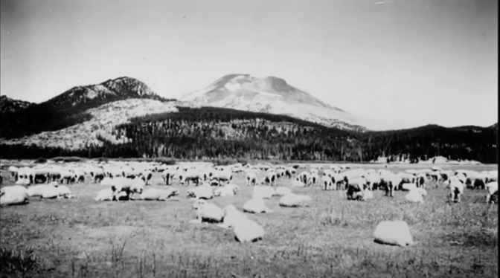
The state of our basin
1920
Pollution from upstream flooding and agricultural practices creates unsafe drinking water. The Deschutes River is no longer used for drinking water.

Slide 28
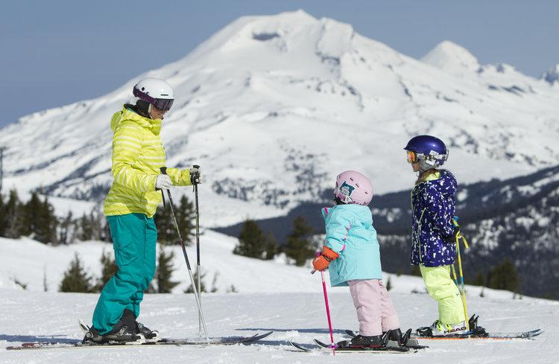
The state of our basin
1990
The last mill of Brooks-Scanlon closes. Recreation becomes a leading business in Central Oregon.

Slide 29
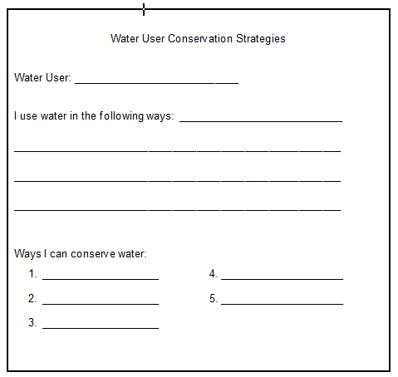

Slide 30
Discussion:
1. Why do people feel strongly about some users and not others?

Slide 31
Discussion:
2. What attitudes or beliefs shape our decisions about what we value?

Slide 32
Discussion:
3. What changes or factors might influence a different decision about who receives water?

Slide 33
Discussion:
4. When decisions about water allocation affect a large group of people, do you believe you can satisfy all users?

Slide 34
Discussion:
5. What options do we have when there isn’t enough water to satisfy all of the users?

Slide 35
Discussion:
6. What can you do as a domestic water user to conserve?

