Slide 1
AHAC Shelter update
June 8, 2022
Housing Department

Slide 2
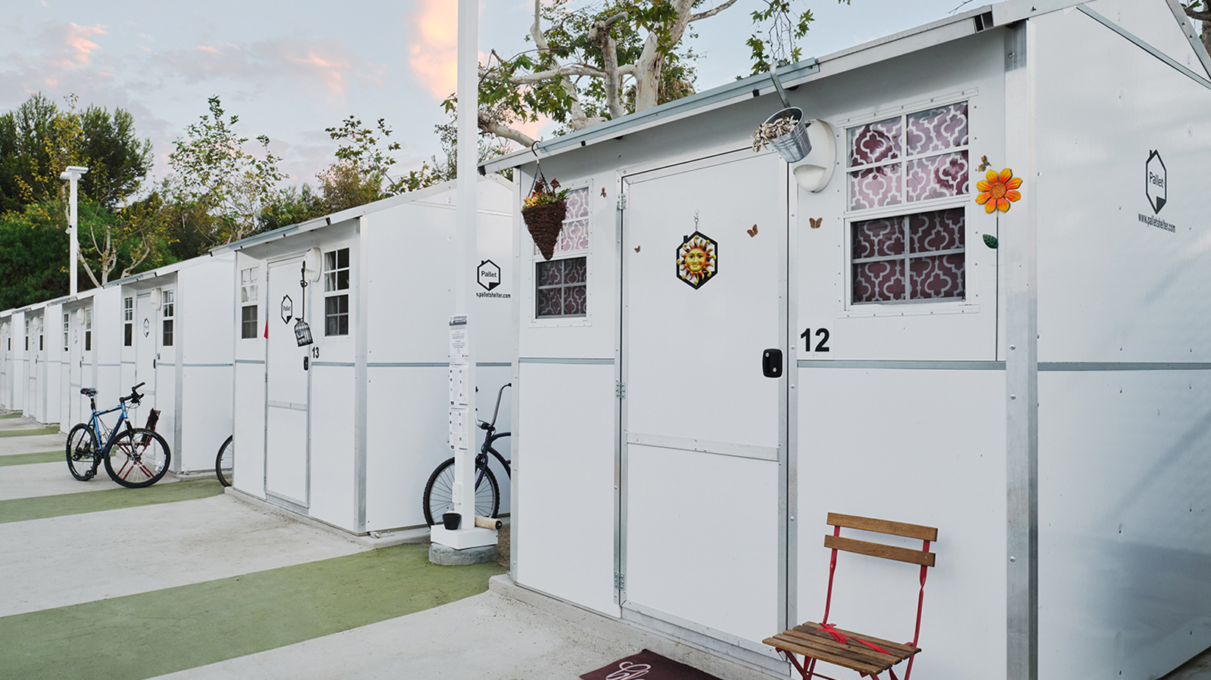
Temporary Outdoor shelter
Request for Qualifications – July 2021
Request for Proposals – November 2021
Intent to Award to Central Oregon Villages – January 28, 2022
Contract for Phase 1 Approved by Council 6/1–not to exceed $45,300
Phase 1 work includes securing the site and extensive community engagement.
Phase 2 (if approved) would include up to 20 pallet shelters. Focus on women and children.
Temporary Outdoor Shelter is a place for people without permanent housing to safely sleep at night in temporary structures.
Housing department

Slide 3
Location
Corner of Bear Creek and 27th
3.87 Acres
Larkspur Neighborhood
Site will be leased directly by Central Oregon Villages
Notes:
At the conclusion of Phase 2, Council may consider Phase 2 20 bed Pallet shelter

Slide 4
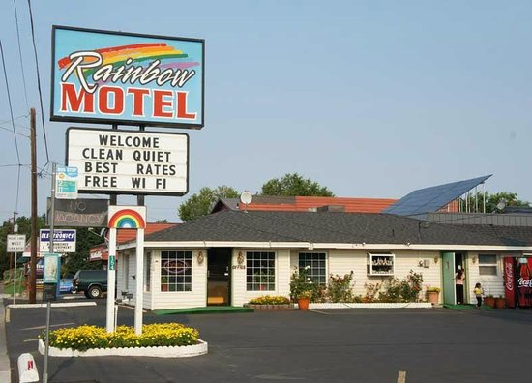
Franklin avenue shelter
Update
  Purchased with General Funds 2022
  Move complete May 13th
  41 clients (7 children)
  24 rooms in use (including 2 ADA in the back building)
  REACH providing case management
  Family Kitchen providing daily meals
  Security on site overnight
  Housing staff meeting with businesses next week
  2 households have transitioned to permanent housing
  Transition back to Division 10/2022
Franklin Avenue Shelter is the temporary Turnkey site while Bend Value Inn is renovated. Renovations have commenced and are on schedule.
Housing department

Slide 5
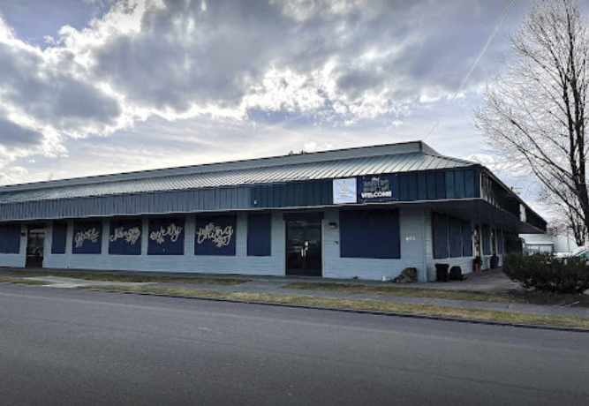
2nd Street shelter/ Navigation Center
Day services to begin mid June
City of Bend Facilities making minor repairs and painting
Shepherd’s House is actively addressing unauthorized camping in area.
5/31/22 (Tuesday): 88 guests
6/1/22 (Wednesday): 92 guests
6/2/22 (Thursday): 93 guests
6/3/22 (Friday): 93 guests
6/4/22 (Saturday): 90 guests
6/5/22 (Sunday): 94 guests
6/6/22 (Monday): 96 guests

Slide 6
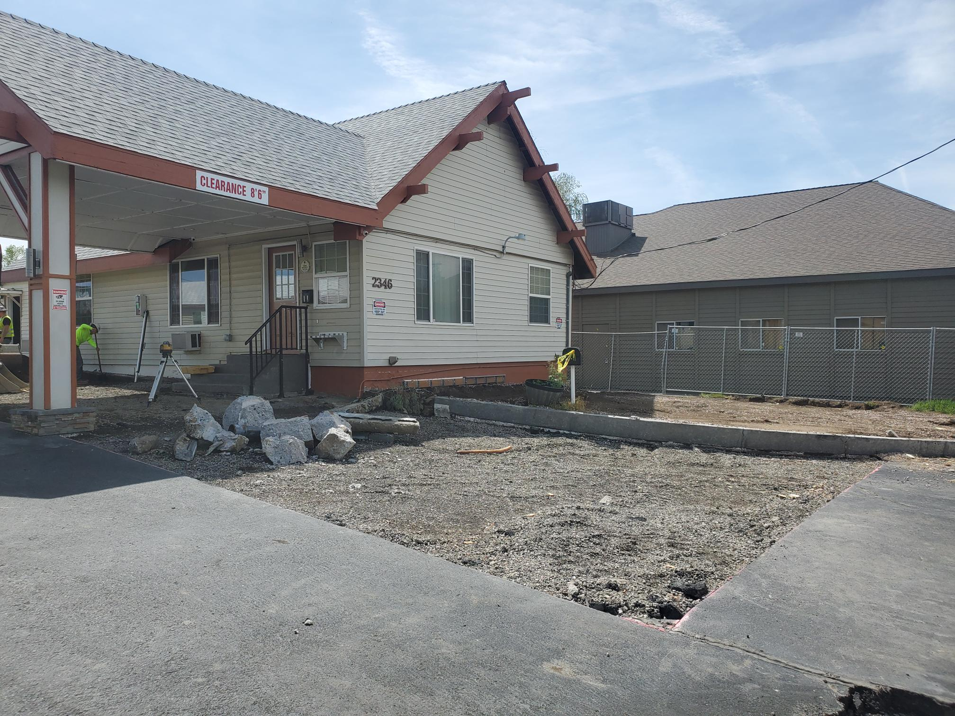
Former Bend value inn on division
Purchased by City with Turnkey funds (2021)
Utilized for overflow shelter during winter 2022
Renovation to be complete in October in 2022
Improvements include:
  Flooring replaced
  ADA compliant rooms
  Asphalt sawcut and removed where elevations will change for accessibility / future ramps
  Updated electric and room interiors

