Slide 1
Housing Equity Plan Update
Mellissa Kamanya, Affordable Housing Coordinator
July 12, 2023

Slide 2
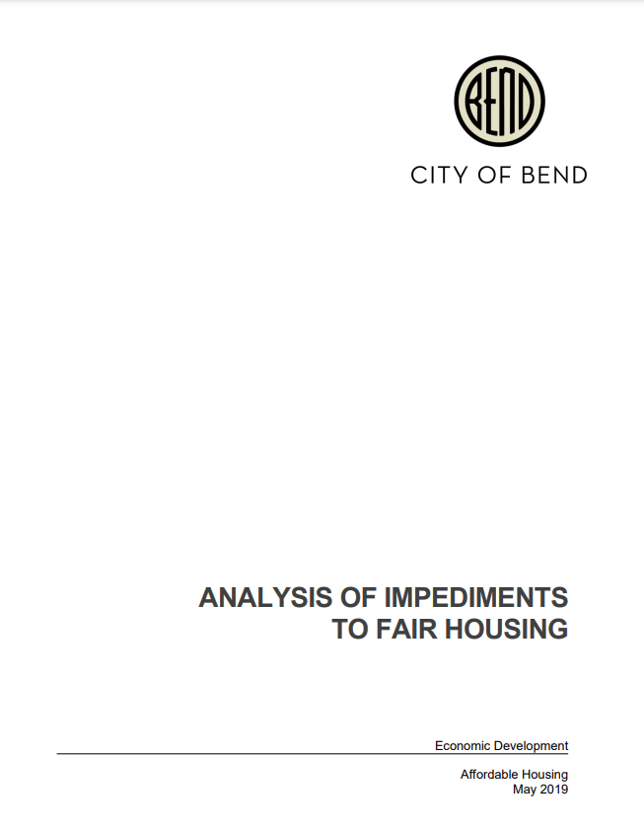
Purpose
As a HUD entitlement, we are required to “Affirmatively Further Fair Housing” (AFFH)
  Latest document = 2019’s Analysis of Impediments to Fair Housing (AI)
Interim Final Rule (IFR) issued in 2021, restoring some regulations to AFFH
In February 2023, HUD released a Notice of Proposed Rule Making
  Overview and timing for “Equity Plan”
  Our options
Begin revision / update of AI

Slide 3
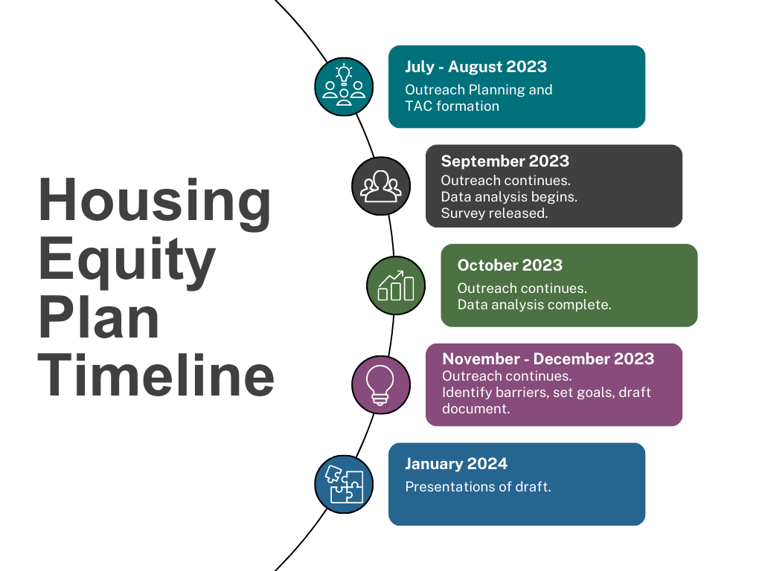

Slide 4
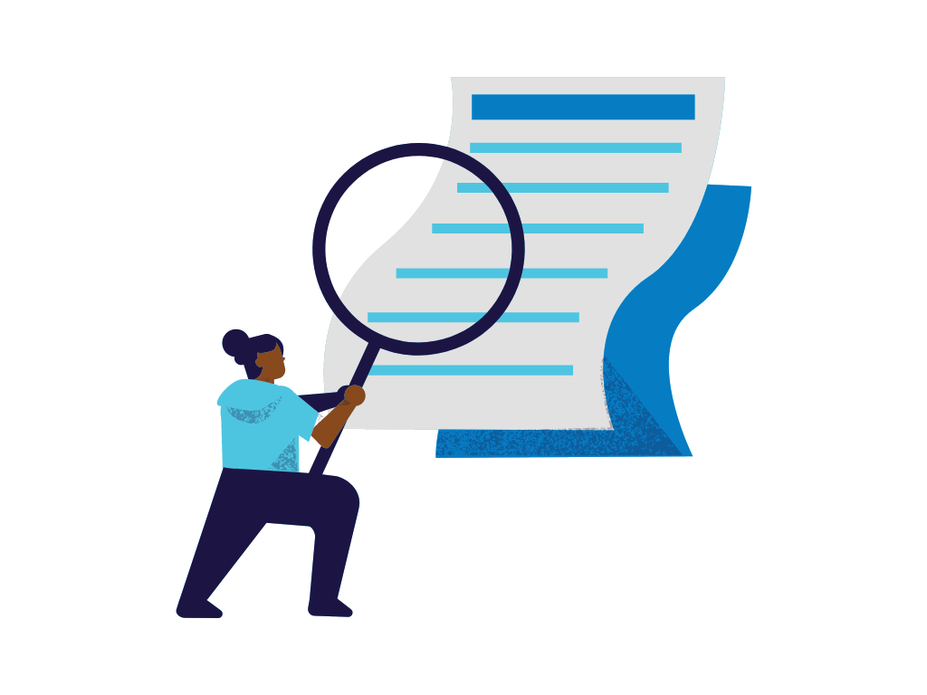
Updates
Upcoming monthly updates to AHAC
Each month a different protected class will be discussed
Community feedback received at recent events and City committees
Review of upcoming applications – observations made

Slide 5

AHAC Opportunities
Participation
  TAC
  Data sharing, review, and analysis
  Outreach
  Goal setting
  Other

Slide 6
To obtain this information in an alternate format such as Braille, large print, electronic formats, etc. please contact Mellissa Kamanya at mkamanya@bendoregon.gov or 541-382-5615. Relay Users Dial 7-1-1.

