Slide 1
Shelter and Houseless Services
Amy Fraley, Senior Program Manager
Brook O’Keefe, Shelter Coordinator
October 28, 2025

Slide 2
Goal
Point in Time Count
City’s evolving role
Shelters
Safe Parking
Housing-focused case management and prevention
Partners
Share the accomplishments and challenges experienced by service providers working with community members experiencing houselessness.

Slide 3
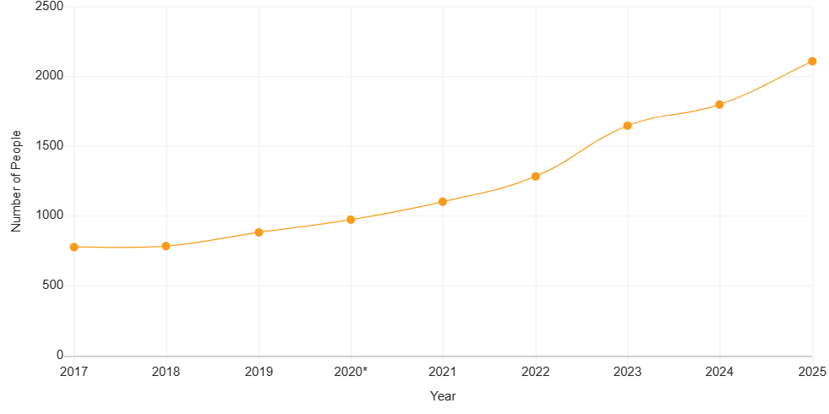
Homelessness in Central Oregon
Notes:
We are better at counting

Slide 4



2025 Point-in-Time Count
Bend
Central Oregon (OR-503)
1001 people experiencing houselessness
2108 people experiencing houselessness
17% increase
5% decrease in 2024
4% increase in 2025
Shelter Beds
571
Beds in Bend
226
Low-barrier beds
Notes:
1 minute

Slide 5
City of Bend Evolving Role- Shelter
City-led Solutions
Applicant and Grantee – Federal, State and Regional
Property owner and technical support
Franklin Shelter
70 beds
Stepping Stone
56 beds
Navigation Center
100 beds
Central Oregon Villages
20 units
25/27 City Council Goals
Maintain 525 beds City-wide (571 current)
Create 15 new Safe Parking spaces (13 thus far)

Slide 6
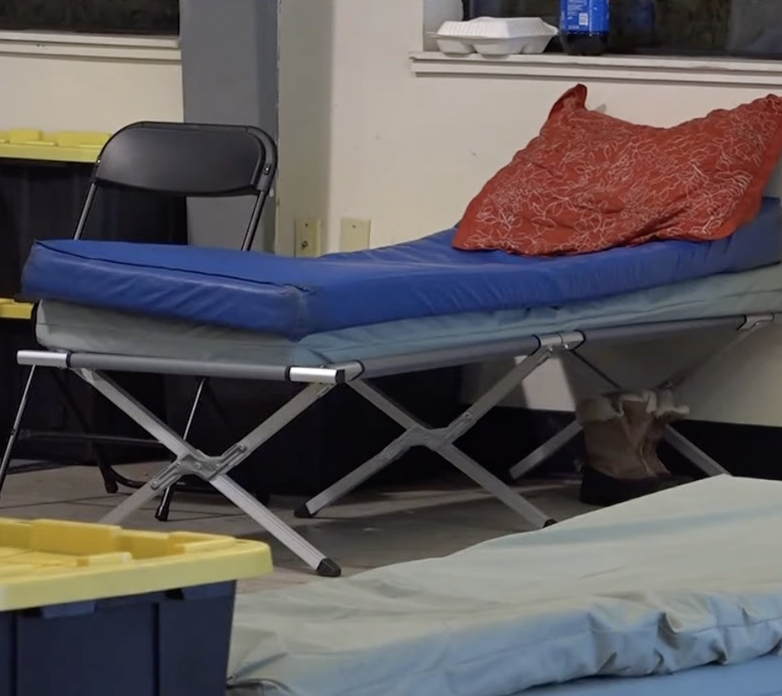
City-supported shelter totals 2025*
Nights of shelter: 66,980
Average Utilization Rate: 92%
Transitions: 205
Includes Safe Parking

Slide 7
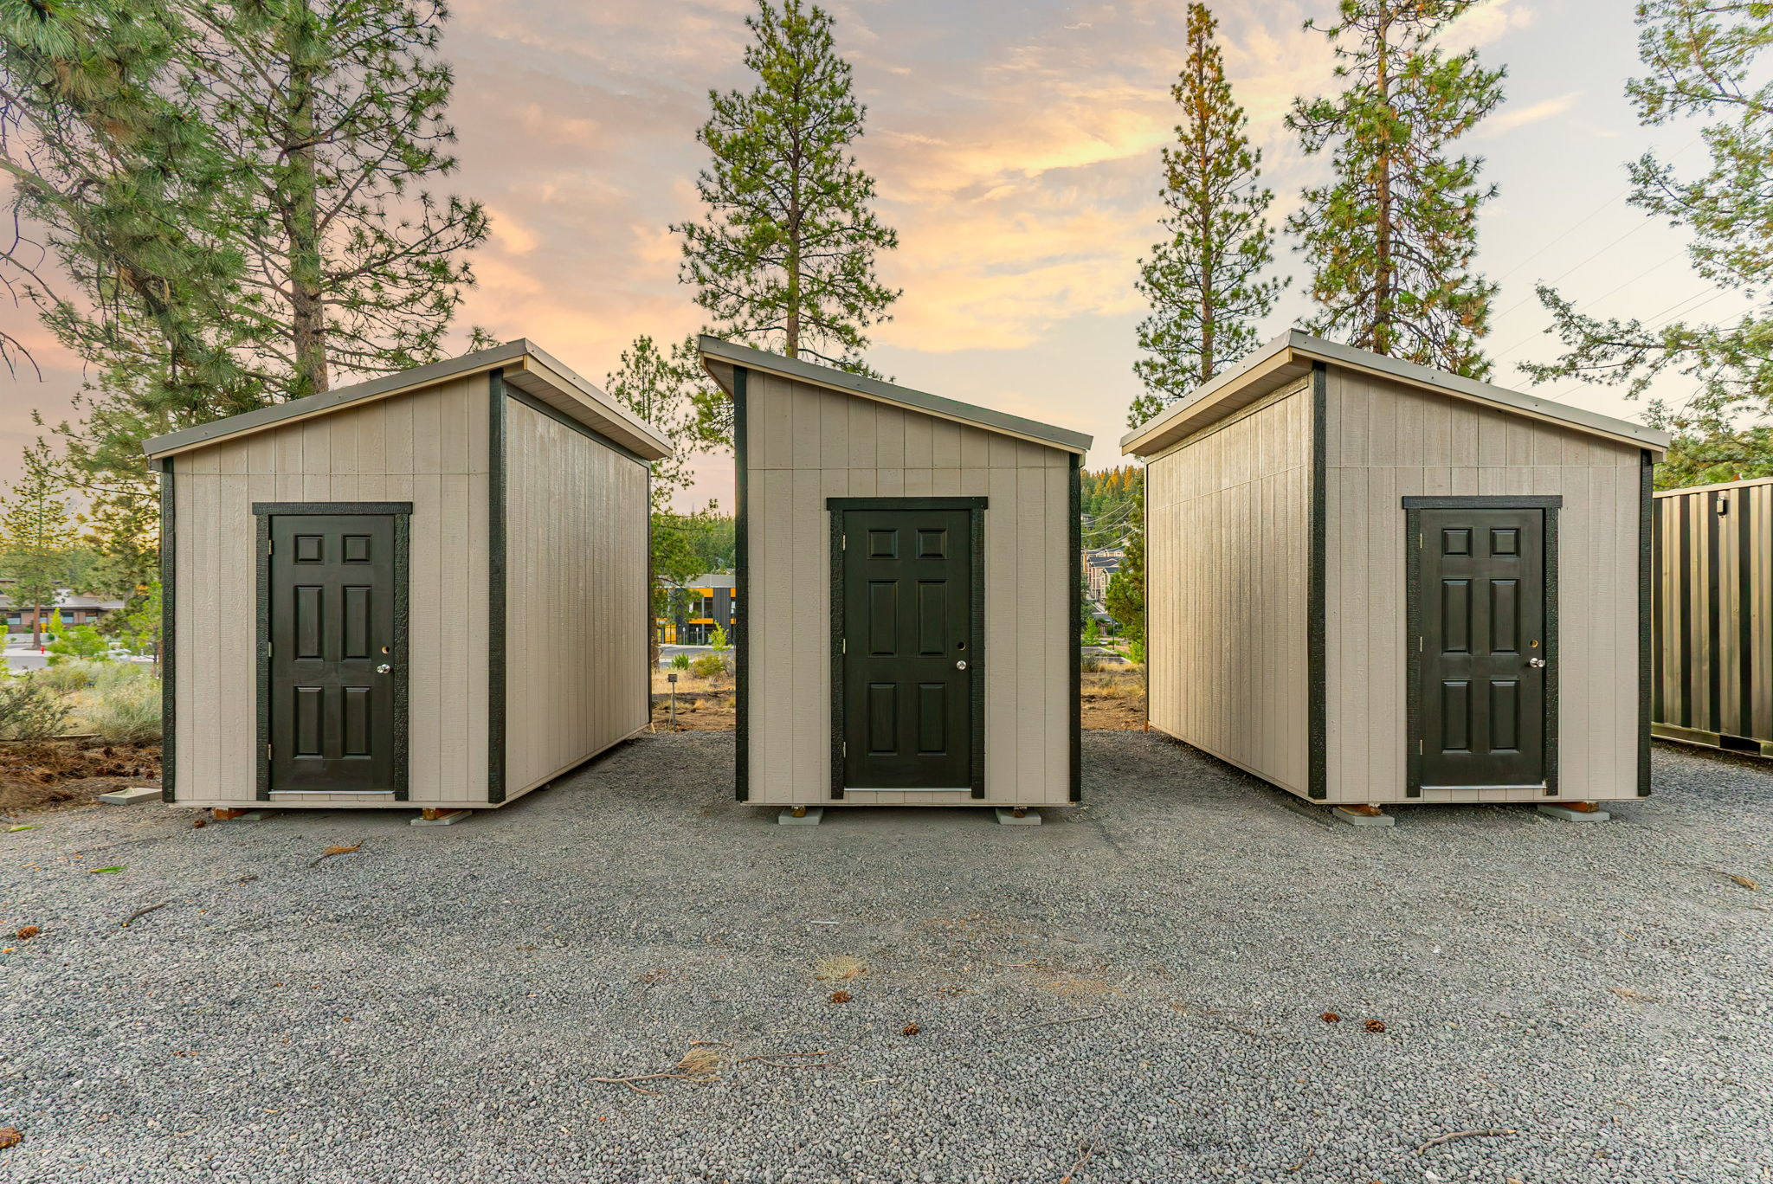
Safe Parking
Council adopted the Safe Parking Programs into the Municipal Code in April 2021
  Can be hosted on land owned or leased by non-profits, public entities, businesses, and religious organizations
  Operated by non-profit service providers
Operational Sites
  6 religious organizations
  1 publicly owned property
  2 properties leased by non-profit
Upcoming expansion
  1 publicly owned property
  5 additional pods, location TBD
Photo Credit: Kaleb Riley of rileyvisuals.org

Slide 8
Houseless Services Grant Program
Grantee | Total Award | TSSA | Safe Parking | Outreach | Housing Stabilization
NeighborImpact - Data Management | $ 50,000.00 | $ 50,000.00
Home More Network | $ 25,000.00 | $ 25,000.00
Companion Animal Medical Project | $ 100,000.00 | $ 100,000.00
Shepherd's House Ministries | $ 294,507.00 | $ 223,132.00 |  | $ 71,375.00
Mosaic Community Health | $ 271,812.00 | $ 135,906.00 |  | $ 135,906.00
Central Oregon Villages | $ 327,463.00 | $ 183,863.00 | $ 143,600.00
REACH | $ 543,941.00 | $ 413,131.00 | $ 130,810.00
Mountain View Community Development | $ 607,950.00 |  | $ 607,950.00
Saving Grace | $ 144,000.00 |  |  |  | $ 144,000.00
Thrive Central Oregon | $ 433,335.00 |  |  |  | $ 433,335.00
Central Oregon FUSE | $ 249,667.00 |  |  |  | $ 249,667.00
Total | $ 3,047,675.00 | $ 1,131,032.00 | $ 882,360.00 | $ 207,281.00 | $ 827,002.00

Slide 9
Prevention
Thrive - Sarah Manke, Executive Director
Saving Grace – Taryn Ramos, Program Services Director
FUSE – Colleen Sinsky, Executive Director

Slide 10

Vision
A Central Oregon where individuals living with housing and income insecurity resolve those needs through access to resources when and where they need them.
Connecting Individual Needs to Community Resources in Central Oregon

Slide 11
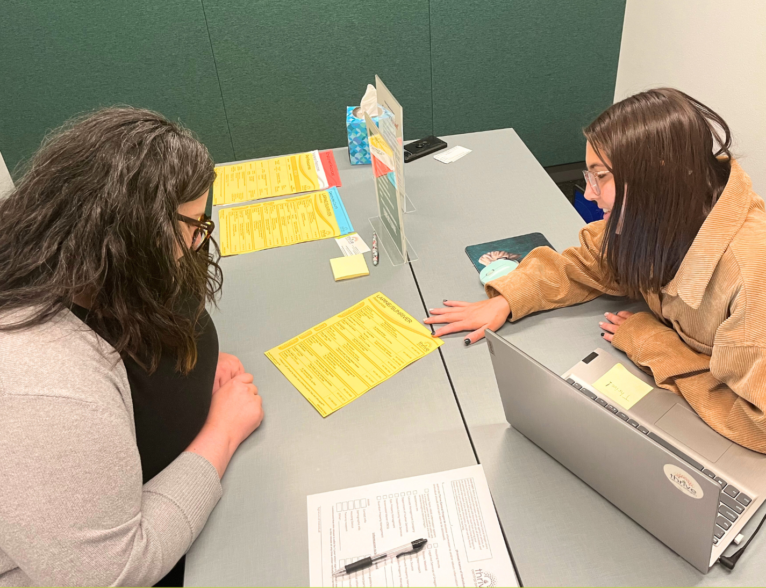


ARPA funding at work in our community!
1 FTE Community Outreach Advocate
    Connecting 60% AMI households with:
      Emergency rental assistance
      Security deposit assistance
      Housing navigation & connection to basic needs resources
    Support to individuals through drop-in sites, phone and office appointments in Bend
      5 sites across Bend each week
      Monday- Friday offerings

Slide 12


ARPA Assistance & Outreach
January - September 2025
  Assistance for community members at or below the 60% AMI
    116 unique households = 277 Bend residents
    Total $112,214.41 in housing payment assistance
      87 rent payments
      29 security deposit payments
  Case management
    4,300 appointments in Bend
    1,397 unique clients

Slide 13
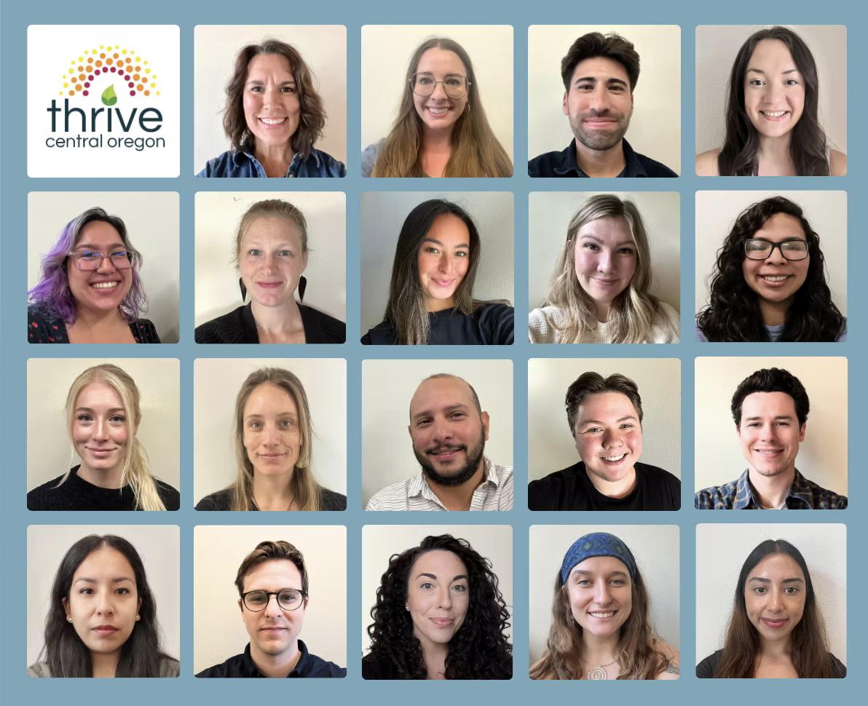


Questions?
Thrive Central Oregon values diversity and is an equal opportunity provider,
employer and partner.
Everyone is welcome here!
Learn more on our website: www.thrivecentraloregon.org
Facebook & Instagram:
@thrivecentraloregon

Slide 14



IMPACT OF CITY FUNDS ON THE SURVIVOR HOUSING PROGRAM
Taryn Amens Ramos
Program Service Director

Slide 15

PROGRAM OVERVIEW
  The city’s funding supports efforts to help survivors of domestic violence access and maintain safe, long-term, and sustainable housing.
  Through partnerships with housing providers, the program removes barriers to stability and ensures survivors can rebuild their lives in safety.

Slide 16




CITY INVESTMENT
  Total City Funds Allocated: $144,000
  Funds used for:
    Rental arrears
    Move-in costs
    Rent
    Mortgage
    Program Administration

Slide 17
IMPACT IN OUR COMMUNITY:
  Households Served: 22 (22 adults, 31 children)
  Payments made: 29
  Total spent on direct service payments: $34,658
  Average spent per household: $1,575
These funds have made an immediate and measurable difference for survivors seeking safety and stability.

Slide 18
CLIENT STORIES:
  Helped a survivor fleeing abuse pay first month’s rent, allowing her and her infant to safely move into new housing and begin rebuilding their lives.
  Paid rental arrears for a survivor who received a 10-day eviction notice after missing work while fleeing abuse — preventing eviction and keeping her and her children safely housed.
  Covered current and past-due rent for a survivor recently separated from her abuser, providing stability and time to find employment as a new sole provider..
  Supported two clients continuing to experience post-separation abuse (court hearings, home break-ins) — ensuring they could maintain stable housing during ongoing safety concerns.

Slide 19



Colleen Sinsky, MSW Executive Director
City of Bend, AHAC. ARPA Presentation
October 28, 2025

Slide 20




2019
October 2025
Our Mission
Fuse Housing Collaborative mobilizes resources to provide housing and supportive services for people experiencing long-term homelessness to improve community health, safety, and stability.
Partnering to end chronic homelessness with Permanent Supportive Housing.

Slide 21


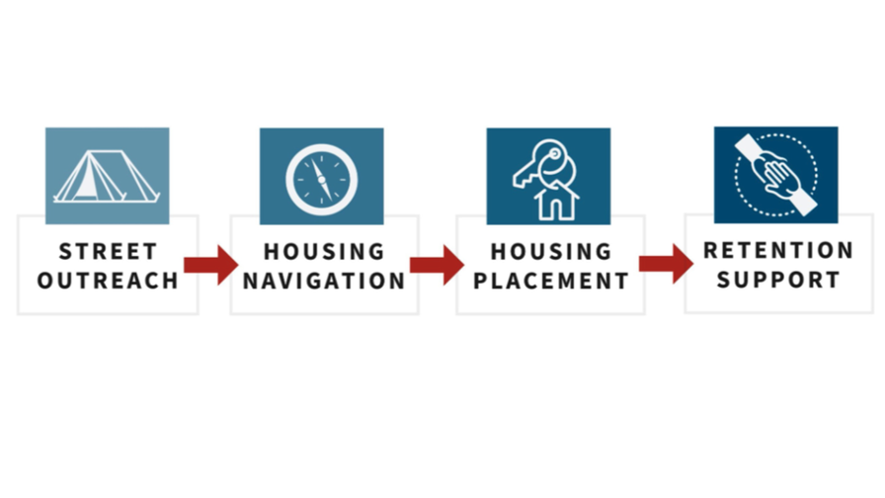
Our Programs
  Services Convener; Cleveland Commons (33-unit Permanent Supportive Housing residence)
  Operator; Scattered-Site Permanent Supportive Housing (8 units, HUD CoC-funded)
  Services Convener; “PSH Lite” enhanced resident services for 55+ at three affordable housing communities in Bend/RDM.
  PSH Advancement; mobilizing resources, TA, community education, research, to enhance Central Oregon’s capacity for increasing PSH.
    Partner; Mountain View Community Development PSH Village (pre-development)
    Developed “Neighbor Notes App” for housing & outreach workers to track & report on client engagements.
    Regional capacity building; create & provide training for housing and homeless service providers.

Slide 22



ARPA Award Impact 2025-2026
Total Award: $249,667
  Hired our second FTE (65%)
    Housing Services Manager, John Baldwin (Formerly with EPIC PM & Housing Works)
    Immense capacity-add across all programs
  .5 FTE Community Support Specialist at Legacy Landing Apts (24%)
    On-site proactive resident supports with Cornerstone Community Housing
  Technology Supports (.08%)
    Staff laptop and portion of “Neighbor Notes” app development cost.
  Admin Costs (10%)
    Financial oversight and reporting, insurance, etc.
JOHN BALDWIN
FUSE HOUSING SERVICES MANAGER

Slide 23
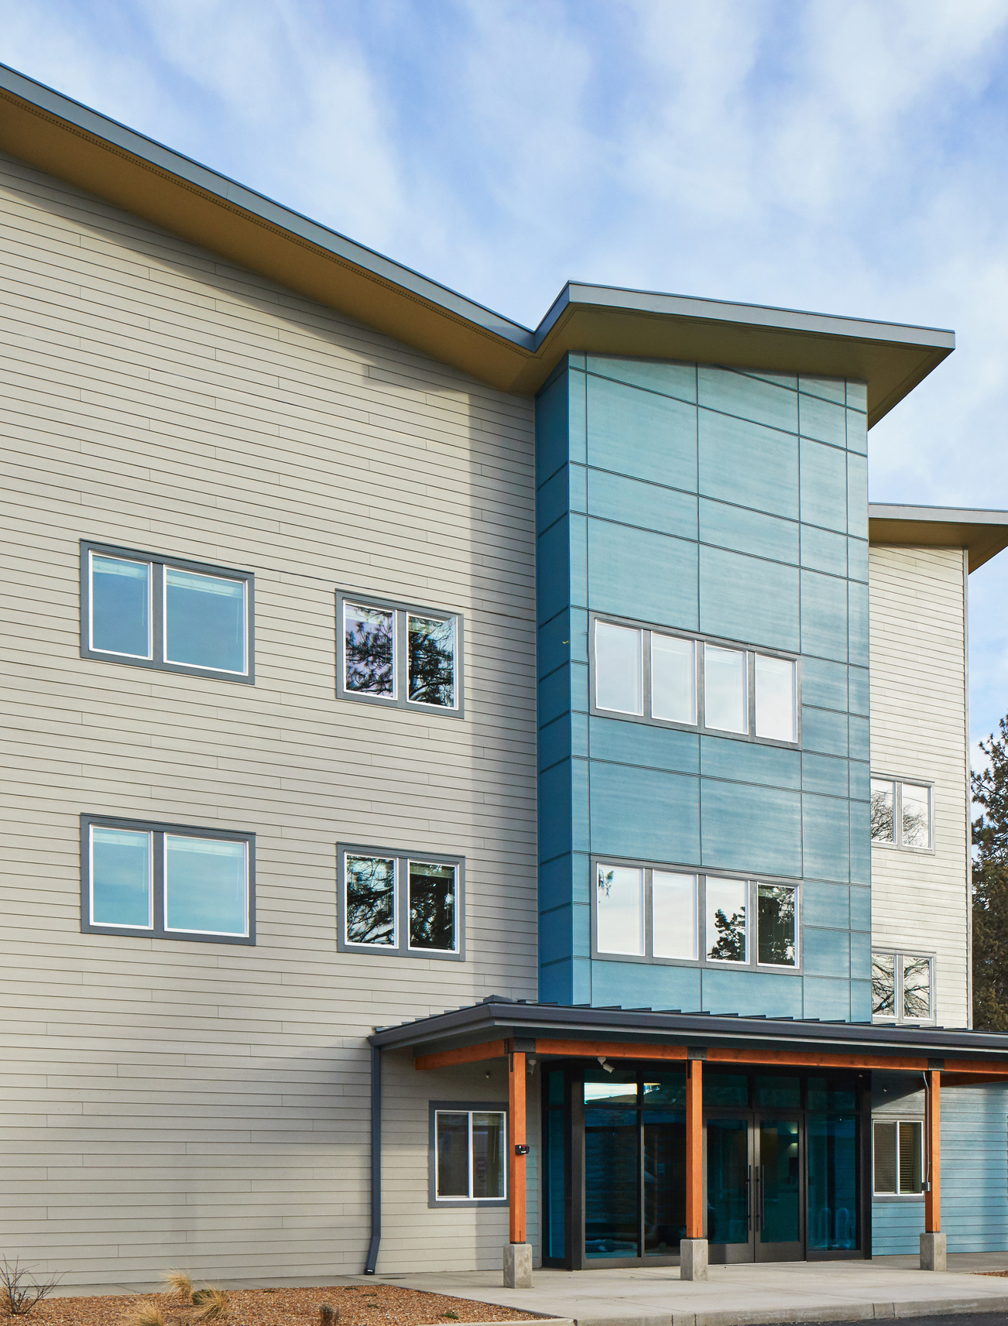



Convening Support Services at Bend’s first Permanent Supportive Housing residence.
Cleveland Commons
  Facilitating weekly partner meetings.
  Developing building Policies & Procedures Manual.
  Furnishing resident units, common areas, and community mural.
  Providing specialized staff training.
  Supporting alignment with PSH best practices & funder compliance.
  Dedicated, flexible, trusted project partner since Day 1.
  33 HOUSEHOLDS EXITED CHRONIC HOMELESSNESS

Slide 24
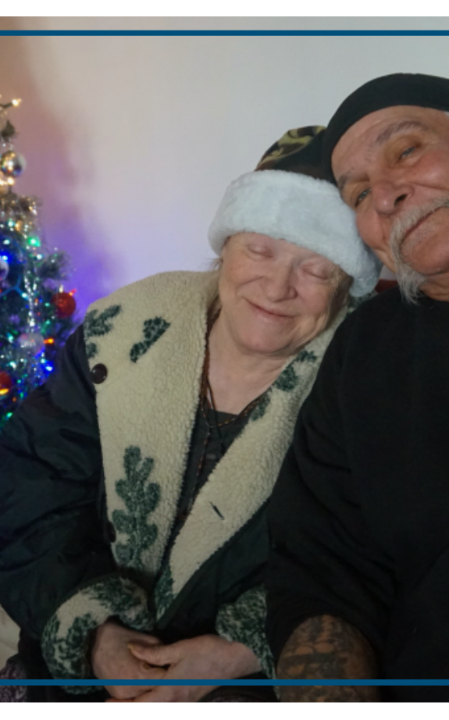


*Federal funding uncertainty means empty units, recaptured dollars this year, highlights need for local investment.
Leveraging HUD funding for tenant-based rental assistance & mobile case management.
Scattered Site PSH
  Ongoing rental assistance and outreach and housing retention supports (via REACH).
  HUD compliance, landlord liaison, eviction prevention, Social Determinants of Health Assessments, case conferencing.
  HMIS, Coordinated Entry System, CoC competitive NOFO annually.
  8 HOUSEHOLDS EXITED CHRONIC HOMELESSNESS
*Federal funding uncertainty means empty units, recaptured dollars this year, highlights need for local investment.

Slide 25
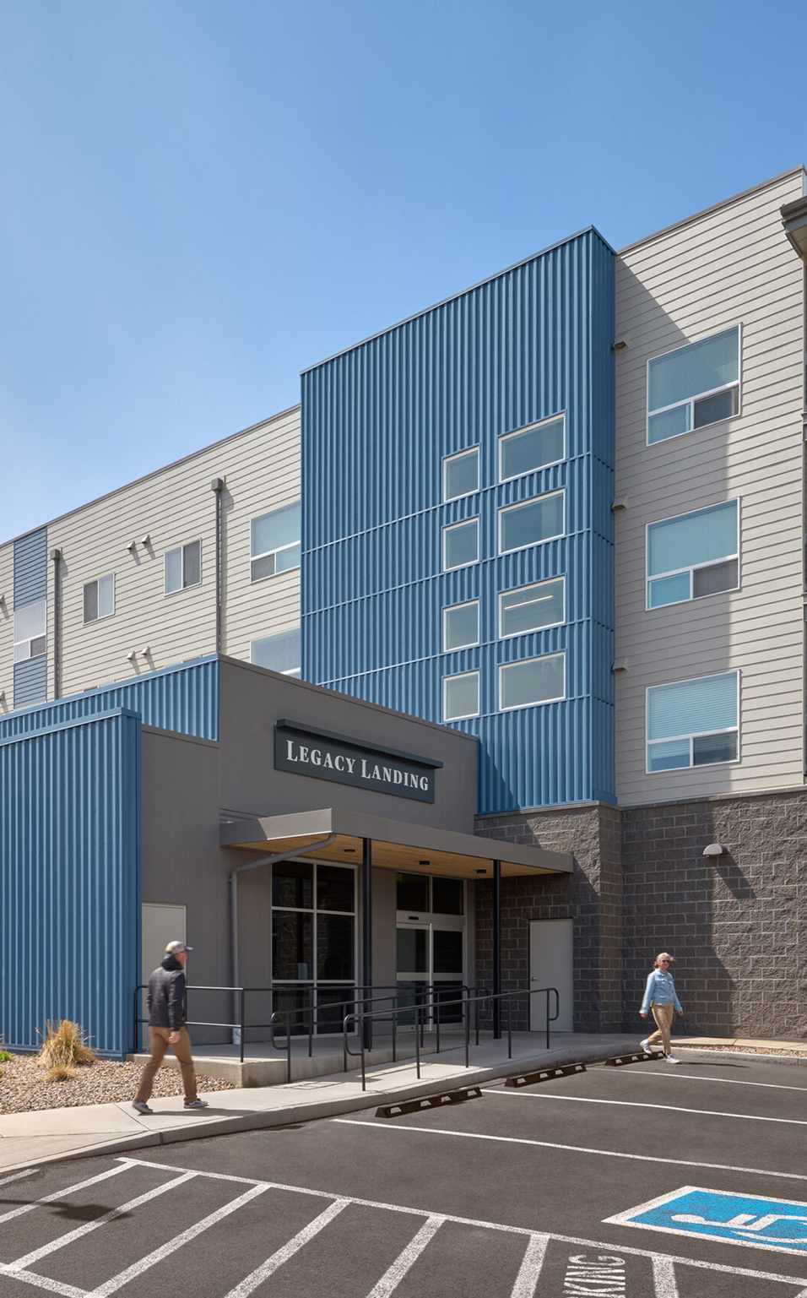



*Federal funding uncertainty means empty units, recaptured dollars this year, highlights need for local investment.
Pilot program to bring proactive community support to aging residents in low-income housing.
“PSH Lite”
  SUPPORTS FOR 47 SENIOR RESIDENTS OF AFFORDABLE HOUSING
  .5 FTE on-site to engage residents individually and with community events (yoga, dinners, movie night, etc.)
  Individual resource navigation and eviction prevention (utility assistance, transportation, healthcare connections, etc.)
  Created new app “Neighbor Notes” for advocates to easily track 1:1 engagements & event attendance.
  Program evaluation and impact assessment with OHSU.

Slide 26
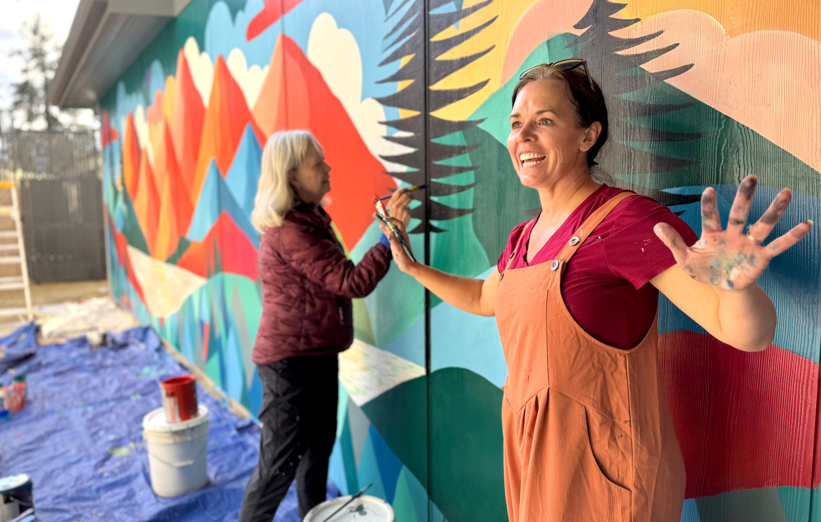
PSH Advancement
  Service Provider Training and Capacity Building: approx 720 in-person training hours across 8 partner organizations in 2025.
    “Mental Health and Homeless Services in Deschutes County”
    Housing Oregon Industry Support Conference (Portland)
    Corporation for Supportive Housing, annual PSH Summit (Chicago, IL)
    CPR & AED training for Cleveland Commons staff
    Trauma Informed Care and Mental Health First Aid for Cleveland Commons staff
  Participating in OHCS’s PSH Institute PSH Project Team with Mountain View Community Development (96 hrs).
  Promoting PSH expansion through community education, program evaluation, PSH cost-savings impact assessment, healthcare and housing connections.

Slide 27
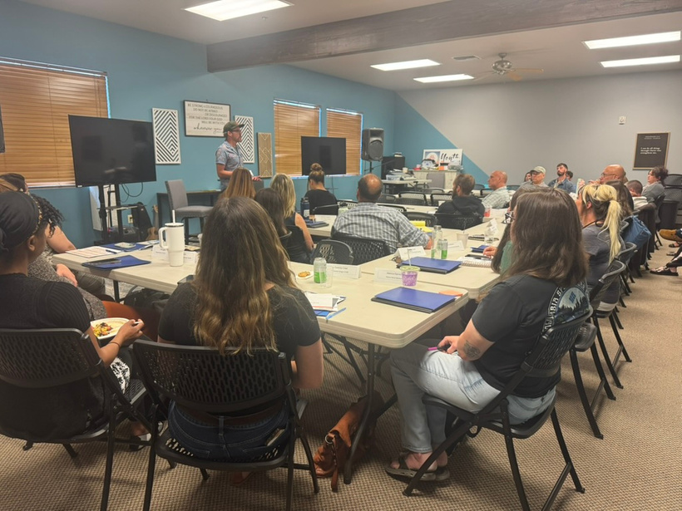
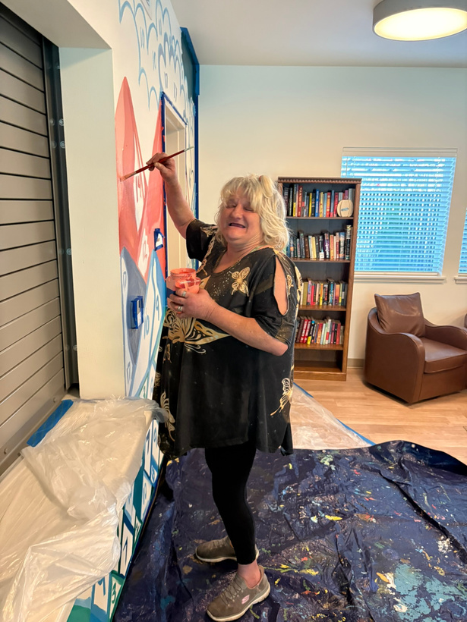
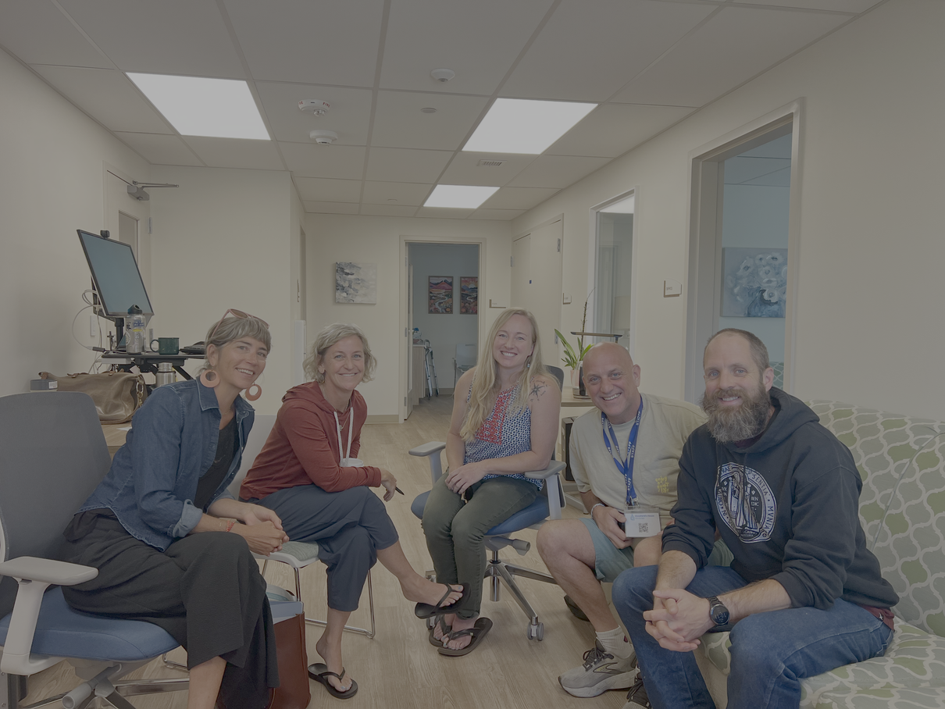
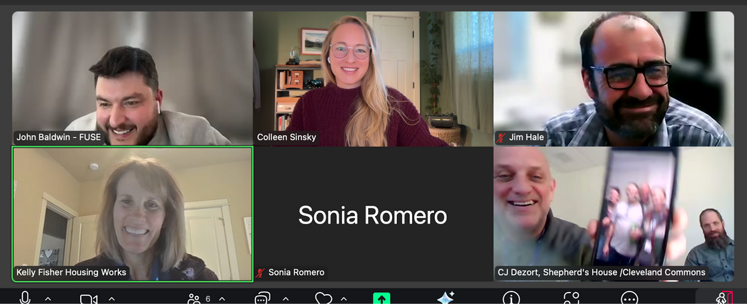
Thank you AHAC & Partner Organizations!
Colleen Sinsky
csinsky@centraloregonfuse.org

Slide 28


Slide 29
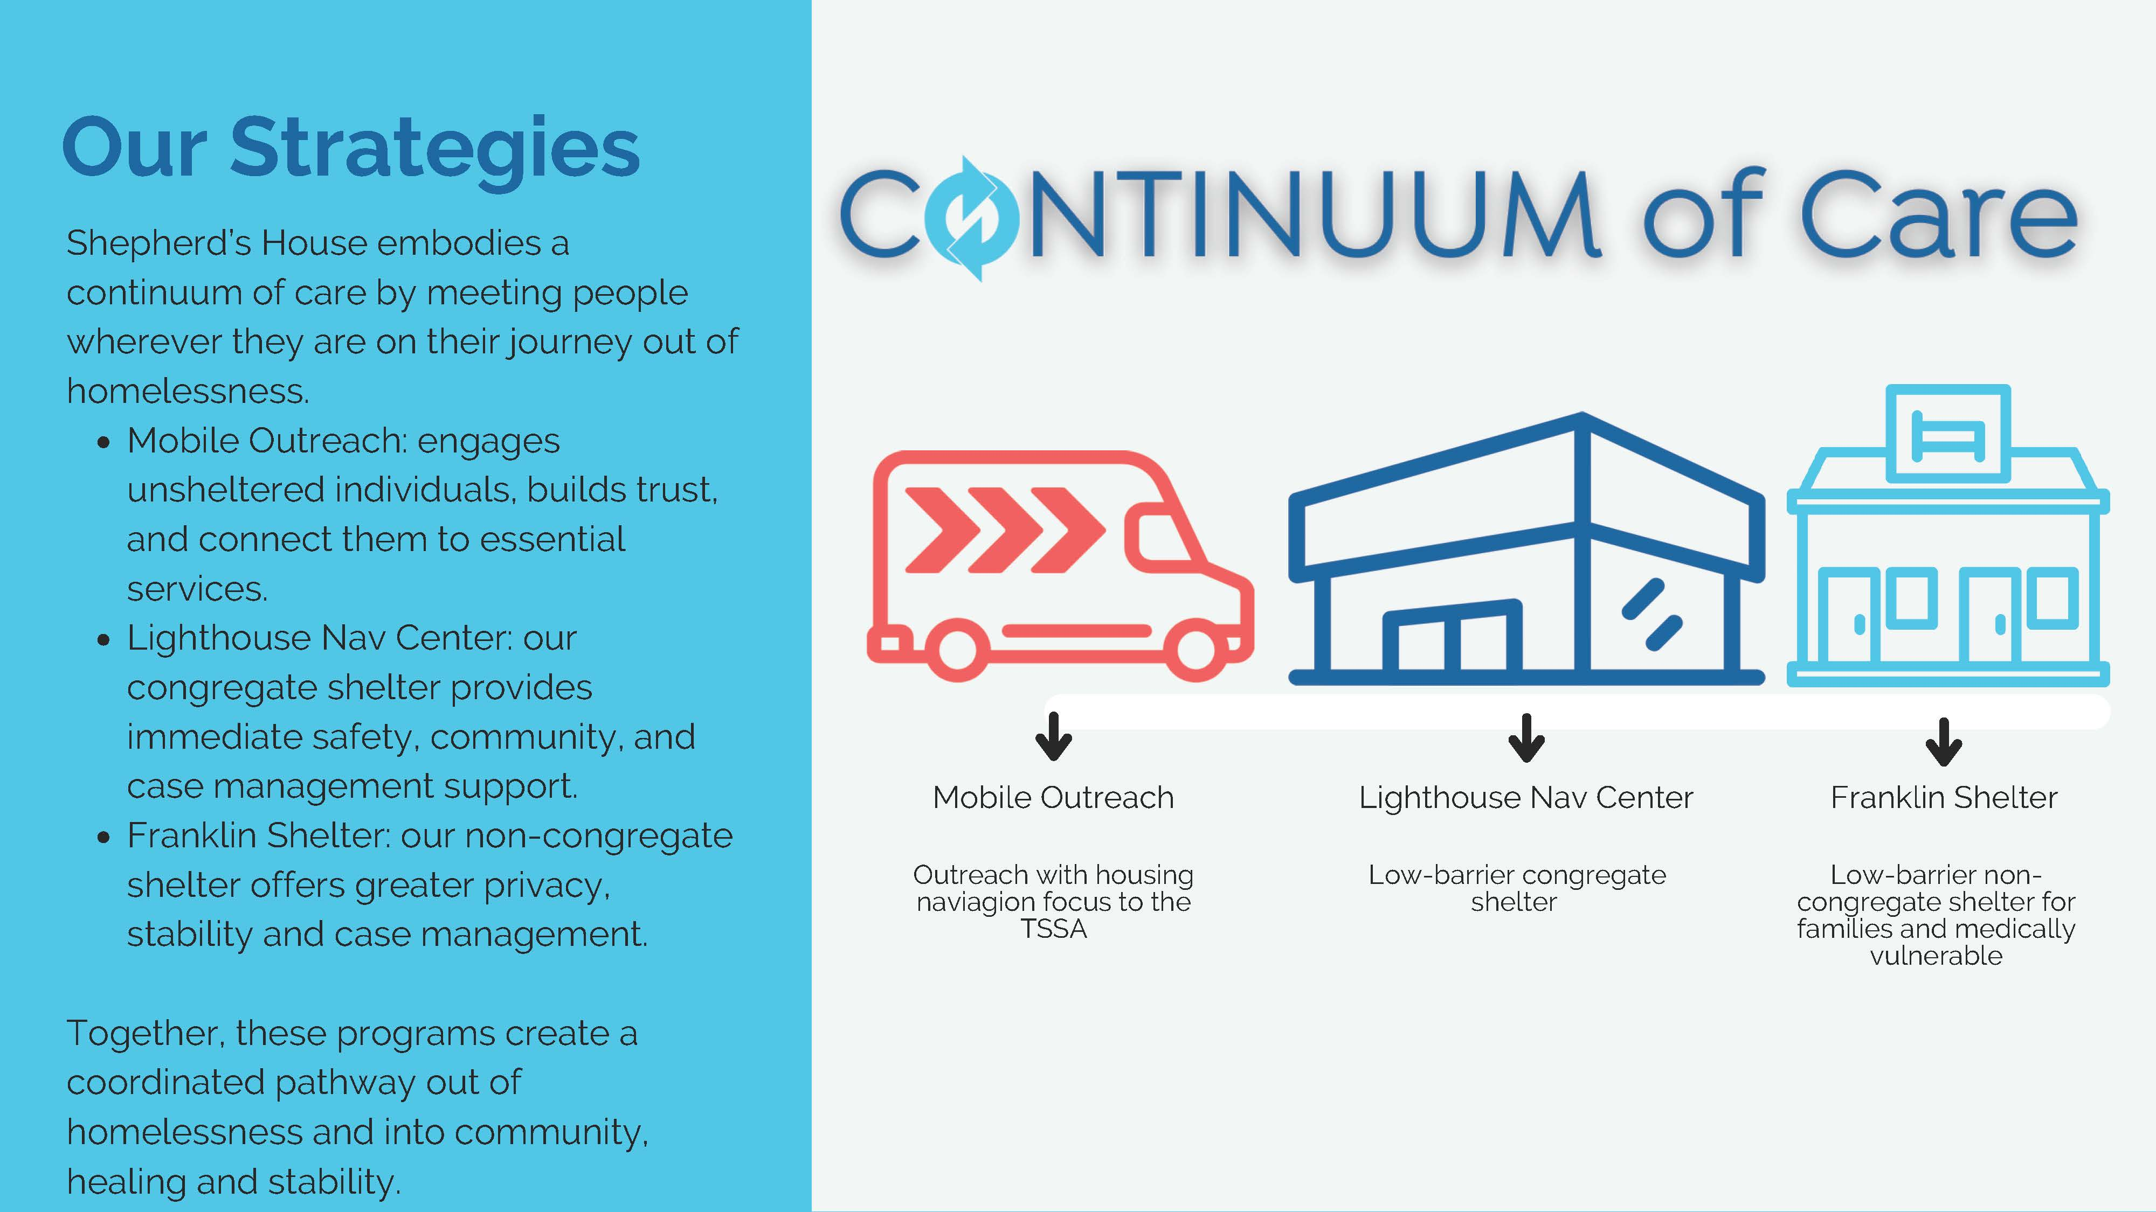

Slide 30
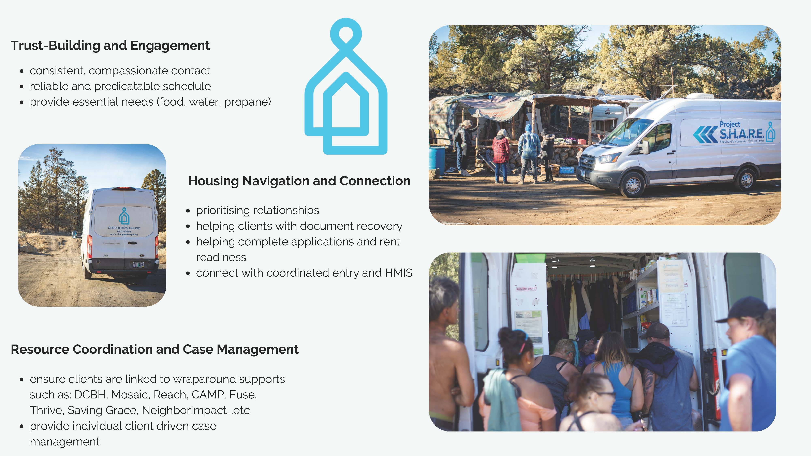

Slide 31


Slide 32
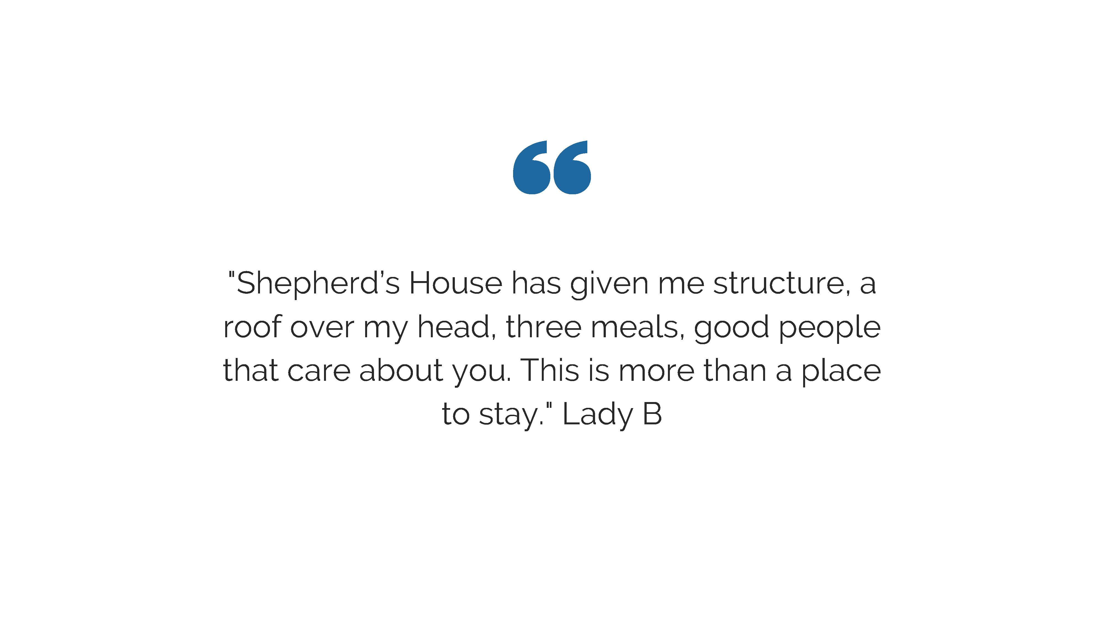

Slide 33


Slide 34


Slide 35
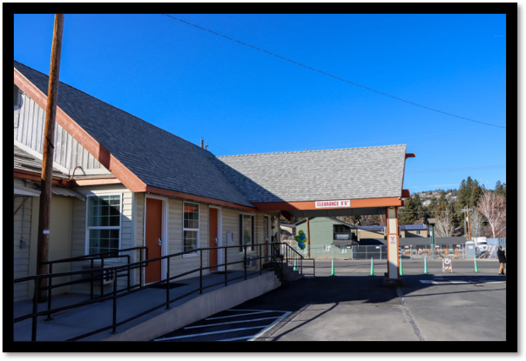
Stepping Stone, NeighborImpact
Todd Rundall, Unhoused Services Manager
Calendar 2025:
Unique Individuals: 111
Transitions:
  Permanent Housing: 35
  Temporary Housing: 3

Slide 36

Emergency Shelter - Safe Parking – TSSA
Scott Jones, Executive Director

Slide 37
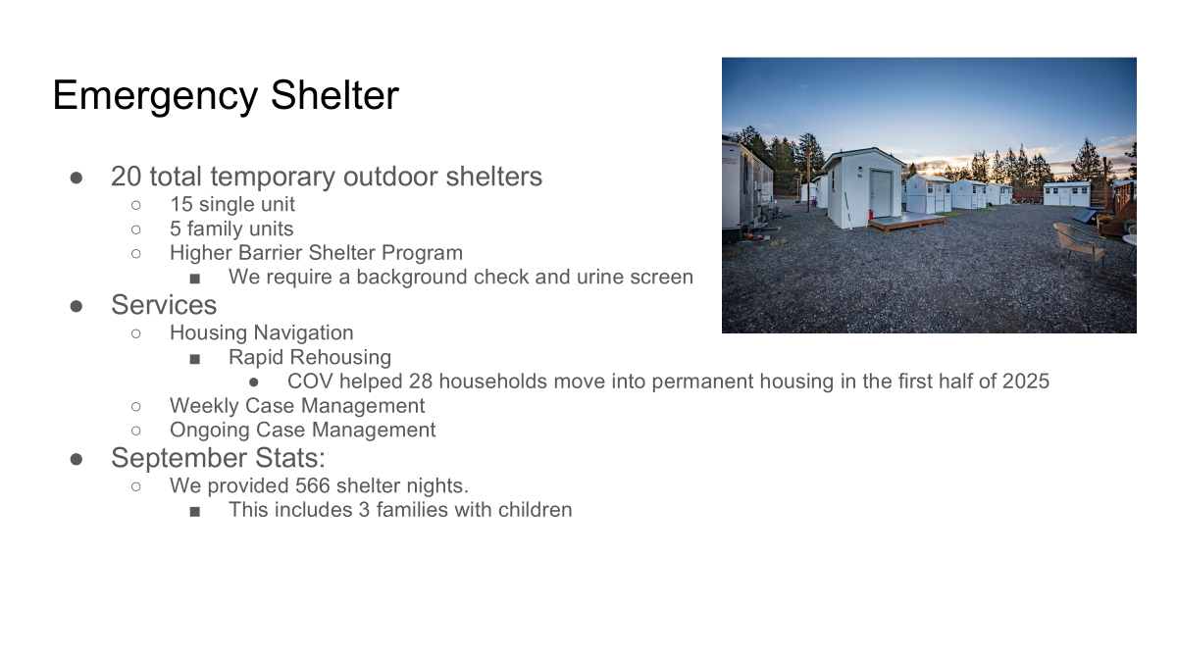

Slide 38
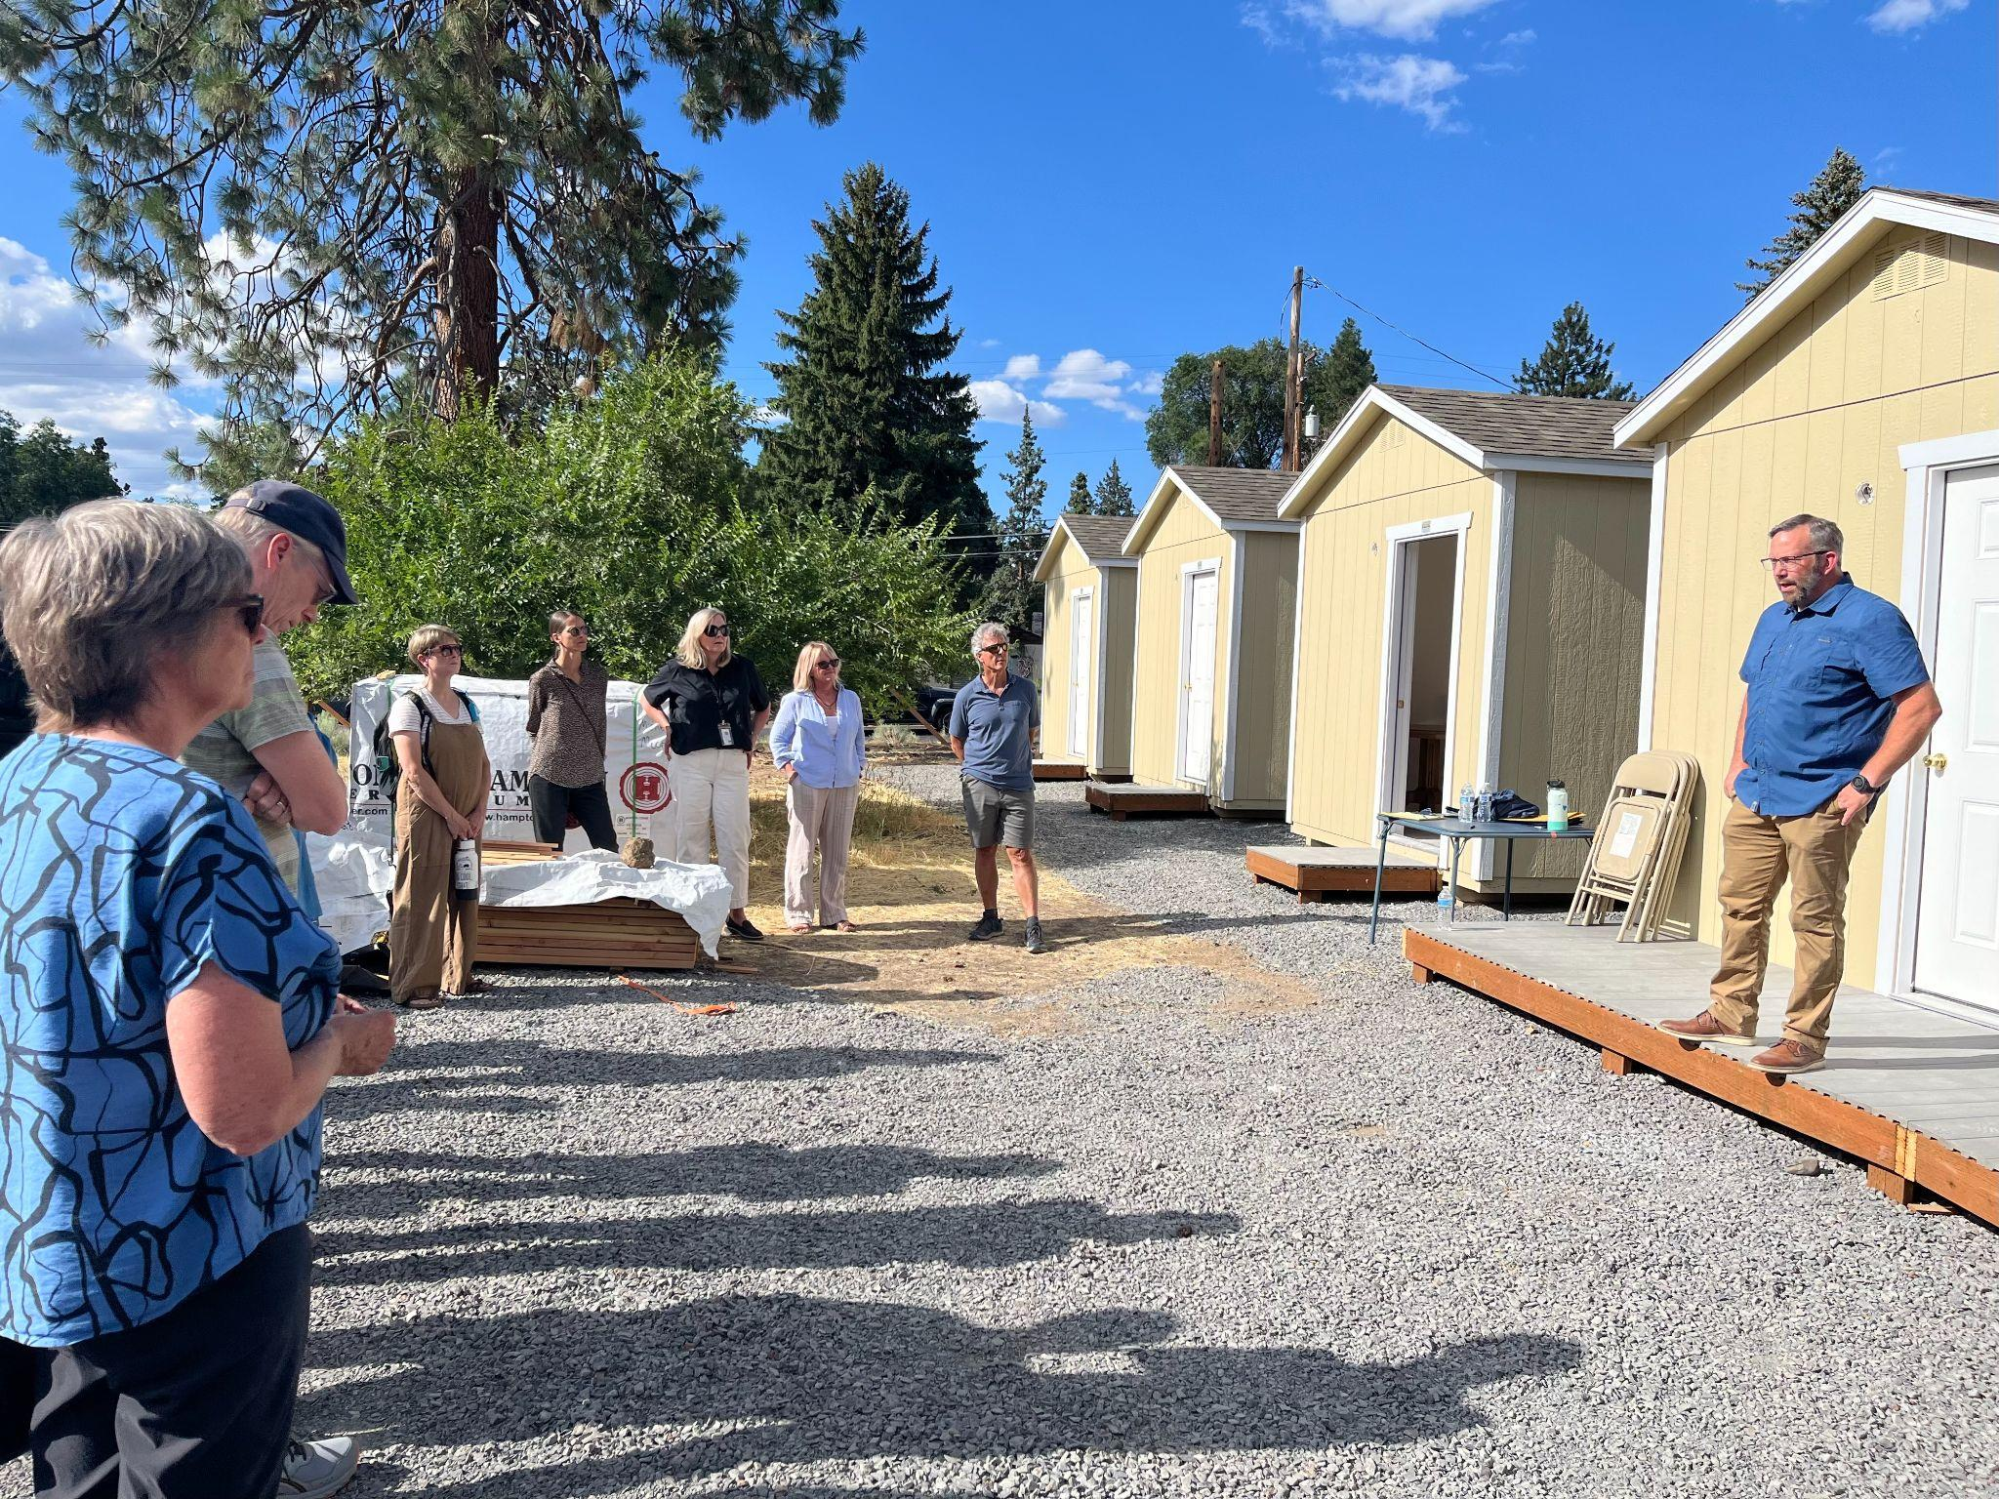
Safe Parking
COV operates 3 safe parking sites within the City of Bend
  Bond street was our first location with 2 single temporary outdoor shelters
  Dean Swift opened in April 2025 with 6 single temporary outdoor shelters
  5th & Franklin opened in August with 4 Family temporary outdoor shelters
Services
    Housing Navigation
      Rapid Rehousing
    Weekly Case Management
    Ongoing Case Management
September Stats
  280 Shelter nights
  14 individuals and 10 households were served

Slide 39
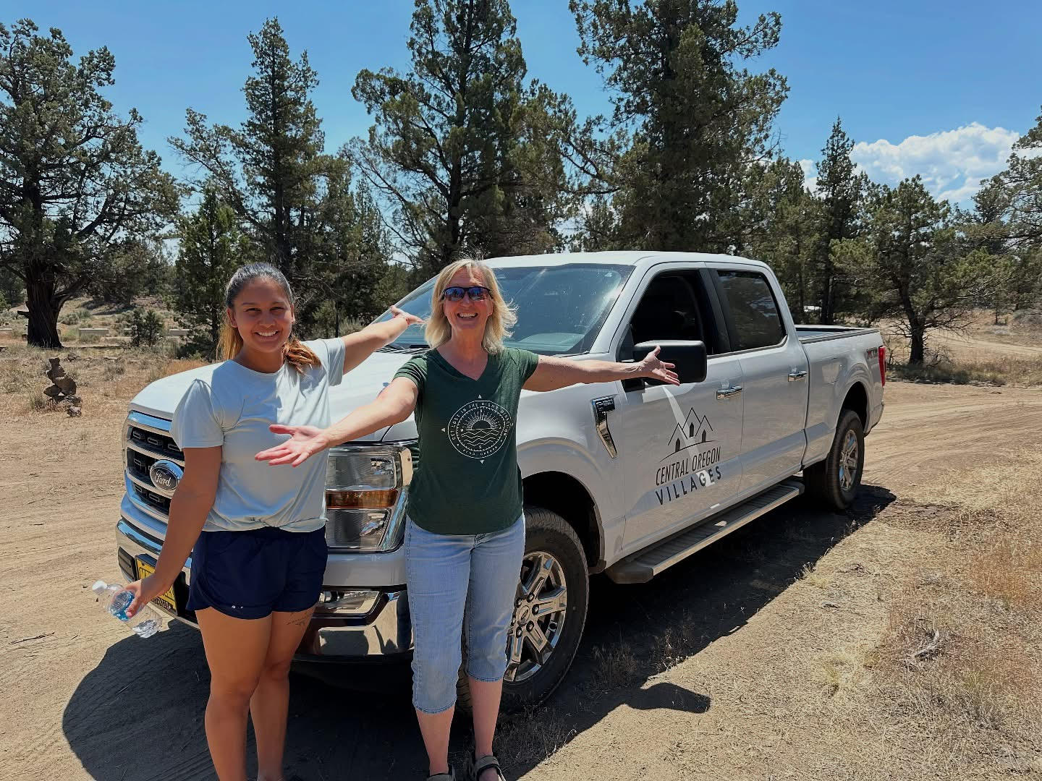
Temporary Safe Stay Area
233 Service Transactions since 1/1/2025
75 Adults and 12 children have been served
Service Provided
  Housing Search Assistance
  Sheltering and Permanent Placement
  Clothing
  Food

Slide 40
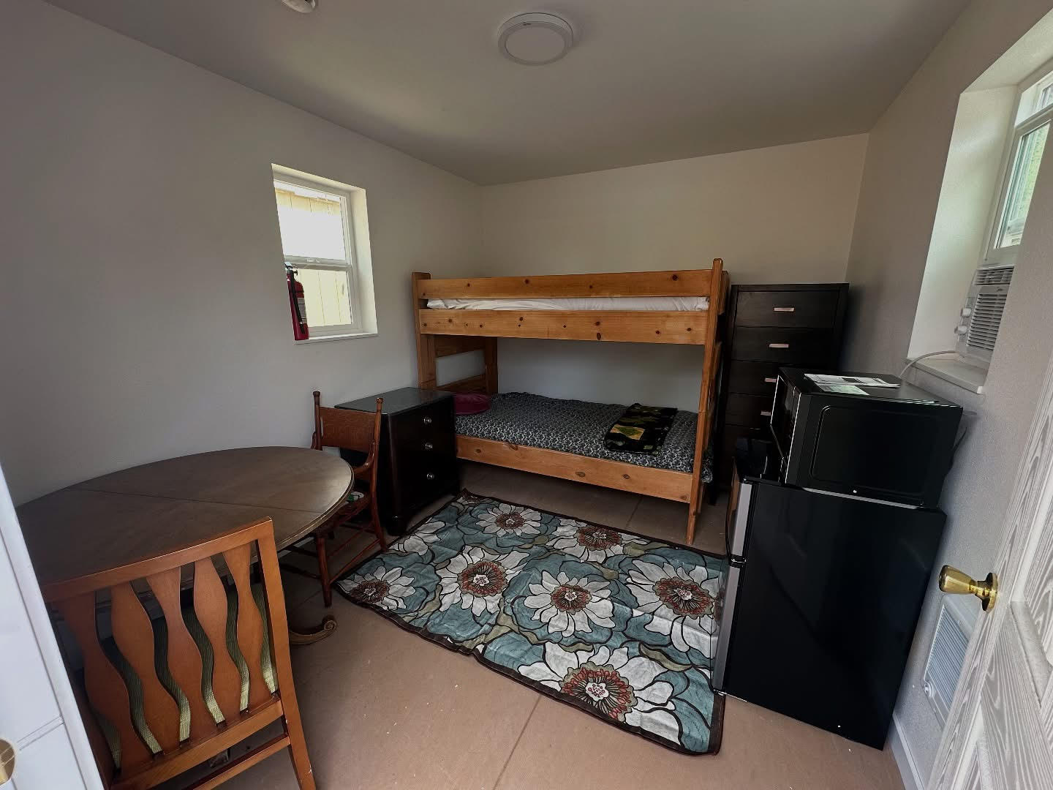
Thank you!
Contact Information:
centraloregonvillages.org
Scott Jones, Executive Director
541-350-8459
scott@centraloregonvillages.org
We especially thank the City of Bend for being our principal funder.

Slide 41

Stacey Witte, Executive Director
reachoutoregon@gmail.com

Slide 42
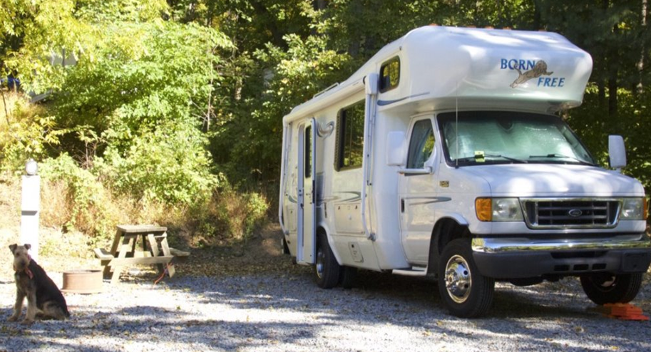

REACH Central Oregon
Safe Parking
  Existing
  New sites
Temporary Safe Stay Area (TSSA)
Outreach Services
Successes/Challenges
Client Story

Slide 43


Slide 44
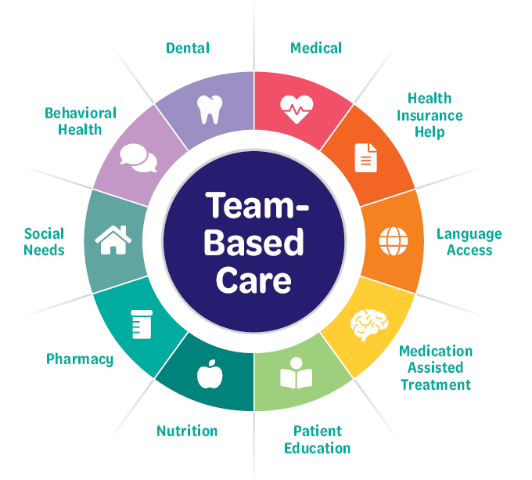
About Mosaic Community Health
Nonprofit community health center
Founded in Prineville in 2002 for the community by the community
Integrated health services that address each patient’s medical, dental, behavioral health, nutrition, social and medication needs
High-quality care for all regardless of income or insurance status
A dedicated street medicine program operating in Bend and Redmond
Mosaic uses a team-based approach to care.
Notes:
Lindsey

Slide 45
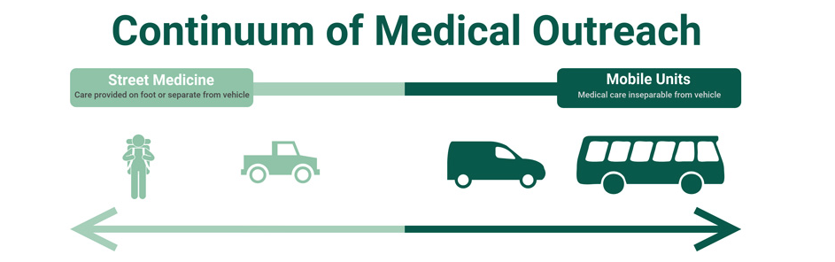
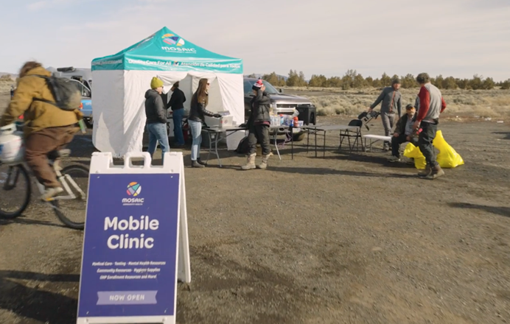
What is Street Medicine?
“Health and social services developed specifically to address the unique needs and circumstances of the unsheltered homeless delivered directly to them in their own environment.” –The Street Medicine Institute
Street medicine programs exist along a continuum of healthcare staffed by street medicine team members who split their time with traditional, mobile, and shelter-based clinics.
“Go to the People”: This addresses medical trauma and discrimination.
Notes:
Brooke

Slide 46
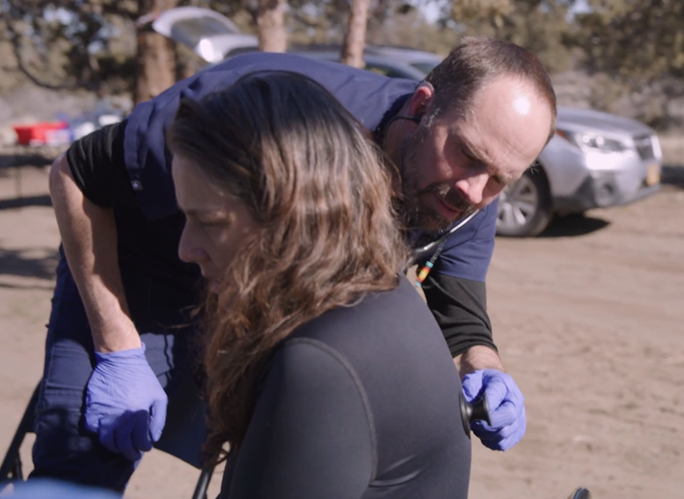
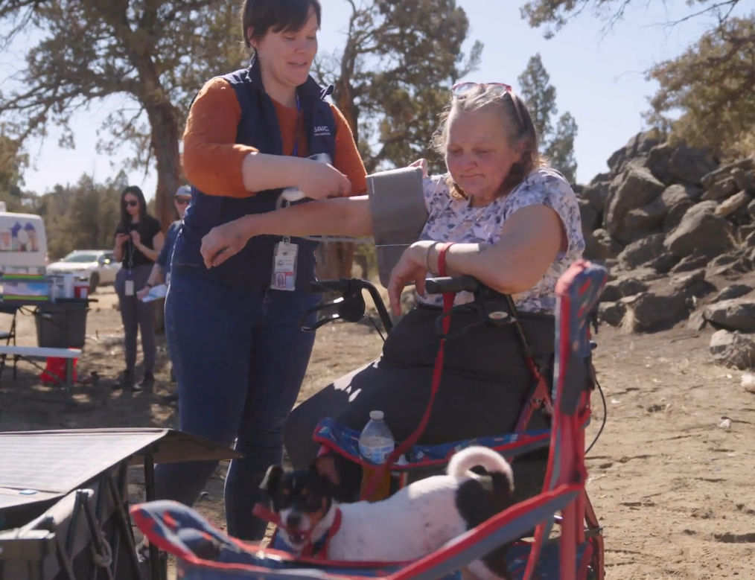
Top Health Needs
Preventative medicine
Diagnostics and management of chronic conditions
Dispensing and administering medications
Urgent and acute care needs
Minor procedures (ex. joint injections)
Women’s health services
Immunizations & lab work/blood draws
Mental health & substance use diagnosis and treatment
Notes:
Brooke

Slide 47
Temporary Safe Stay Area Services
Current Services
Medical provider outreach each week
Behavioral Health provider outreach each week
CHW outreach 2x each week and as needed
Outcomes
  Medical visits: 198
    Unique medical patients: 55
  Behavioral Health Visits: 60
    Unique behavioral health patients 22 began in September 2025
  Community Health Worker Services: 237+
    Unique patients: 50*
Notes:
Lindsey
Mosaic is funded for CHW services at the TSSA and throughout the City of Bend. CHW Services: What is reported on this slide is the number of individuals supported during the funding window Jan-Sept 2025 at the TSSA and only for only those who have consented to services and been recorded in HMIS.
Note: Not all people who consent to services with Mosaic consent to having their information collected in Homeless Management Information system.
Medical visits at TSSA: are reported from Jan 2025 – Sept ‘25. BH visits at TSSA began in Sept 2025. These positions are NOT funded by the HSGP/TSSA and City of Bend.

Slide 48
Recent Celebrations
Mosaic is expanding staffing for street medicine services to include nursing, behavioral health, and an additional medical provider.
Mosaic was able to purchase 2 dedicated street medicine outreach vehicles thanks to the Governor’s Executive Order investments for our region.
TSSA
  12 E-Bikes have been provided via Medicaid’s Flexible Services benefit to increase transportation for working patients
  2 patients were cured of Hepatitis C and 3 are actively in treatment
  2 patients housed, 1 in progress and 1 moving to safe parking
Notes:
Brooke

Slide 49
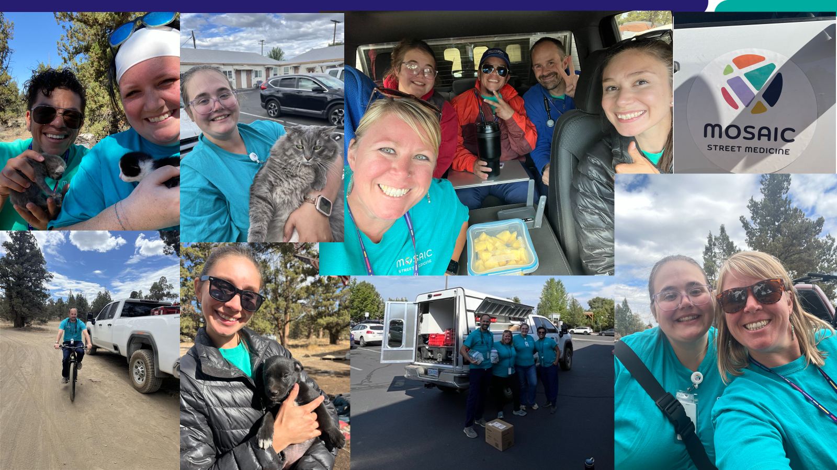
Notes:
“The prescription we wish we could offer to all those we are serving is safe, stable, affordable housing. We thank this committee for their work to make sure everyone in Bend has a place to call home.”

Slide 50
Thank you
Contact for more information:
hello@Mosaicch.org

Slide 51
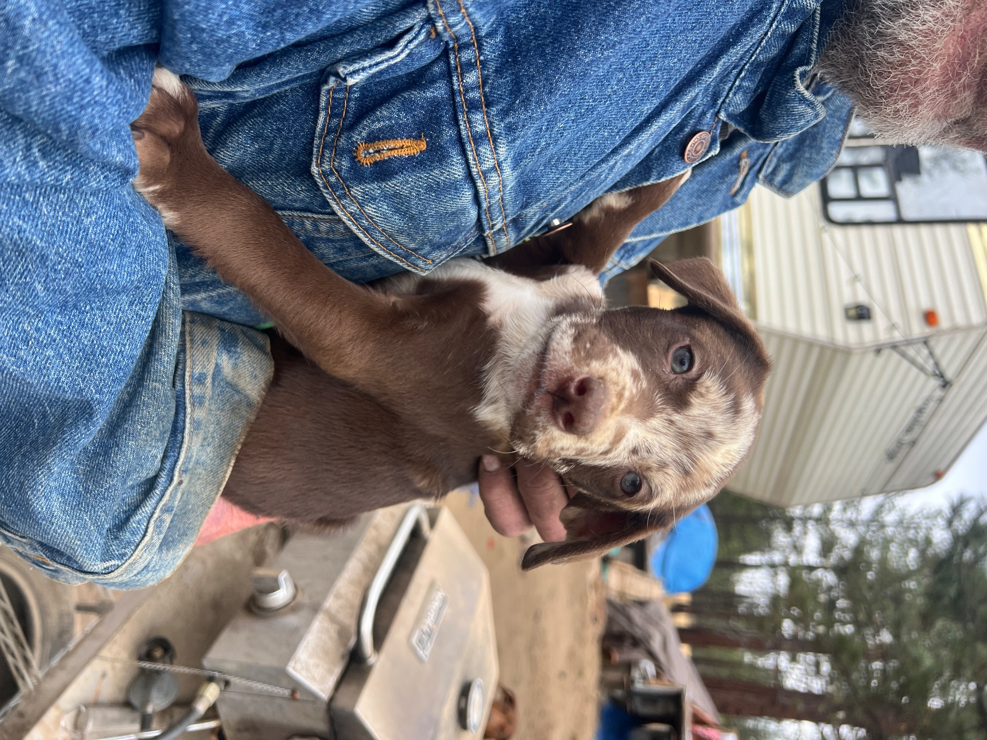

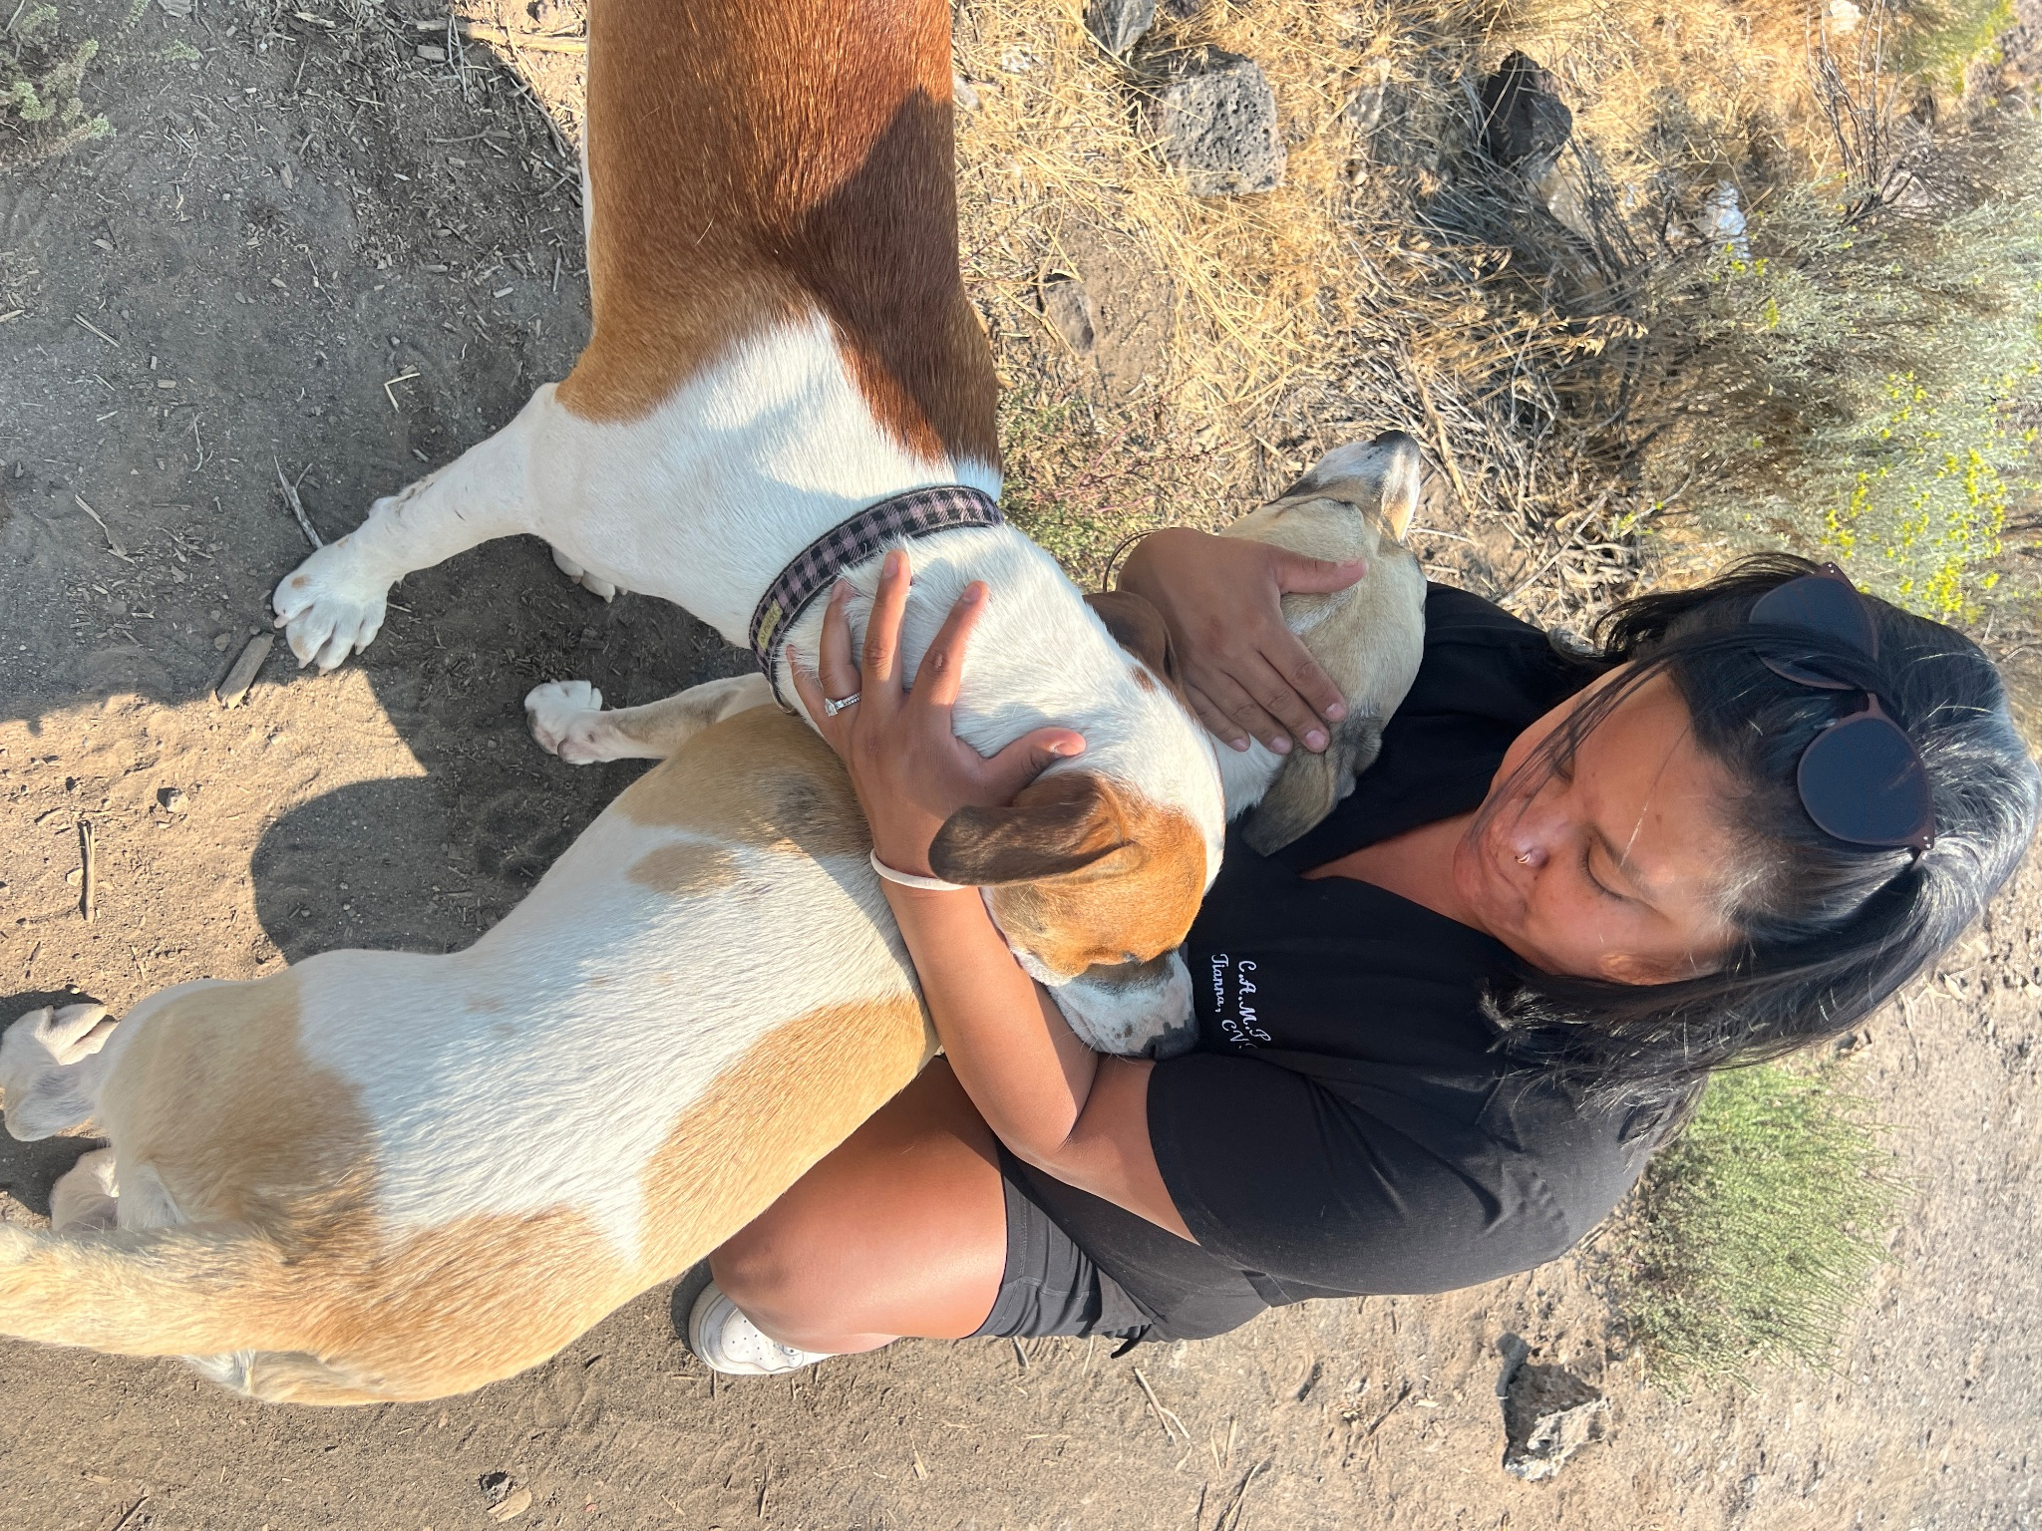
Companion Animal Medical Project

Slide 52
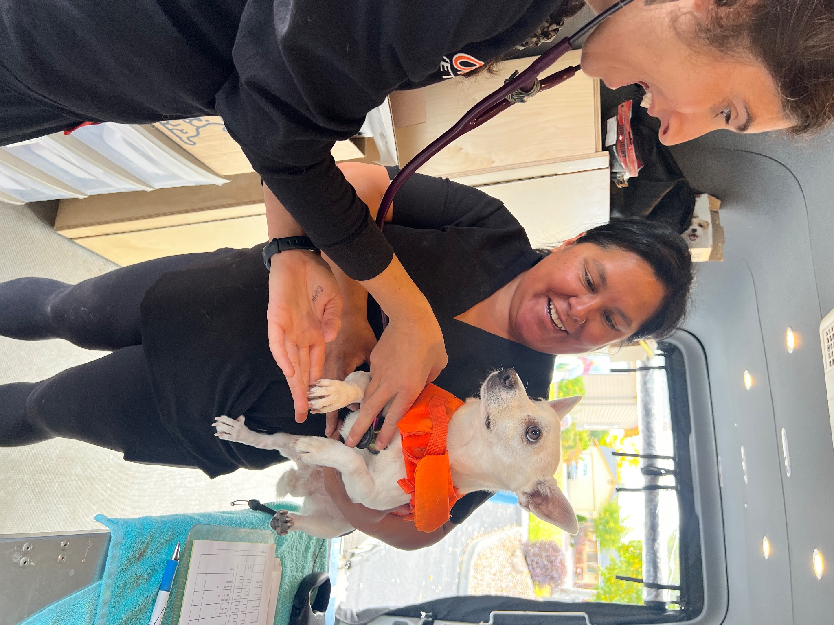
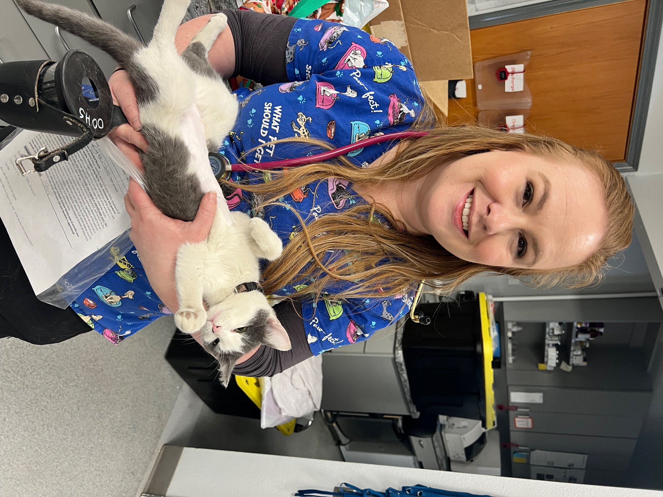
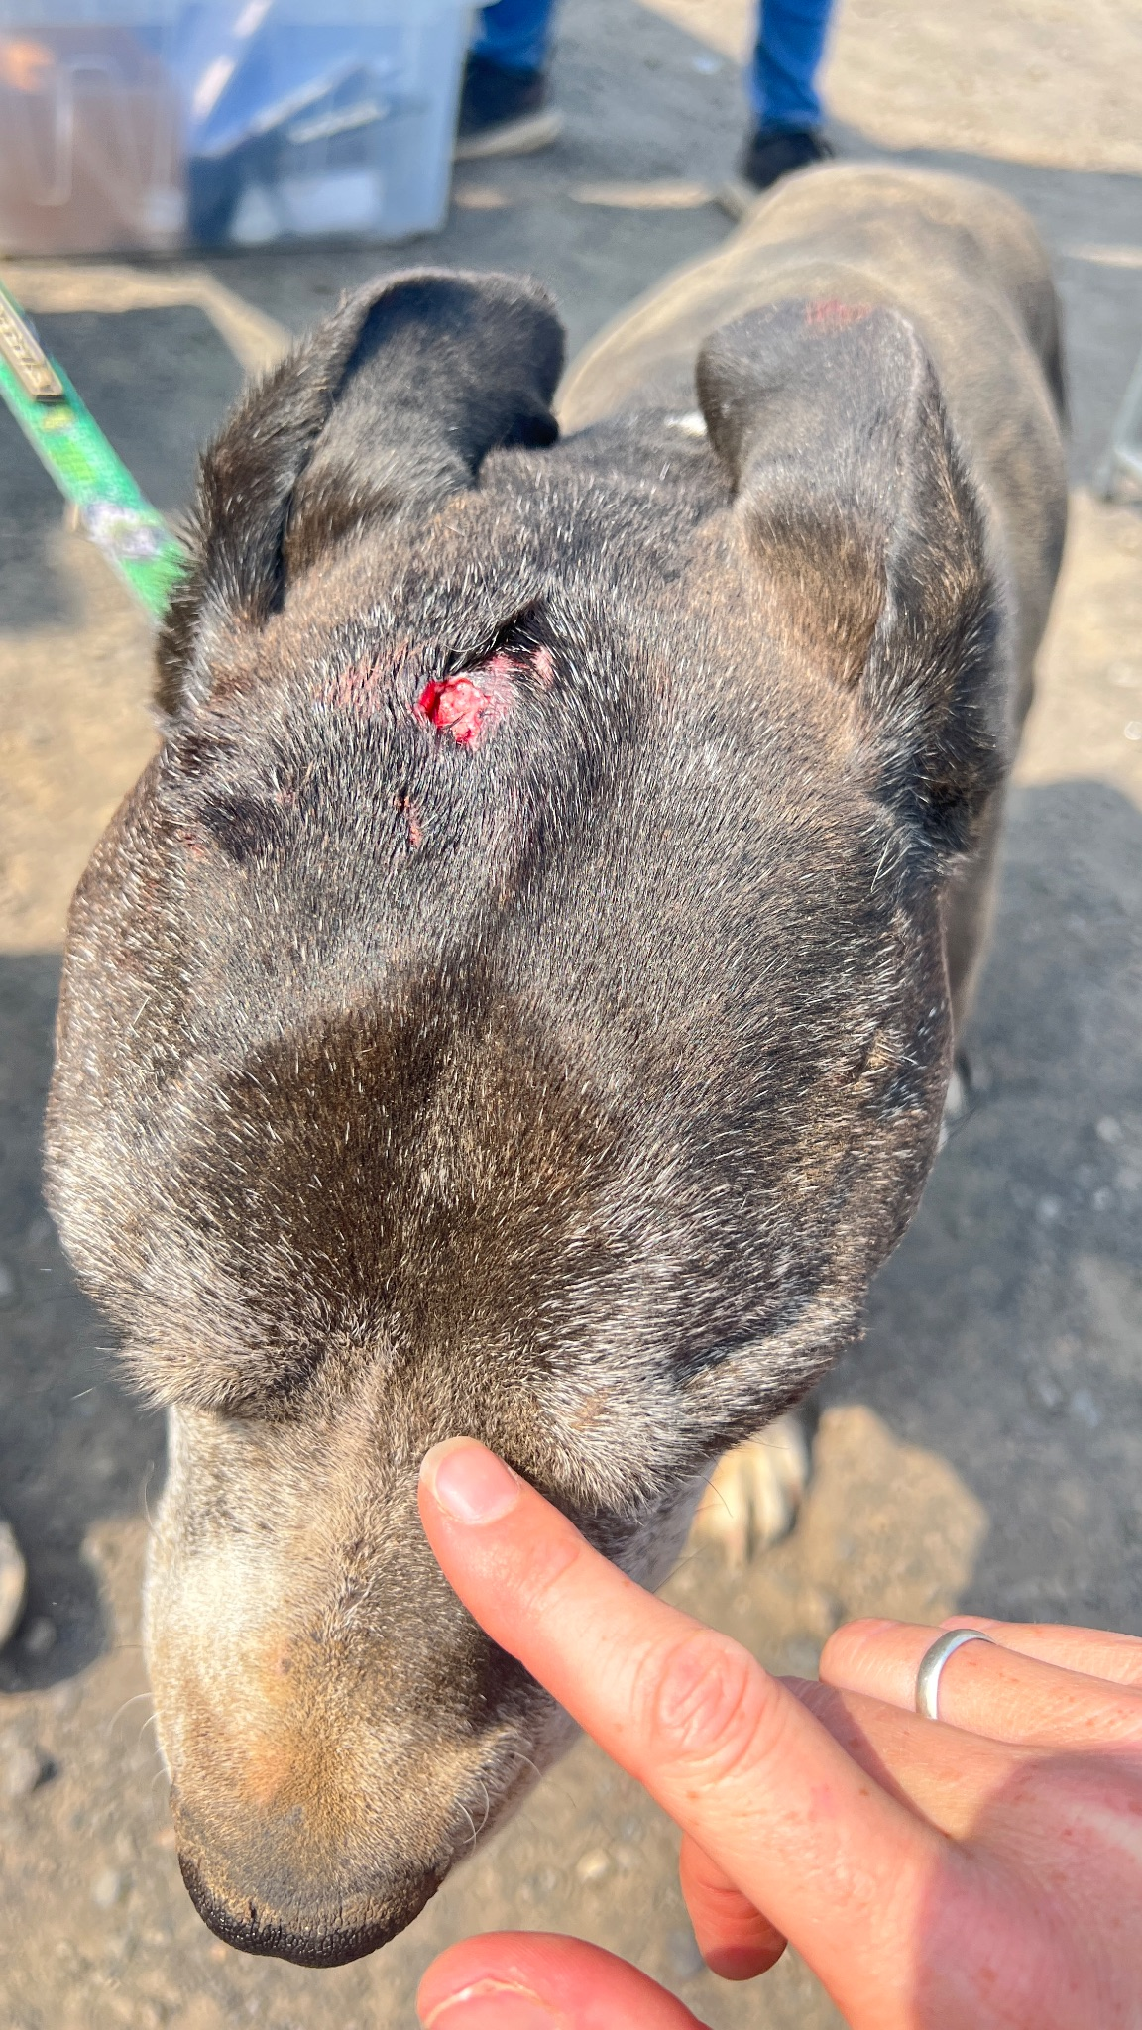
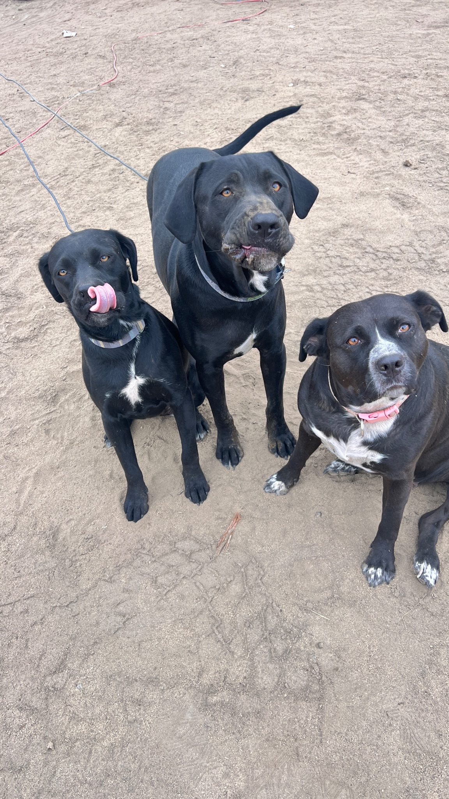
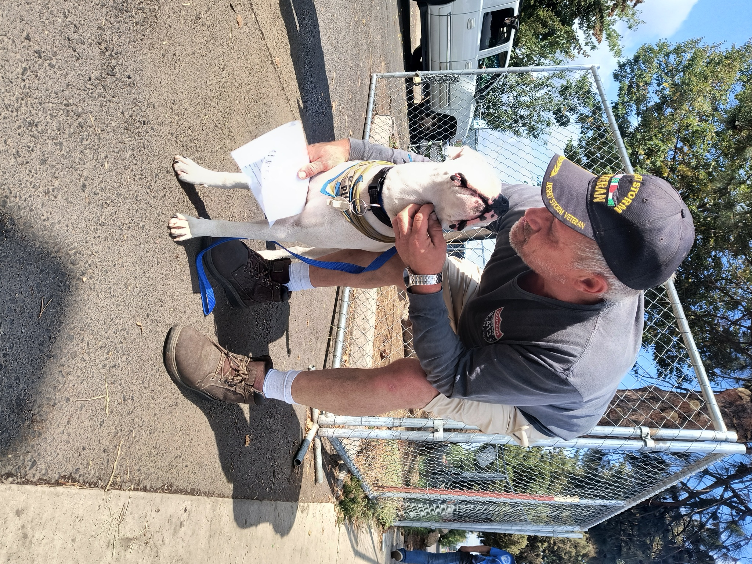
CORE Prevention Programs
Pet-Focused & Human-Centered
‘Ready Together’ Shelter/Housing Navigation
CAMPclinics & Outreach
Pet Food /
Supplies
Spay/Neuter
Urgent Care

Slide 53
To obtain this information in an alternate format such as Braille, large print, electronic formats, etc. please contact Amy Fraley at afraley@bendoregon.gov or 541-323-8550; Relay Users Dial 7-1-1.

