Slide 1

Surplus Land RFP: Bear Creek
Application Overview
Mellissa Kamanya, Affordable Housing Coordinator
Notes:
This is Mellissa Kamanya, City of Bend Affordable Housing Coordinator.
This presentation is an application review for the Surplus Land Request for Proposals (or RFP) for the Bear Creek property.

Slide 2

Background
Notes:
There is important background information regarding the City of Bend and the surplus land process.

Slide 3
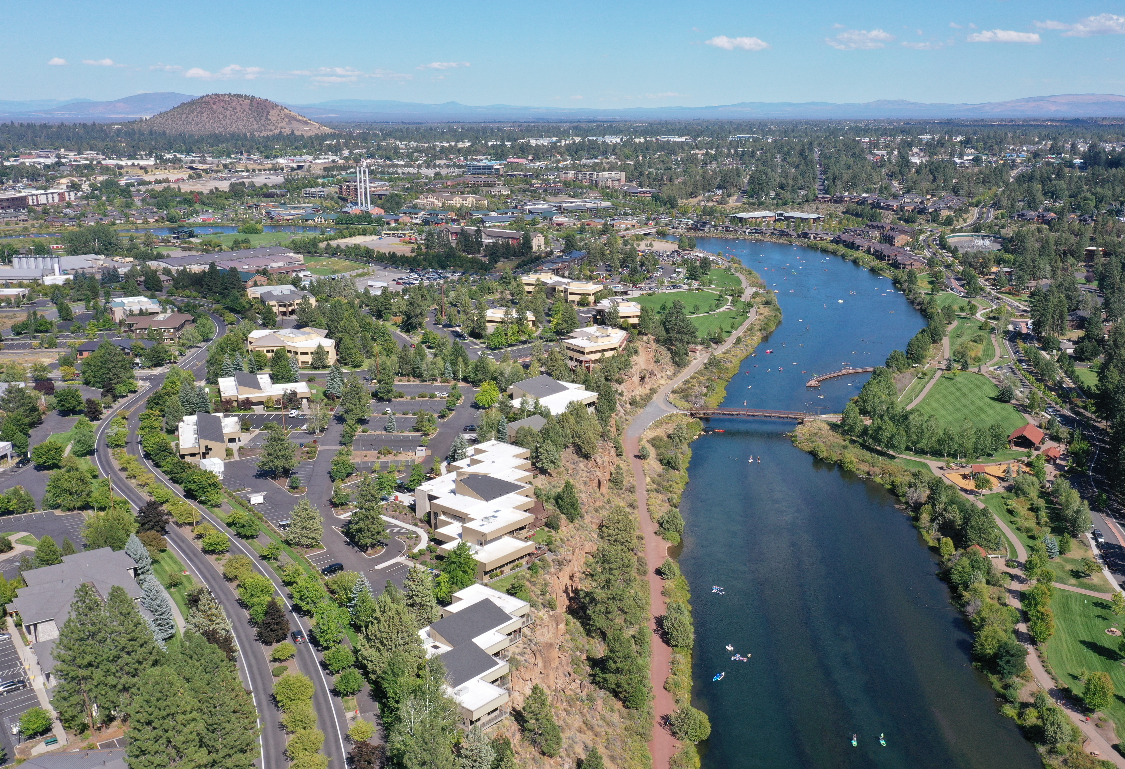
City of Bend
Bend is the largest urban area in Oregon east of the Cascade Mountains with an approximate population of 99,178 (2020 census data).
2030 population ≈ 123,574
2050 population ≈ 184,754
Increased challenges related to housing availability and affordability.
By 2028, 16,700 new dwelling units will be needed to meet population growth.

Slide 4
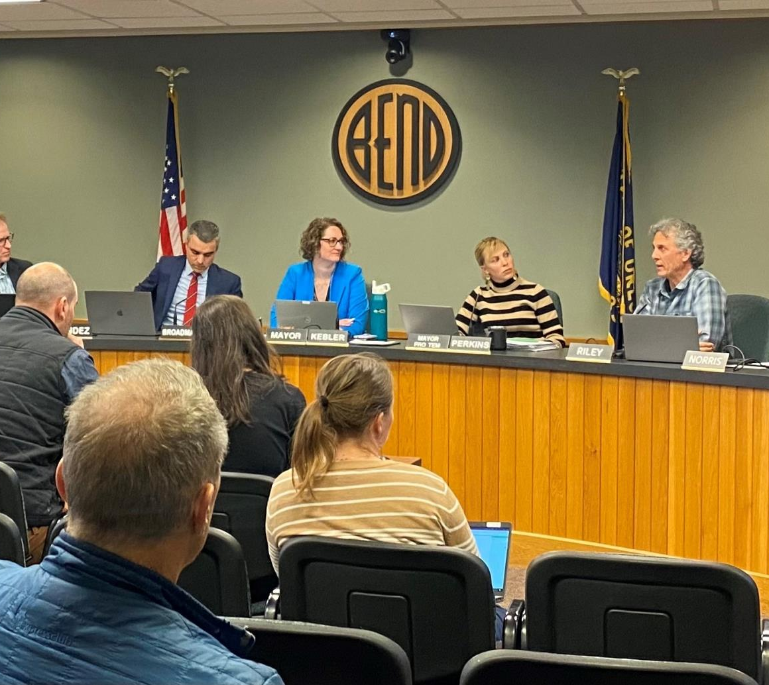
Bend City Council Resolution
On June 21, 2023, Bend City Council adopted the Resolution Adopting a Procedure for the Sale of City Property for Developing Affordable Rental and Owner-Occupied Housing Purposes and Declaring Certain Property Surplus.
Bend Code 1.50.040.K requires property to be sold by Request for Proposals (“RFP”) to those interested in developing the property for the use as affordable housing.
proposals to be reviewed by the City’s Affordable Housing Advisory Committee (“AHAC”),
AHAC makes a recommendation to the City Council as to which proposal to accept, or whether to accept a proposal if only one is received.
The City Council will make the final decision on any proposal.

Slide 5

Timeline
Notes:
Timeline.

Slide 6
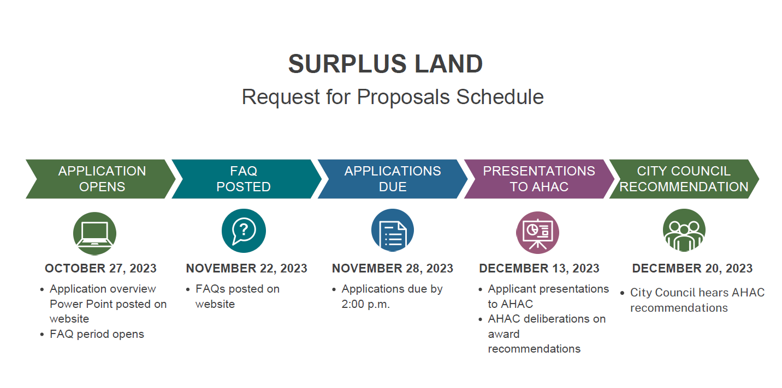

Slide 7
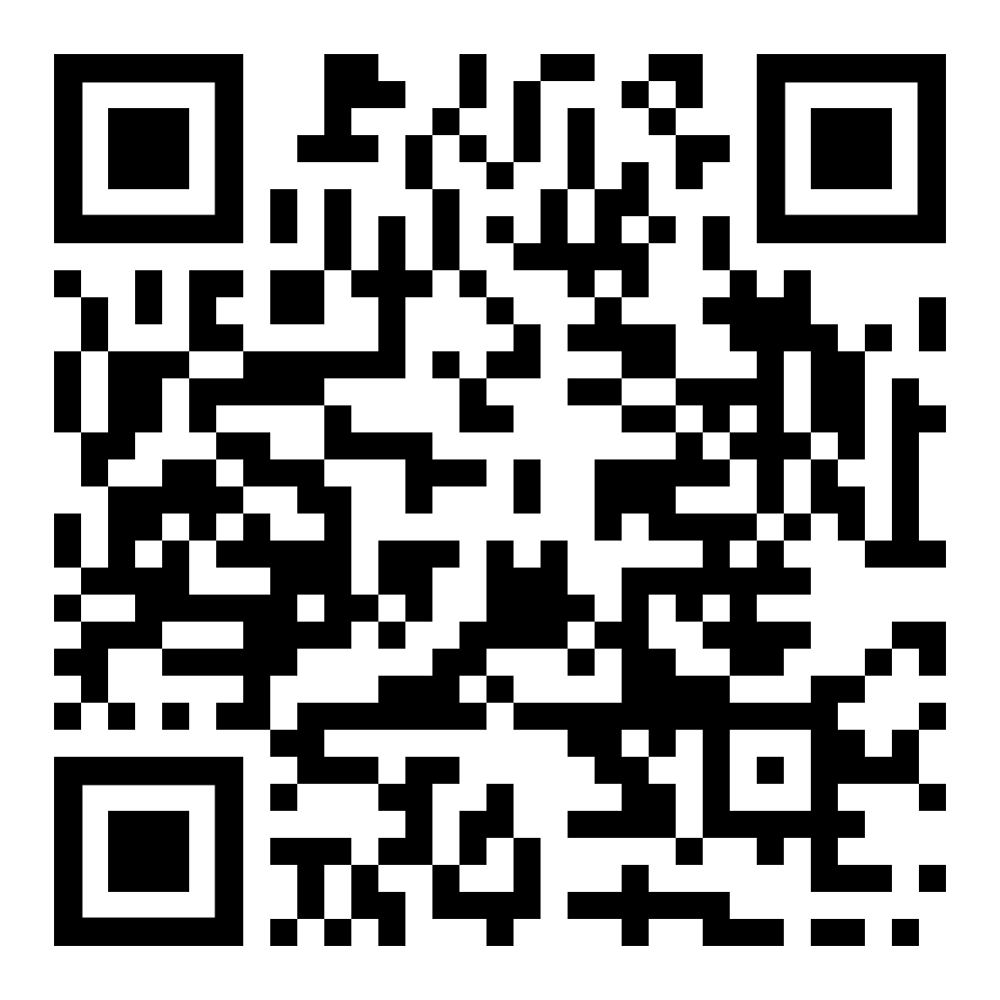
Pre-Application Meeting with Planning Division
Applicants are also encouraged to participate in a no-cost pre-application meeting through the Planning Division prior to submitting an application.
To schedule the pre-application, scan the QR Code or visit https://cityview.ci.bend.or.us/Portal/Account/Logon
This link will also be on the Affordable Housing Developer Resources website.

Slide 8

FAQs

Slide 9
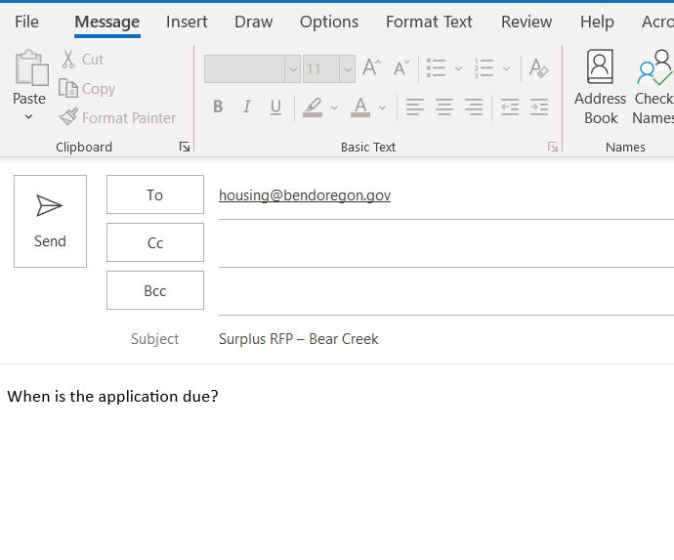
Frequently Asked Questions (FAQs)
Technical questions should be directed to housing@bendoregon.gov
Include “Surplus RFP – Bear Creek” in the subject line.
The FAQ period closes November 21, 2023, at 11:59 AM PST.
FAQs and answers will be posted at www.bendoregon.gov/affordable-housing-developers on November 22, 2023.
Questions requiring clarification or modifications to the RFP from the City of Bend will be made available in the form of an addenda(s) to the RFP and posted on the website.

Slide 10

Bear Creek Parcel

Slide 11
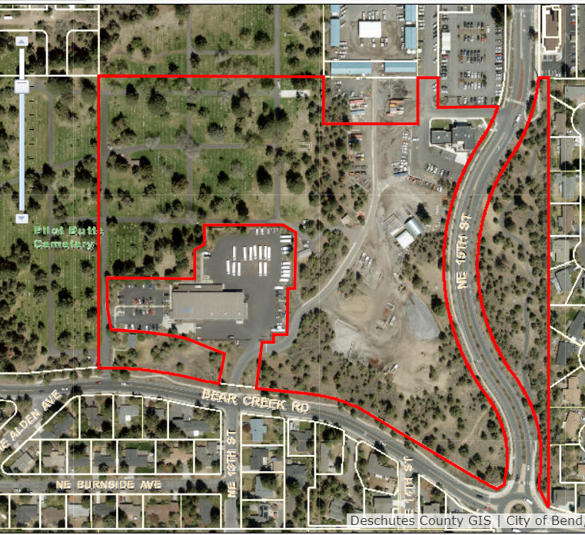
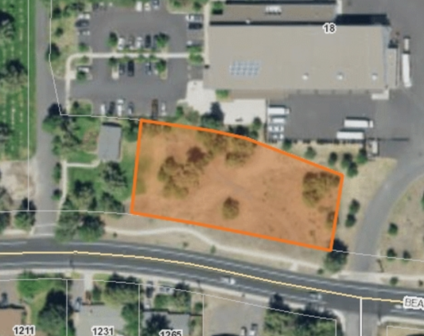
Bear Creek Parcel
Intersection of Bear Creek & NE 13th St.
PP20011-14 lot PARCEL 1 Block
Taxlot 171233DD00102
Approx. 0.62 acres
Zoned RS, bordered by land zoned PF
City of Bend is working to partition the property and record an access easement.
Successful purchaser will be required to work with the City on any remaining titling issues.

Slide 12

Cost Information

Slide 13
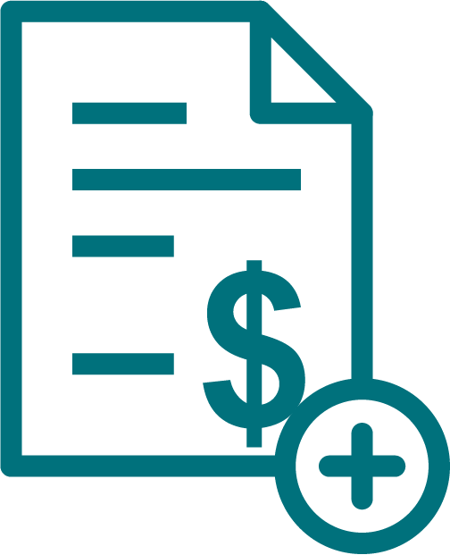
Cost Information
The sale price of the subject property is approximately $20,000 and is based on the costs the City has associated with the sale, including the parcel.
Buyer will be responsible for the cost of titling.
The successful applicant will be responsible for all costs associated with development, including but not limited to cost of required infrastructure construction, cost of recording, and costs of obtaining necessary governmental approvals
City of Bend is not liable for any cost incurred by applicants prior to issuance of a contract. Applicants responding to this RFP do so at their own expense and the City will not reimburse any expense incurred by Applicants or any other party in the preparation or submission of a response to this RFP.

Slide 14

Request for Proposal Details

Slide 15

Affordable Housing Covenant
Buyer(s) will develop the property for affordable housing, maximizing the available sites, under the City of Bend’s Comprehensive Plan Chapter 5-20.
Restricted to sixty (60%) percent of Area Median Income (AMI) for rentals
Restricted to and eighty (80%) AMI for home ownership
The successful Applicant must enter into an Affordable Housing Covenant at the time the contract is awarded, minimum of 20 years.
Specify the affordability period in your application

Slide 16

Submittal Requirements
Cover Letter
Applicant Identification
Project Description
Qualifications and Experience
Development Schedule
Due November 28, 2023 by 2 p.m.
Email to housing@bendoregon.gov
Include ‘RFP – Bear Creek’ in the subject line
May also submit paper copies, but email is preferred

Slide 17

Selection Process

Slide 18

Selection Process
Complete proposals meeting the qualification criteria will be forwarded to AHAC for review, evaluation, and scoring.
Presentations to AHAC in December
AHAC forwards their recommendations to City Council for final approval.
Applicant enters into a Purchase and Sale Agreement for the Property.
Possible City Council presentation
If a satisfactory agreement cannot be negotiated, the second-best proposal may be invited to enter into a Purchase and Sale Agreement for the property.

Slide 19

Evaluation Criteria and Bonus
Complete proposals will be evaluated by AHAC using the following criteria.
Project Evaluation (15 points)
Funding/Budget (10 points)
Affordable Housing Compliance (10 points)
Development Feasibility (10 points)
Bonus points
Accessibility Bonus Award (5 bonus points)
Lowest AMI Priority Bonus Award (up to 5 bonus points)

Slide 21
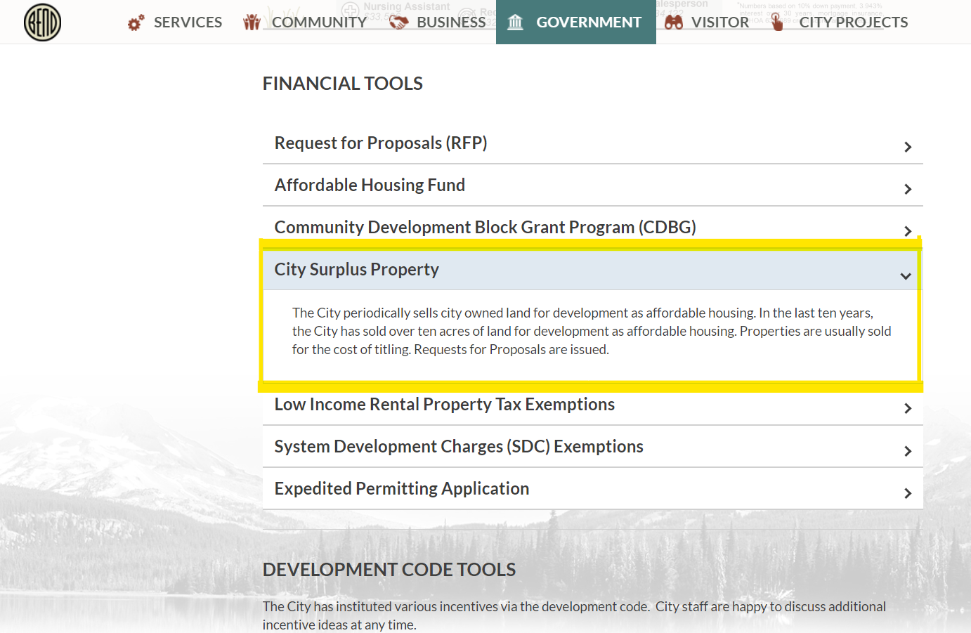
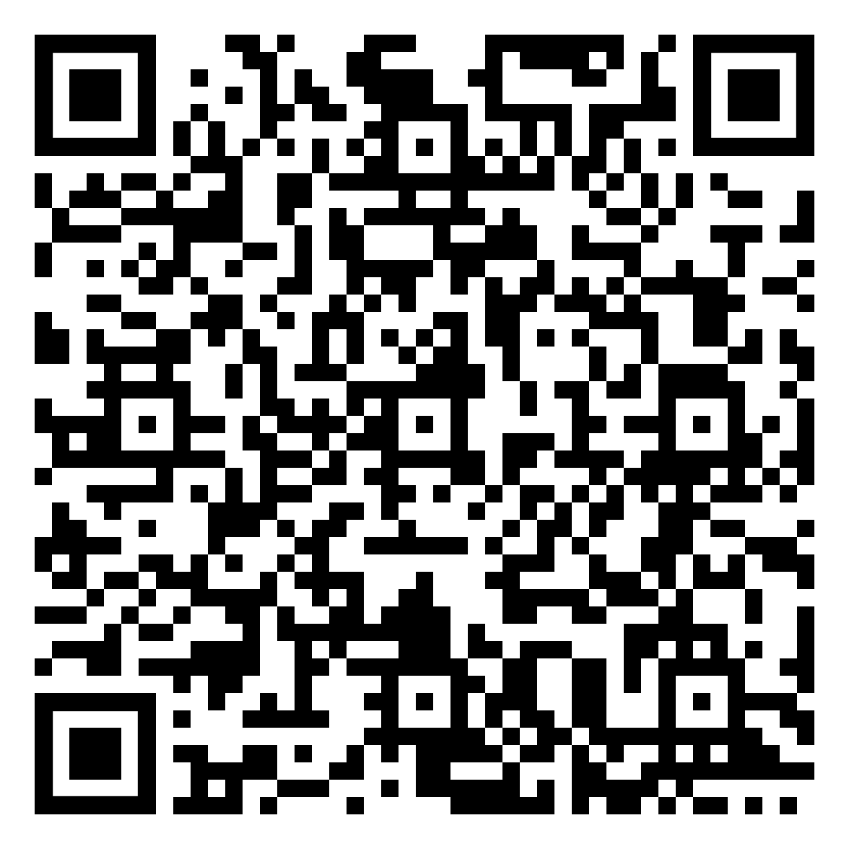
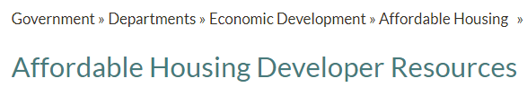
Where to find information on the RFP

Slide 22
To obtain this information in an alternate format such as Braille, large print, electronic formats, etc. please contact Mellissa Kamanya at mkamanya@bendoregon.gov or 541-382-5615. Relay Users Dial 7-1-1.

