Slide 1
2025 Houseless Services Accomplishments
Brook O’Keefe, Houseless Services Coordinator, Housing Division
January 27, 2026

Slide 2



2025 Point-in-Time Count
Bend
Central Oregon (OR-503)
1001 people experiencing houselessness
2108 people experiencing houselessness
17% increase
5% decrease in 2024
4% increase in 2025
Shelter Beds
586
Beds in Bend
226
Low-barrier beds

Slide 3
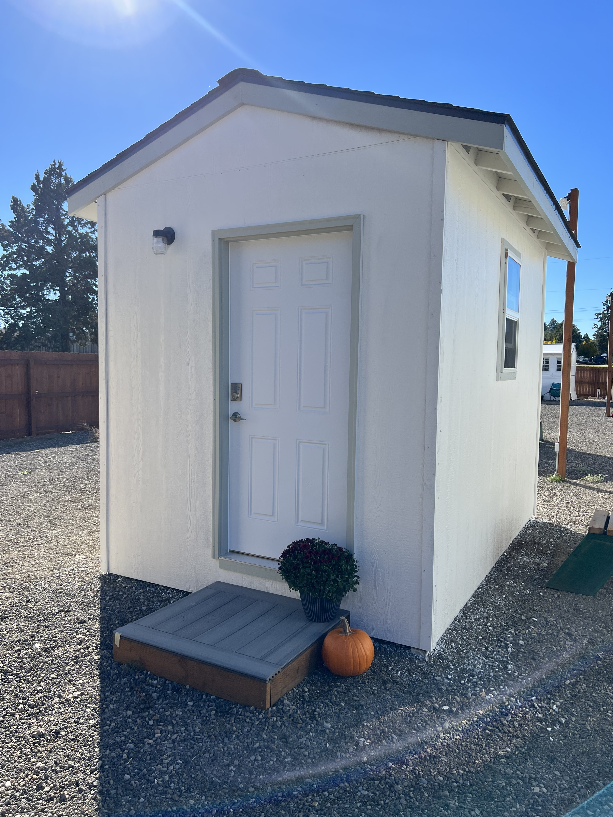
Shelters
City-Supported Shelters:
  The Lighthouse Navigation Center
  Franklin Avenue Shelter
  Stepping Stone Shelter
  Central Oregon Villages
2025 Accomplishments
  10-bed expansion of Franklin Avenue Shelter
  80,843+ bed nights provided
  93% average utilization
  812 clients served
  221 transitions to more permanent housing
    Temporary: 56
    Permanent: 165

Slide 4
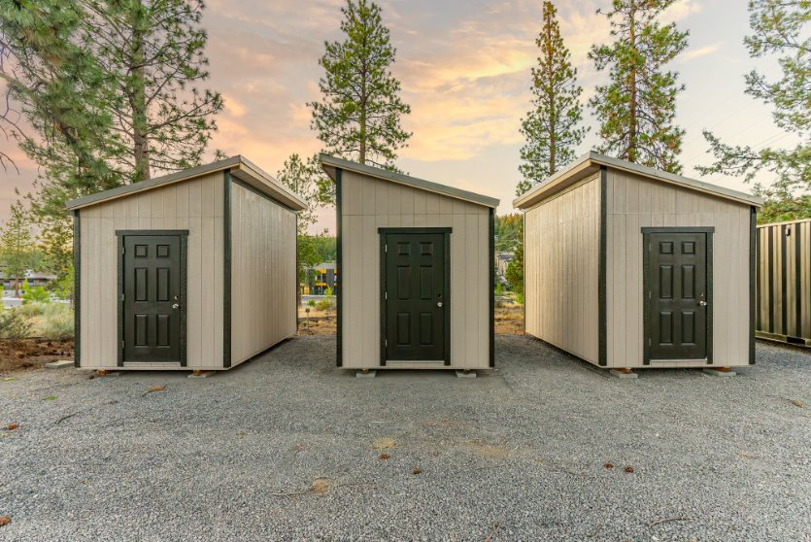
Safe Parking
City-Supported Safe Parking
  Mountain View Community Development
  REACH
  Central Oregon Villages
2025 Accomplishments:
  25 new spaces added
  7,823+ bed nights provided
  78% average utilization
  69+ clients served
  29 transitions to more permanent housing
    Temporary: 2
    Permanent: 27
Photo by Kaleb Riley

Slide 5
Housing-Focused Case Management at the Temporary Safe Stay Area
Grantees
  NeighborImpact (data & case conferencing)
  Central Oregon Villages
  Companion Animal Medical Project
  Mosaic Community Health
  REACH
  Shepherd’s House Ministries
2025 Accomplishments
  327 clients served
  5,728 service hours provided
  2,753 client engagements
  36 transitions to more permanent housing
    Shelter: 14
    Temporary: 8
    Permanent: 14

Slide 6

Housing-Focused Case Management & Prevention Services
Outreach
  Mosaic Community Health
    154 clients served
    442 client engagements
    3 Transitions to more permanent housing
      Permanent: 1
      Shelter: 2
Permanent Supportive Housing
  FUSE Housing Collaborative
    337 clients served
      All clients maintained permanent housing
    1,156 client engagements
Prevention Services:
  Thrive Central Oregon
  Saving Grace
  Accomplishments:
    396 clients served
    2,557 client engagements
    ~124 Transitions to more permanent housing
    ~272 clients maintained permanent housing
Notes:
Rental Assistance
Community Building
Medical Care

Slide 7
Preliminary 2025 Totals
2095+ Clients Served
88,666+ Nights of Shelter and Safe Parking Provided
7,789+ Client Engagements
~609 Clients Retained Permanent Housing
~413 Transitions to More Permanent Housing
Permanent: 332
Temporary: 66
Shelter: 15
*individuals may engage with multiple service providers throughout the year, duplication may exist within this data.
**Data is being cleaned and verified. Data dashboards will reflect updated metrics when they are available.

Slide 8
2025-2027 Council Goals
Goal 1: Maintain 525 Shelter Beds
Progress: 586 shelter beds are currently operational
Goal 2: Create 15 New Safe Parking Spaces (total 51 spaces)
Progress:
19 new spaces added since July 1, 2025
41 spaces currently operational
Goal 3: Transition 300 People to More Permanent Housing
Progress: 178+ transitions to more permanent housing (~60% accomplished)
Notes:
July 1, 2025 – June 30, 2027

Slide 9
Language Assistance Services & Accommodation Information for People with Disabilities
You can obtain this information in alternate formats such as Braille, electronic format, etc. Free language assistance services are also available. Please contact Brook O’Keefe at bokeefe@bendoregon.gov or 541-388-5544. Relay Users Dial 7-1-1.
Servicios de asistencia lingüística e información sobre alojamiento para personas con discapacidad
Puede obtener esta información en formatos alternativos como Braille, formato electrónico, etc. También disponemos de servicios gratuitos de asistencia lingüística. Póngase en contacto con Brook O’Keefe en bokeefe@bendoregon.gov o 541-388-5544. Los usuarios del servicio de retransmisión deben marcar el 7-1-1

