Slide 1
Temporary Safe Stay Area (TSSA) Update
Amy Fraley, Senior Program Manager, City of Bend
January 27, 2025

Slide 2
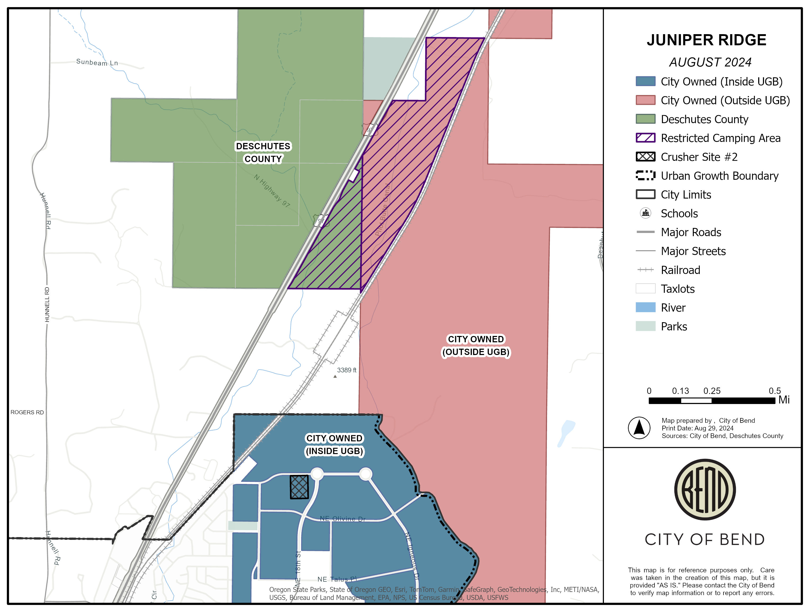
Day Use
Permitted
Only
Open for Temporary Safe Stay Area
Closed to
Public – 5/31/2025
Personal Property
Storage ONLY

Slide 3

Temporary Safe Stay Area (TSSA)
As stated in the adopted resolutions*, goal is to “…mitigate and improve the health and safety risks associated with unmanaged camping, and to provide improved sanitation services and case management to facilitate people camping at Juniper Ridge moving into safer shelter or housing.”
Reduce Temporary Safe Stay Area (TSSA) by ~50% in Year 2 (2026)
Full Closure of Temporary Safe Stay Area (TSSA) – on or before Dec. 31, 2026
*County No. 2024-046, City No. 3401

Slide 4
TSSA Timeline
September 5, 2024
Joint Meeting on Juniper Ridge
October 2024
Joint resolution creates Temporary Safe Stay Area at Juniper Ridge
November 6, 2024
Houseless Services Grant Program established
March 1, 2025
Full services in place including housing-focused case management, hygiene, security
September 29, 2025
Scaled closure notice (60-day) for Sections 1 & 2 noticed
June 1, 2026
Sections 1 & 2 closed
Joint Meeting to discuss phased closure
March 2026
No new camps permitted in Sections 3 & 4
Closed
June 2027

Slide 5
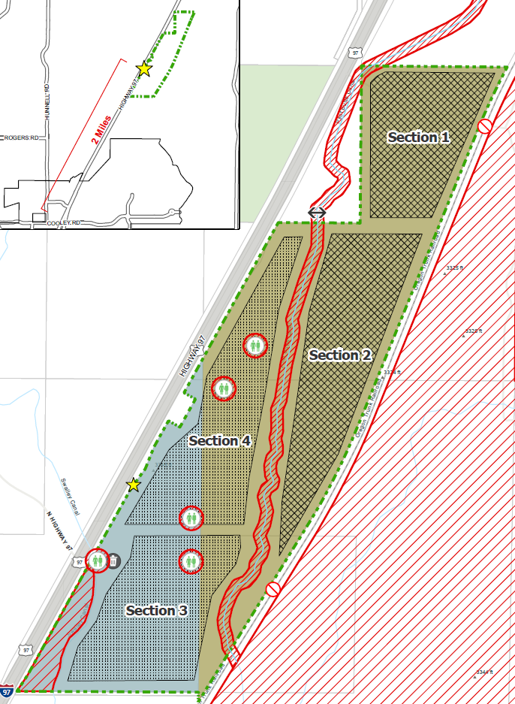
2026 Sectional Closure
Temporary Safe Stay Area divided into 4 sections
Sections 1 & 2 to be noticed in March 2026 with closure set for June 2026
Sections 1 & 2 guests permitted to move to Sections 3 & 4

Slide 6

Temporary Safe Stay Area – Enforcement
June 2025 began concerted effort to educate camps of the Rules & Regulations, emphasizing compliance
July 2025 began issuing Notice to Remedies – 49 to date
September 2025 began issuing notices to move due to non-compliance with remedy and Rules – 10 to date

Slide 7
Operational Expenses – City & County
CATEGORY | FY ’25 | FY ‘26 (6 months) | TOTAL
Water | $34,255 | $30,750 | $65,005
Portable Toilets & Handwashing Stations | $19,450 | $10,800 | $30,250
Dumpsters | $10,189 | $11,470 | $21,659
Security | $65,821 | $50,343 | $116,164
General Trash / Cleanup | $457,004 | $228,501 | $685,505
Misc (fire gates, eco blocks, etc.) | $45,741 | $4,550 | $50,291
TOTAL | $512,379 | $336,414 | $848,793
City/County Shared Expenses through Intergovernmental Agreement (IGA)
*Total Expenses by both City & County. Does not include City & County staff time or other allocation costs.

Slide 8
Housing-focused Case Management - HSGP
Grantees | Grant Amounts
NeighborImpact | $50,000.00
Central Oregon Villages | $183,863.00
Shepherd's House Ministries | $294,507.00
REACH | $419,729.46
Home More Network | $18,401.54
Companion Animal Medical Project | $100,000.00
Mosaic Community Health | $135,906.00
TOTAL | $1,202,407.00

Slide 9
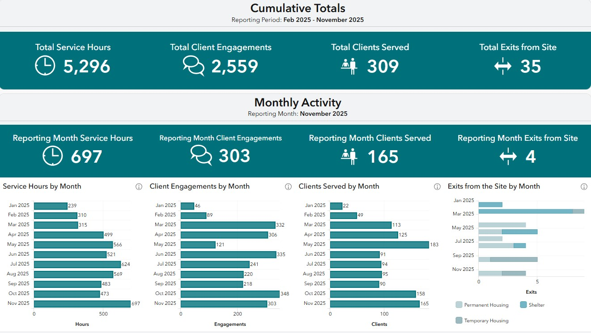
Case Management - Dashboard
Temporary Safe Stay Area (TSSA) Dashboard

Slide 10
Currently
192 campers in 150 camps at Temporary Safe Stay Area: January 9, 2026
City-supported shelters have an average utilization rate of 88% in 2025
Navigation Center 99% and Franklin Avenue Shelter 101% in 2025
Safe Parking has expanded from 13 to 41 spaces in 2025
Franklin Avenue Shelter expanded from 60-70 beds
Expected new beds prior to end date are limited
1 Safe Parking program – Bend
35 Campground spaces – Redmond (late spring 2026)
8 Shelter beds – Bend (high barrier for women)

Slide 11
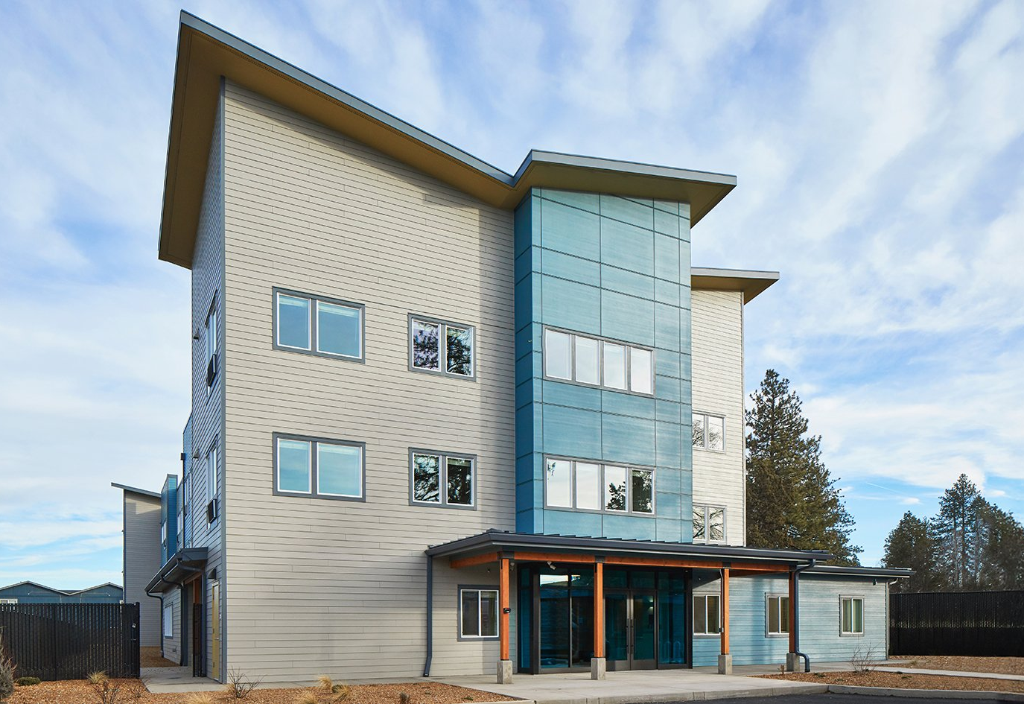
Housing
Permanent Supportive Housing
$400,000+ per door
50 units
$850,000 services ($17k per)
Total $21M
Affordable Housing
$400,000+ per door
50 units
Total $20M

Slide 12
Traditional Shelter Costs
 | Motel Conversion | Congregate Shelter
Beds | 70 | 100
Acquisition | $5M | $2M
Renovation | $500,000 | $1.5M
Per bed cost start up | $78,600 | $35,000
Annual Operations | $1,368,000 $54 a day per person | $3,000,000 $82 a day per person (3 meals a day and services)
Acquisition and Year 1 Total | $6.9M | $6.5M

Slide 13
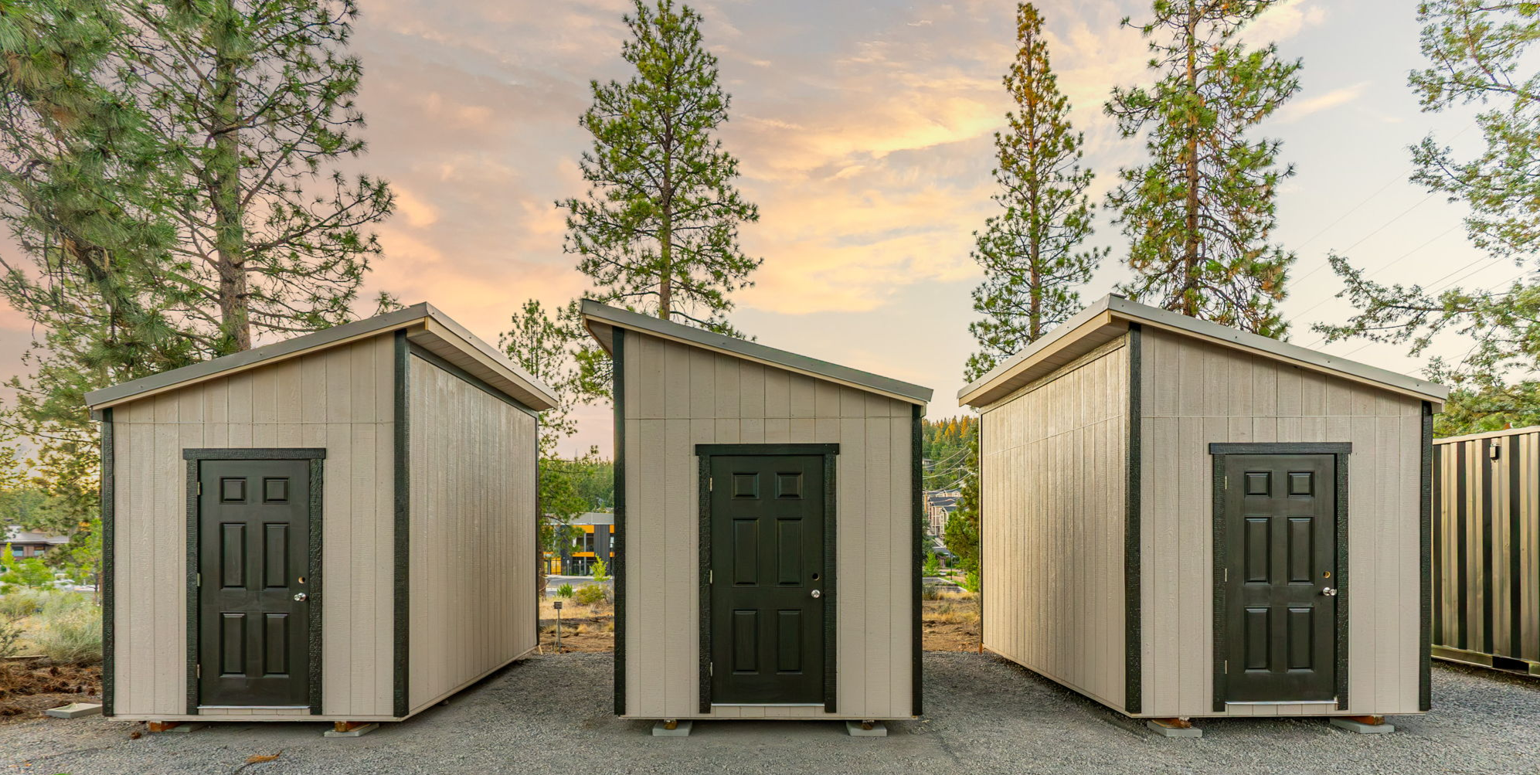
Safe Parking and Outdoor Shelter
Safe Parking
6 spaces
$1,400 per space monthly
Start-up costs $8,500-$15,000*
Annual operations $100,800
Outdoor Shelter
20 units
$1,275 per space monthly
$439,210 start up
Annual operations $306,000
*Existing Central Oregon Villages shelter will be moving to City-owned land in 2026.

Slide 14

New Campground
70 people
Identify land and secure land for 50-ish sites at no cost
Construction $676,000*
Management $500,000*
$1,000,000+ in first year
*Based on Redmond 35-site camp opening March 2026 w/ 2 person per site
Notes:
Review Redmond / County

Slide 15
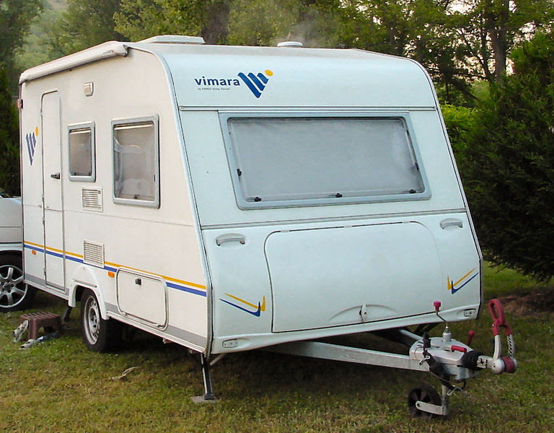
Temporary Safe Stay Area Continuation
~190 people
Existing service contracts and costs
Case management $450,000
Hygiene/trash/security $500,000
Enforcement staff time $150,000
$1,100,000 Annually
*Excludes any cleanup costs associated with closures/removals and other incidentals
This Photo by Unknown Author is licensed under CC BY
Notes:
The 20 reduction in case management would theoretically be tied to the reduction in population – do you want to start with a year or 6 months. Staff time is a guess with increased enforcement
$900,000 for a year – with a 20% reduction in Case Management

Slide 16
Anecdotal population needs
25% of people may qualify for Permanent Supportive Housing
25% of people may be interested in Safe Parking
25% of people may be interested in non-congregate shelter bed
25% people may wish to access a managed camp
Type | Beds | Cost
Permanent Supportive Housing | 50 | $21,000,000
Safe Parking | 50 | $961,140
Non-congregate/Motel Conversion | 50 | $4,905,714
Campground | 50 | $1,100,000
Total |  | $27,966,854
Notes:
SP – 8.3*115,800 Motel took 6.9M divided by 70 and multiplied by 50

Slide 17
Cost Comparisons Recap
Type | Per bed/person month | Start up | Timing
Congregate shelter with services | $2,500 | $3.5M | 2 years
Non-Congregate shelter | $1,628 | $5.5M | 2 years
Outdoor Shelter | $1,275 | $440,000 | 1 year+
Safe Parking | $1,400 | $8,500-15,000 | 3-6 months
Campground | $595 | $676,000 | 12-18 months
Temporary Safe Stay Area continuation | $483 | $0 | Current
Notes:
TSSA based on 200 people without 20% reduction

Slide 18
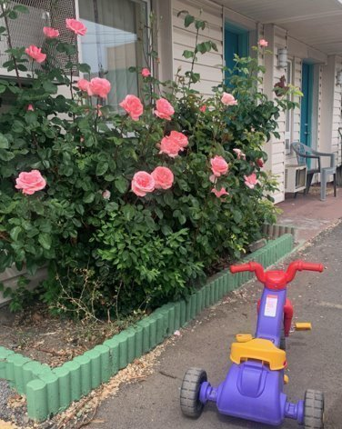
Funding Cliffs On the Horizon
American Rescue Plan Act (ARPA) $’s expire Dec. 31, 2026 - All City dollars for houseless services expended
Statewide shelter funding does not fully fund shelter in the region
$1.7M deficit in current biennium for City supported shelter services (6 months of FY27)
Forecasted short falls
The Lighthouse Navigation Center
All Safe Parking
Central Oregon Villages Shelter
Notes:
Explain current funding nuiances

Slide 19
Discussion / Direction – Temporary Safe Stay Area
Staff will continue to move forward with area reduction of the Temporary Safe Stay Area
Closure of Sections 1 & 2 by June 2026
January 20, 2026 Council and Board of Commissioners expressed consensus to:
Extend for 6 months at current service levels (hygiene, security, case management, trash/cleanup): ~$550,000
50/50 cost share for expenses
Excludes staff and final cleanup costs associated with full closure
Close TSSA to new campers with closure of Sections 1 & 2 June 2026

Slide 20
Language Assistance Services & Accommodation Information for People with Disabilities
You can obtain this information in alternate formats such as Braille, electronic format, etc. Free language assistance services are also available. Please contact Amy Fraley at afraley@bendoregon.gov or 541-388-5510. Relay Users Dial 7-1-1.
Servicios de asistencia lingüística e información sobre alojamiento para personas con discapacidad
Puede obtener esta información en formatos alternativos como Braille, formato electrónico, etc. También disponemos de servicios gratuitos de asistencia lingüística. Póngase en contacto con Amy Fraley at afraley@bendoregon.gov o 541-388-5510. Los usuarios del servicio de retransmisión deben marcar el 7-1-1

