Slide 1
Bend Economic Development Advisory Board
February 2, 2026

Slide 2
Public Comment

Slide 3
Approve Meeting Minutes
November 3, December 1 and January 5

Slide 4
Mayor Pro Tem Perkins Updates

Slide 5
Mayor Pro Tem Perkins Updates

Slide 6
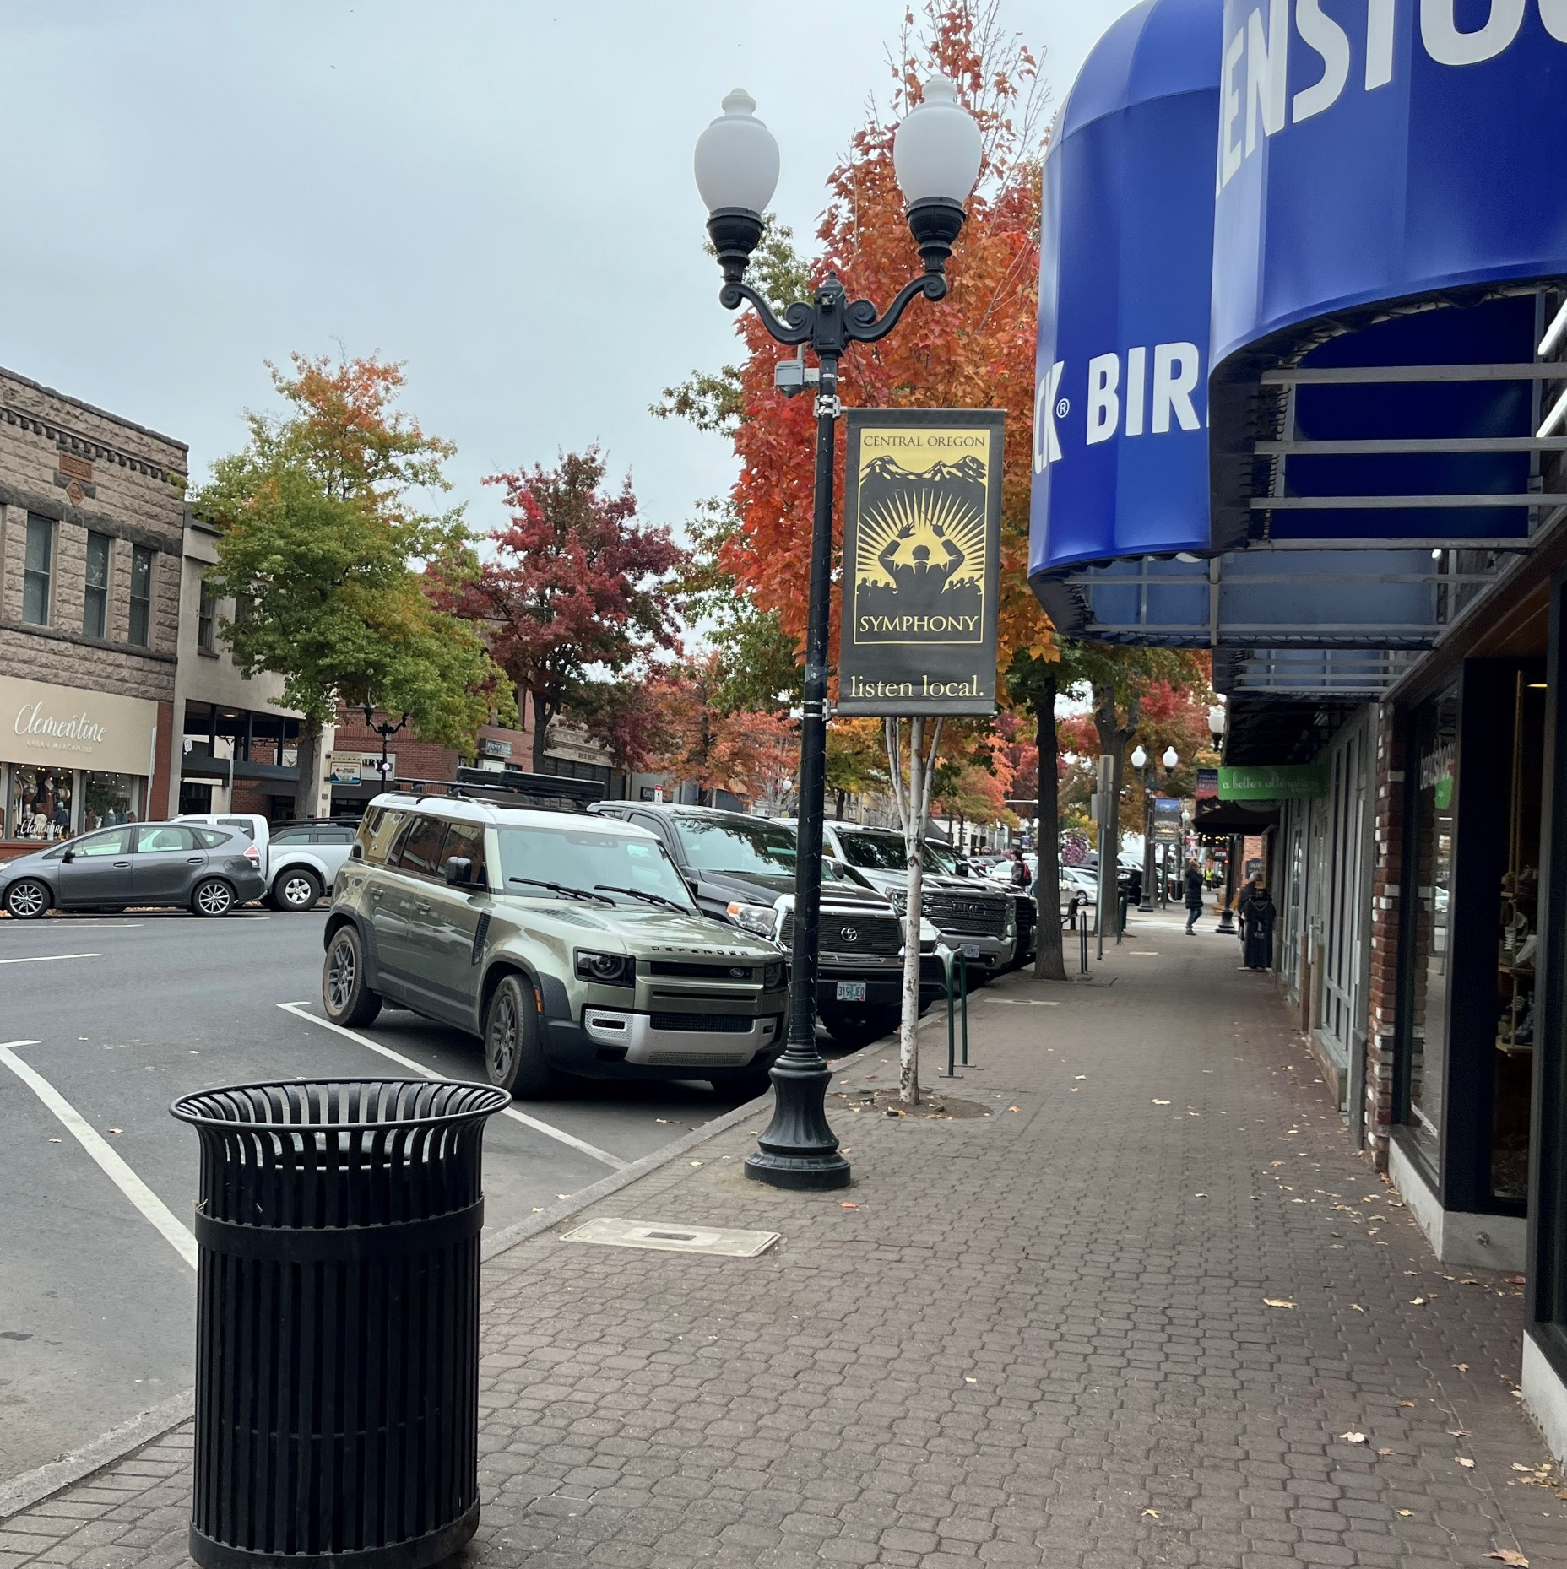
Economic Development Strategic Plan
February 2, 2026
2025-2027 Biennium

Slide 7
Economic Prosperity
Create a comprehensive economic development plan and vision, which is measured by a Bend-specific economic prosperity index
Lead an effort to strengthen economic prosperity by enhancing strategic partnerships
Implement the Urban Renewal Investment Strategy as a local tool to support economic growth with a target of 200 jobs created and 500 multi-family housing units constructed in the biennium using this tool.

Slide 8

What’s in the Report
Outreach process, business & stakeholder feedback, data analysis & peer city learnings
Guiding principles
Economic data analysis
Key indicators & assumptions
Goals and strategies
Data monitoring & bend-specific metrics

Slide 9
Informing Our Goals & Strategies
Focus Groups | 50+ members, variety of industries, under-represented owners - 6 sessions total
Stakeholder Interviews | >80 individuals
Business Survey | >170 responses
BEDAB | Continuous briefings and feedback

Slide 10

Stakeholder Guiding Principles
Inclusive economic growth
Customer service
Adaptable & innovative
Accountable & transparent

Slide 11

Indications of a Changing Economy
State of Oregon/Business Oregon, our Region and the City
INDICATORS
Slowing federal & state economy
Stagnating population
Regulation & delay making Oregon less competitive
More businesses leaving the state or downsizing
Limited business incentives
Workforce in flux
High housing costs
RESPONSES
Oregon Prosperity Roadmap
Business Oregon Economic Development Strategic Framework
Regional Strategic Plans – EDCO, East Cascade Works, COIC Community Economic Development Strategy, etc.
City of Bend Economic Development Strategy

Slide 12

Factors Impacting Bend’s Economy
More modest growth in population – about 2.5%
Workforce has moved out of town – 53% commuting from other cities
Incomes have grown but disparities continue – housing costs, cost of living, wages
Business cost burden is high – taxes, building & operation costs, tariffs, etc. – 49th in nation
Oregon regulation is high – 47th in nation
Although our net gain of business has been positive, we are seeing leakage

Slide 13
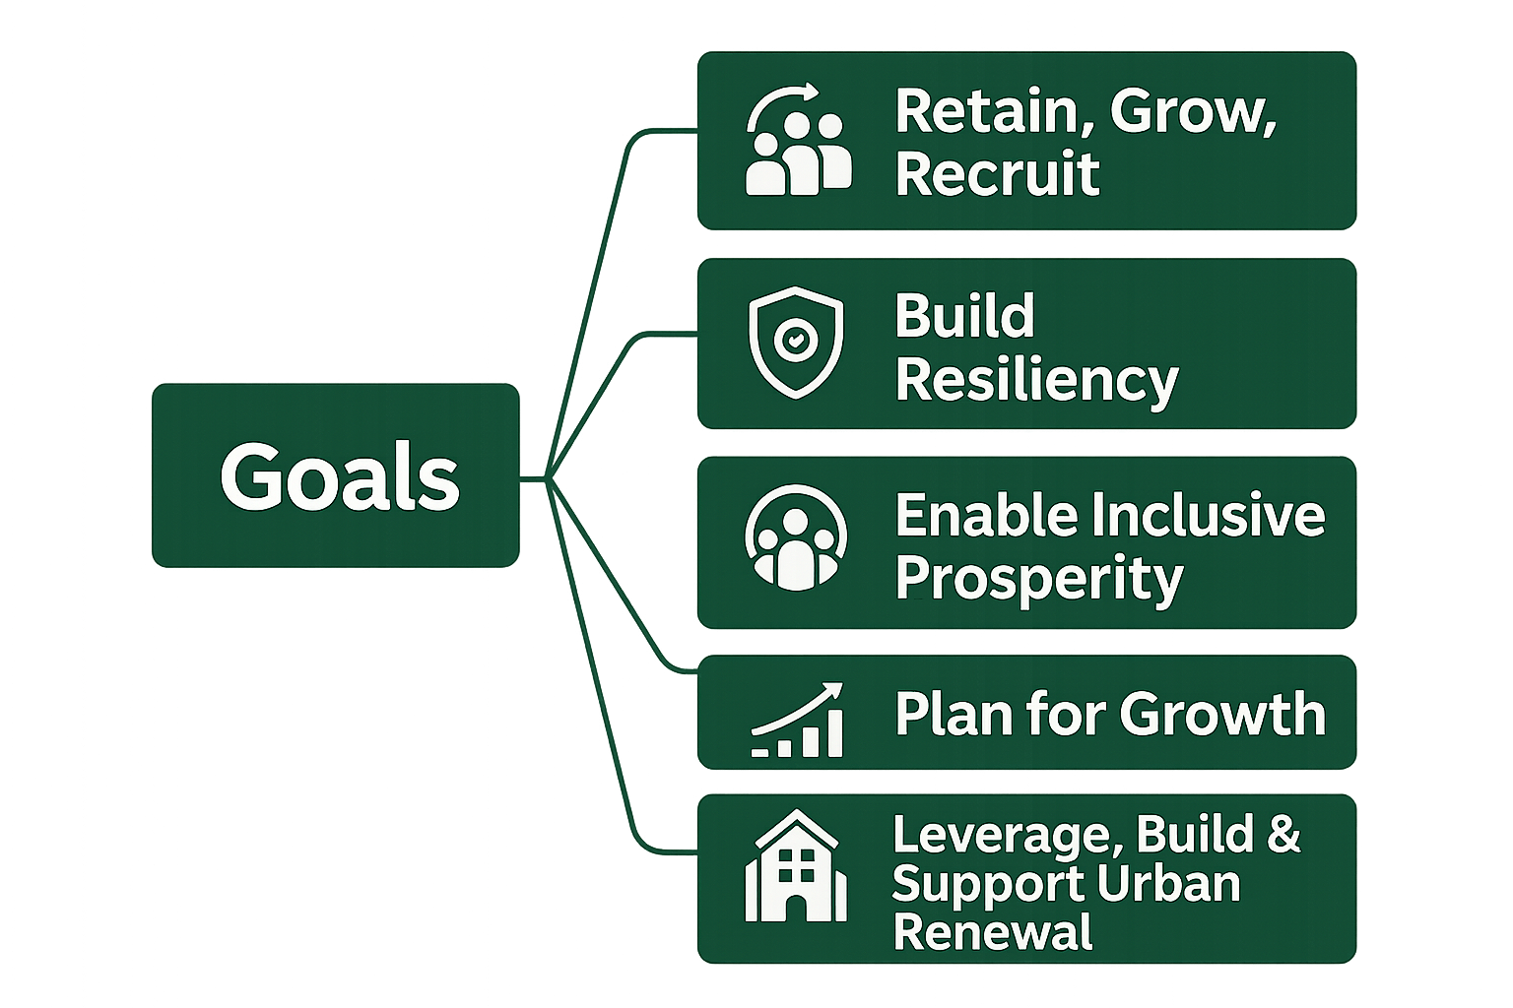
Economic Development Goals

Slide 14
Strategies
RETAIN, GROW, RECRUIT BUSINESS
Develop & Implement a Business Retention Plan
Implement small business support programs
Leverage new state economic development programs and incentives
Continue to improve customer service and permit timelines
BUILD RESILIENCY
Economic, natural and workforce impact strategies
ENABLE INCLUSIVE PROSPERITY
Create more attainable housing
Enable wage growth through upward mobility for the workforce
Ensure more opportunities for small and under-represented businesses
“Delays in the workflow on top of the high cost of land creates real problems…”
“AI, speed and analysis, intellectual efficiencies, tariffs, aging workforce, increased healthcare costs are all direct impacts to our business.”
“We need more housing affordability to attract quality workers.”

Slide 15
Strategies
PLAN FOR GROWTH
Include future economic needs in long-range planning, including commercial, industrial and micro-commercial uses, infrastructure, and connected job centers
LEVERAGE, BUILD & SUPPORT URBAN RENEWAL
Implement the BURA Investment Strategy for three urban renewal areas and TIF’s
Develop a plan for city properties
Explore public/private partnerships for urban renewal projects
“We are incredibly excited to see the City take more of a direct role in strategic planning for economic development. We need a shared vision that is specific to Bend…”
“Private money follows public money. We need the Central District of Bend to be invested in by the City to meet the vision that our community has expressed…”

Slide 16

City of Bend Economic Development Delivery
BURA (Economic Development Dept.)
Invest
CONTRACTED
Destination Marketing
CITY ECONOMIC DEVELOPMENT OFFICE
Business & Entrepreneur Support
PARTNERSHIPS
Workforce Development
Build
Recruit
Leverage Investment
Housing
Traded Sector Business Recruitment
Economic Advocacy
Education
Funding & Infrastructure
Housing
Commercial Development
Industrial Development
Infrastructure Development
Housing Development
Regional Collaboration

Slide 17
Monitoring Bend’s Economy
Economic Output | GDP, tourism occupancy, tourism taxes, total assessed value growth
Business Development & Investment | New business licenses, new business utility accounts, total value of permits, new business growth, real estate vacancy rates
Inclusive Workforce Prosperity | Income growth comparison, Gini index, house affordability ratio
Labor & Workforce | Employment growth, labor force participation rate, unemployment rate, wage growth

Slide 18
City Economic Development 2025-2027 Timeline
BURA Property Acquisition Strategy
Implement BURA Investment & Business Retention Strategies
Business Retention Plan Development
Small Business Grants
BEDAB Workplan to Council
Mar
July
Jan ‘27
June
Nov
Update EDSP & Budget for 2027-2029 Biennium
BURA Incentives Adoption
EDCO Bend Employee Co-located at City

Slide 19
Recommended Motion
“I move to recommend on behalf of BEDAB that the Economic Development Strategy be adopted by City Council as presented on February 2, 2026”

Slide 20
BEDAB Workplan and Code Update Process

Slide 21
Community Development Department Memo Presentation

Slide 22
Ex-Officio Updates

Slide 23
Roundtable & Future Topics

Slide 24
Accessible Meeting/Alternate Format Notification
This meeting/event location is accessible. Sign and other language interpreter service, assistive listening devices, materials in alternate format such as Braille, large print, electronic formats, language translations or any other accommodations are available upon advance request at no cost. Please email accessibility@bendoregon.gov or call 541-693-2198. Relay Users Dial 7-1-1. All requests are subject to vendor processing times and should be submitted 48-72 hours in advance of events.
Información sobre accesibilidad en reuniones
Hay accesibilidad disponible en esta reunión. Si se solicita con antelación, se puede disponer de servicio de intérprete de lengua de señas, dispositivos de ayuda auditiva, materiales en formatos alternativos como Braille, letra grande, formatos electrónicos o cualquier otro tipo de adaptación. Póngase en contacto en correo electrónico accessibility@bendoregon.gov o número de teléfono 541-693-2198. Los usuarios del servicio de retransmisión deben marcar el 7-1-1. Por favor, envíe sus solicitudes con 48-72 horas de antelación al evento; todas las solicitudes están sujetas a los tiempos de procesamiento del proveedor.

