Slide 1
Water Advisory Group
April 1, 2026 • 11 a.m.–12:30 p.m.
Hybrid Meeting • MS Teams or Public Works Headquarters Building Roundabout Room
Lori Faha, Environmental Resources Manager • Elisabeth O'Keefe, Stormwater Program Manager • Aubrie Koenig, Facilitator
Notes:
Speaker:

Slide 2
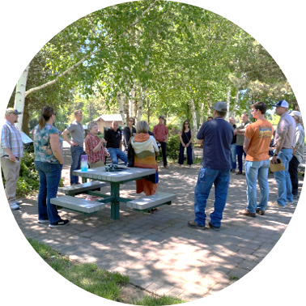
Purpose & Agenda
Share drainage and density policy updates and collect input on general approach and key considerations for neighborhood-scale and residential infill implementation.
Welcome and Introductions
100 Years of Water Update
Drainage and Density Discussion
Needs and objectives
Neighborhood-scale
Residential infill
Summary and Closing
Notes:
Speaker:

Slide 3
March meeting reflections: water rights topic
Any additional questions about how the March water rights presentation relates to Bend’s water operations?
Discussion and feedback:
Basin history, geography and geology, and how the water cycle functions regionally
Water budget forecasting, basin challenges, and how dry years impact regional supplies
Other basin water interests, irrigation canal piping
Influences to groundwater wells, distance from Cascade recharge
Deschutes Basin Mitigation Program
Notes:
Speaker:

Slide 4
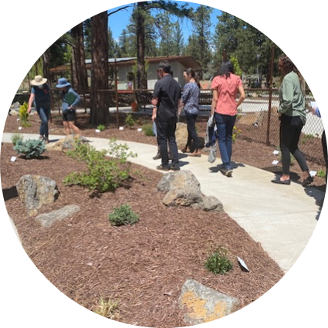
June tour preview
Planning to tour Hatfield Ponds and the Water Reclamation Facility to discuss key facilities planning project topics.
Agenda:
11 a.m. tour start
Walking tour
12:30 p.m. optional lunch
Look for more RSVP info soon!

Slide 5
Codes and Standards Updates
New 2026 Standards & Specifications
Estimated sign off date: 4/15/26
Effective date: 5/15/26
Stormwater:
New standard drawings for modified and deep drywells
Updated horizontal and vertical setbacks
Notes:
Speaker:

Slide 6
ROW Standard Updates
Updates to sections on Irrigation, Tree placement in Ch.12
Clarification on irrigation equipment requirements.
Modifications to tree offsets and placement outside of the ROW.
Clarifications added to tree list species appropriate for tight spacing and placed behind PUE on private property.
Structural soil, suspended concrete requirements for large species trees when tree grates are required on arterials.

Slide 7
100 Years of Water Update

Slide 8
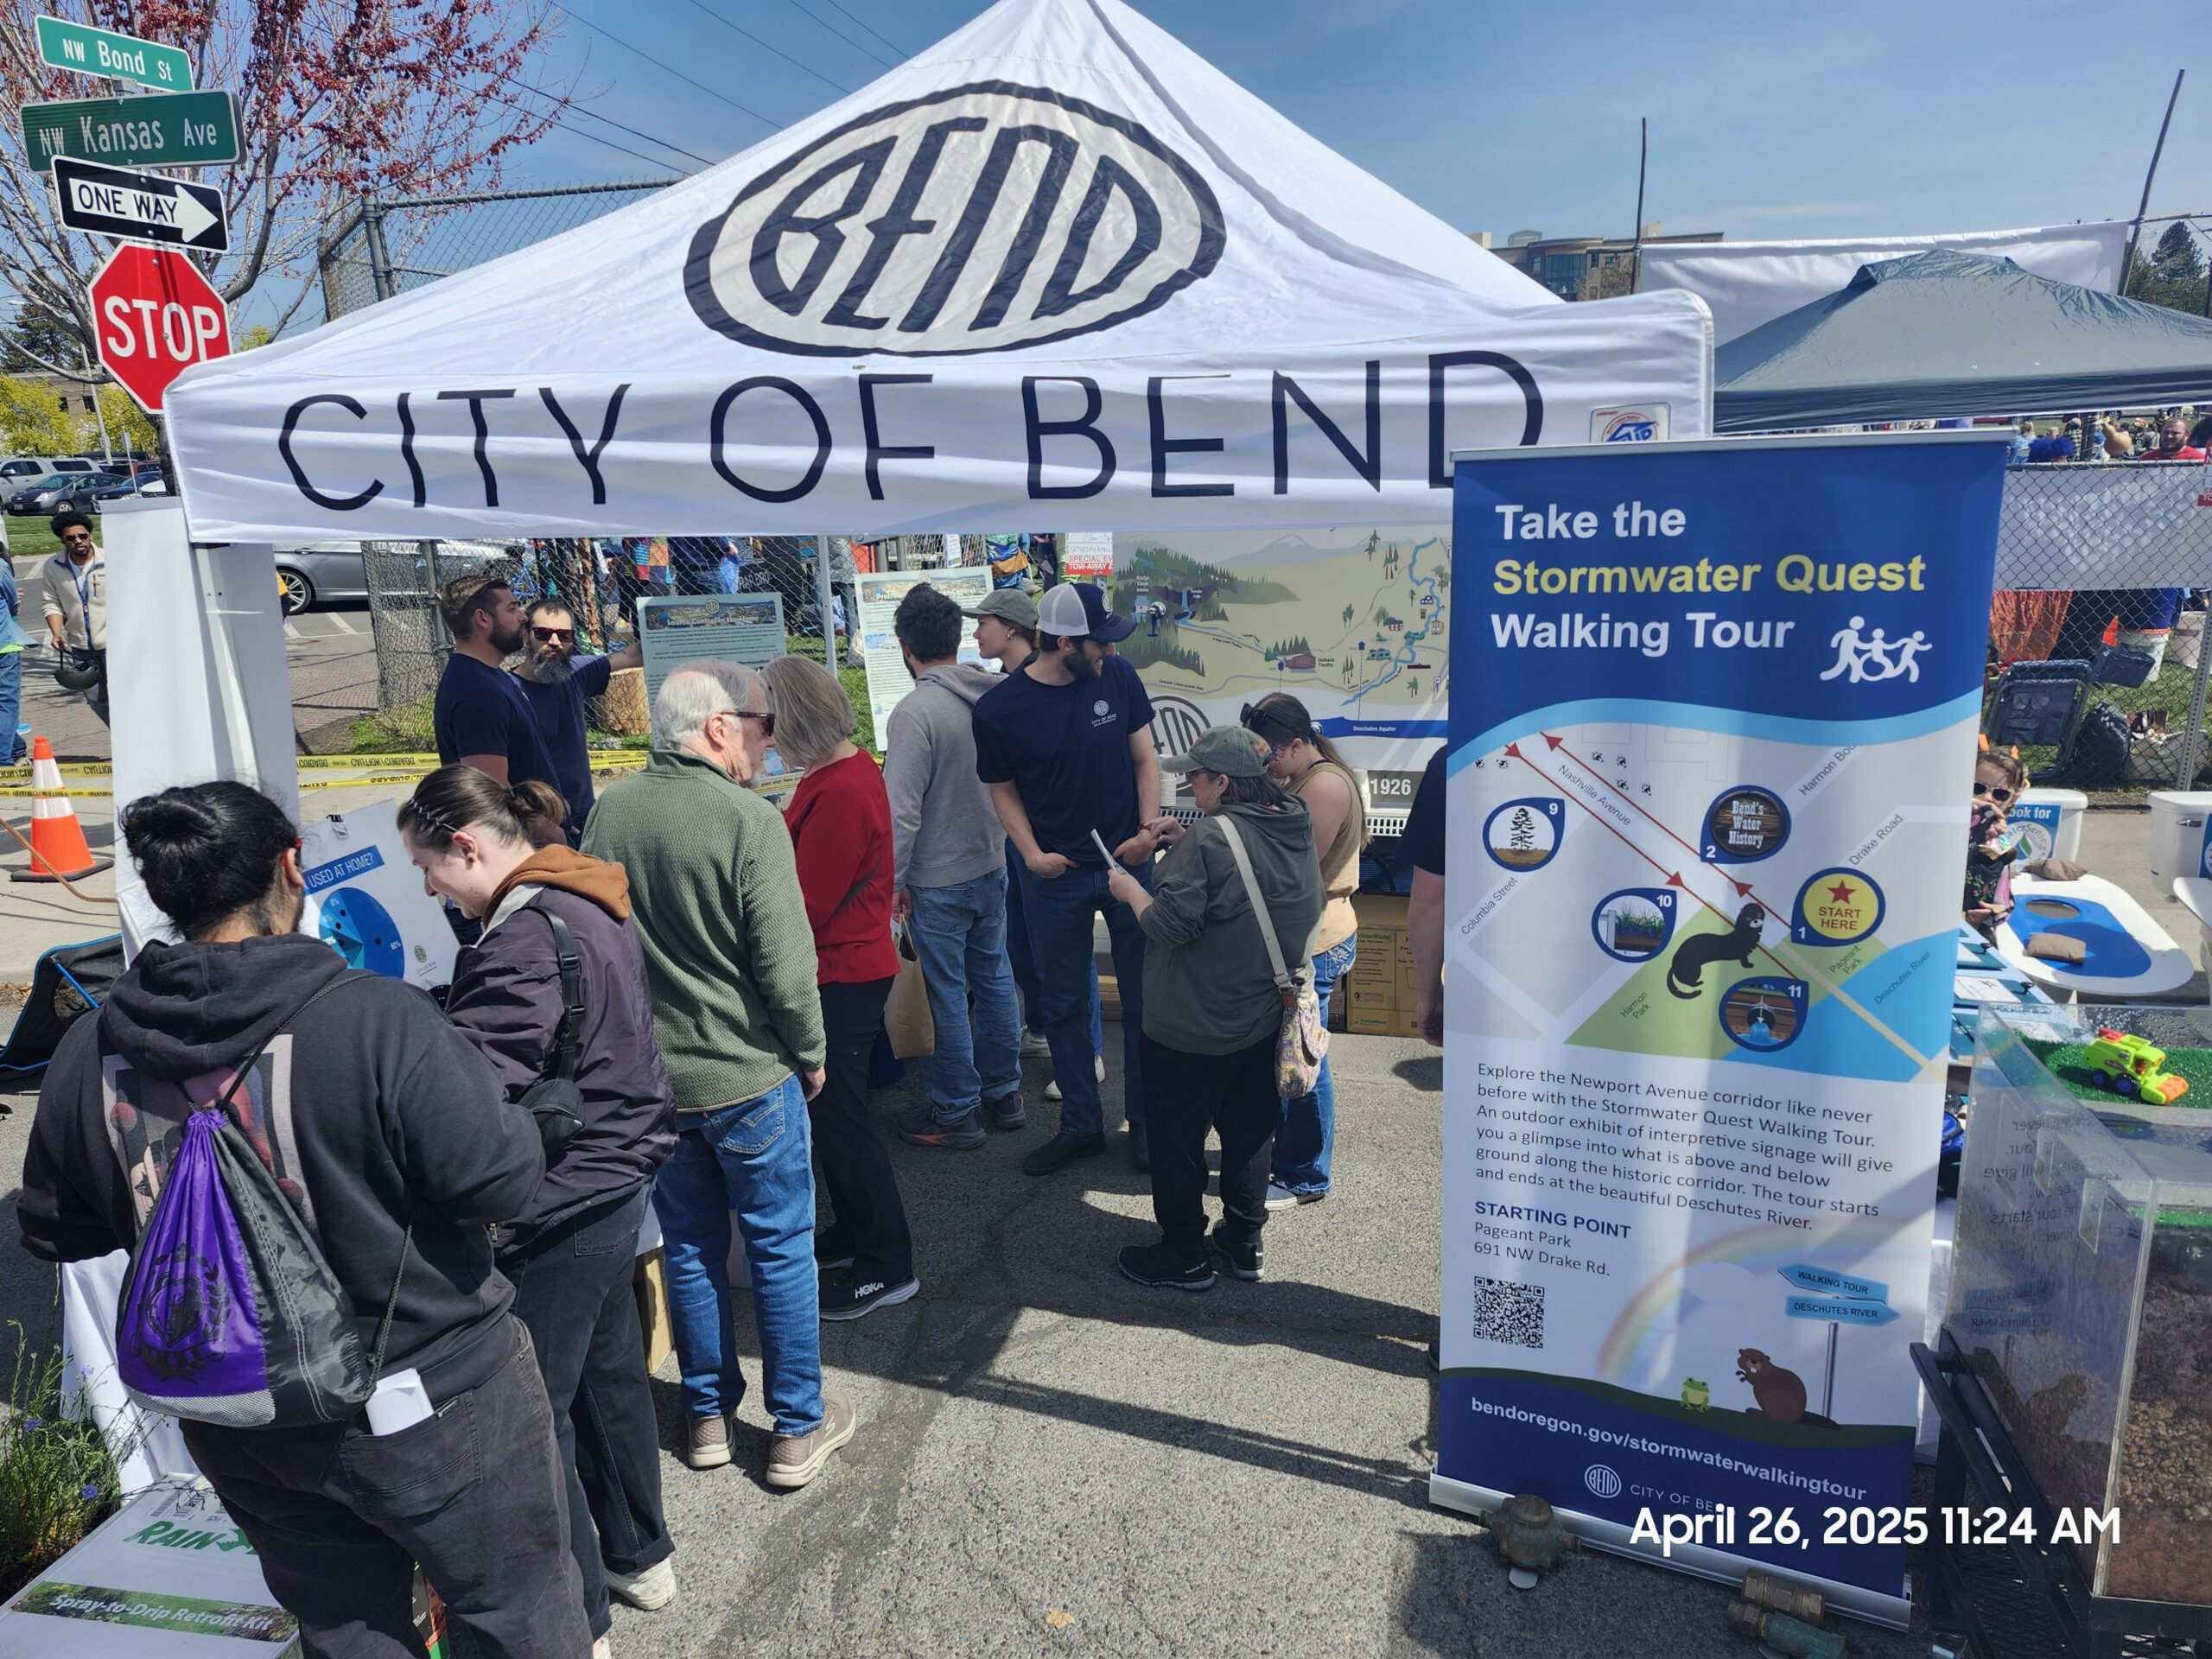
Upcoming events
Earth Day Fair & Parade
Family-friendly community event
Saturday, April 25, 11 a.m.–3 p.m.
Alpenglow Park, 61049 SE 15th St.
Visit the Water Services booth to:
Pick up brochures and I ❤️ Bend Water swag
Take a selfie and enter a prize drawing

Slide 9
Drainage and Density Discussion
Notes:
Speaker:

Slide 10
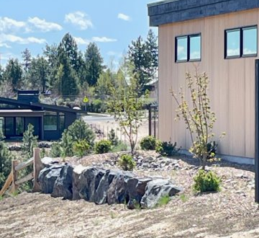
Needs and Objectives
With increasing density, staff and the community have observed the need for:​
How to fit storm facilities on small lots​
Providing more stormwater options to developers​
Preventing downstream impacts from on-site stormwater facilities​
Local flooding (street, neighbors)​
Erosion​
Alternatives for areas with low infiltration ​
Allowing or requiring centralized stormwater facilities that serve a whole neighborhood​
This infiltration swale should be setback both from the foundation and property line.
Notes:
Speaker: Elisabeth O’Keefe

Slide 11
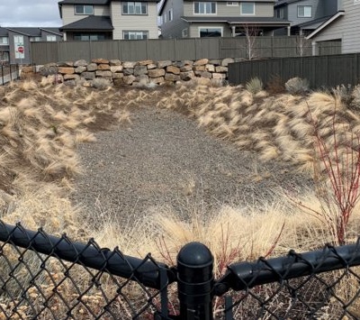
Drainage and Density Recommendations​
Recommended next steps:​
Clarify minimum requirements for on-lot facilities (template)
Create pathways for more subdivision level facilities​
Consider city maintenance of facilities serving multiple properties and ROW​
Create more options for infill stormwater management, including in the ROW​
Develop area specific storm plans for some special districts ​

Slide 12
Drainage and Density Pathways
Neighborhood
2 or More Residential Lots
Multifamily & Non-Residential
5+ Residential Units, Commercial and Industrial
Residential “Infill”
1-4 Residential Units (One Lot)
Presumptive: Fully comingled system
Public and private drainage is collected and discharged into a combined system.
Requirement: Separate Public and Private Systems
All Public Drainage is managed by a public system.
All Private Drainage is managed independently on private property.
Option 1: Separate public and private systems
All public drainage is managed by a public system.
All private drainage is managed independently on private property.
OR
Deviation 1: Partially comingled system.
Some public and private drainage is collected and discharged into a combined system.
Some private drainage is managed independently on private property.
Ownership:
Is City ownership the default?
OR
Option 2: Partially comingled system.
Some public and private drainage is collected and discharged into a combined system.
Some private drainage is managed independently on private property.
Feasibility analysis may be used to direct drainage to existing public system.
OR
Deviation 2: Separate public and private systems.
All public drainage is managed by a public system.
All private drainage is managed independently on private property.
OR
Fee In-Lieu:
Would the City collect a fee in-lieu for use of existing system?
Option 3: Fully comingled system.
Public and private drainage is collected and discharged into a combined system.
Feasibility analysis may be used to direct drainage to existing public system.

Slide 13
Approaches
Neighborhood-scale projects:
Presumptive: This is the preferred standard method by the City but is not a requirement to use.
Deviation: Available to implement but may require more submittal work for developers.
Residential “infill” projects:
Option: No preferred method by the City.

Slide 14
Neighborhood Pathway
Neighborhood
2 or more residential lots
Presumptive: Fully comingled system.
Public and private drainage is collected and discharged into a combined system.
Deviation 1: Partially comingled system.
Some public and private drainage is collected and discharged into a combined system.
Some private drainage is managed independently on private property.
Ownership:
Is City ownership the default?
Deviation 2: Separate public and private systems.
All public drainage is managed by a public system.
All private drainage is managed independently on private property.

Slide 15
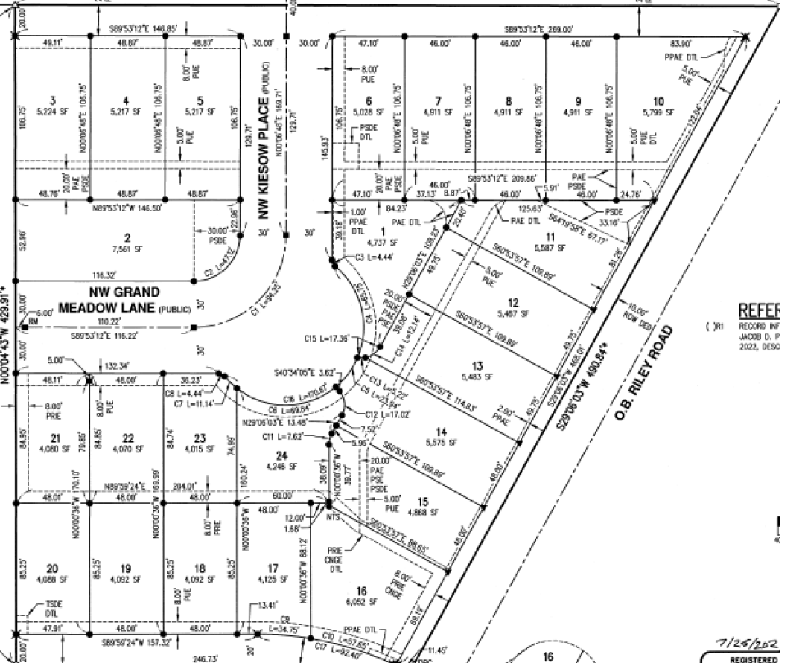



Neighborhood Pathway Approach Overview
Example Land Division:
24 Lot Residential Development
Drainage Pathway:
Neighborhood (2 or more lots)
Presumptive Approach:
Public and private drainage is combined.
Deviation 1:
Partially combined.
Deviation 2:
Separate public and private.
Notes:
Speaker: Elisabeth O’Keefe

Slide 16
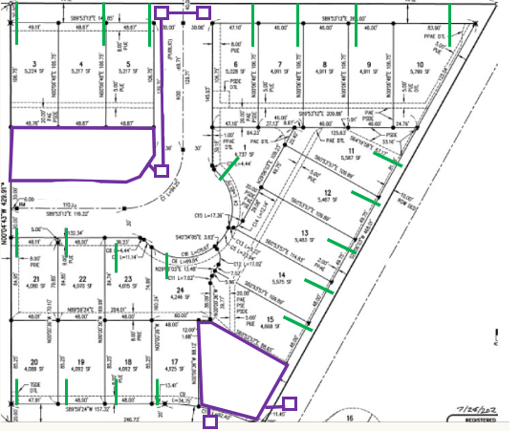
Neighborhood Pathway (Swale)
Public Swales
Presumptive Approach: Combined system.
Private laterals daylight through curb (green).
All drainage is collected in the curbline and conveyed to the public system (purple).

Slide 17
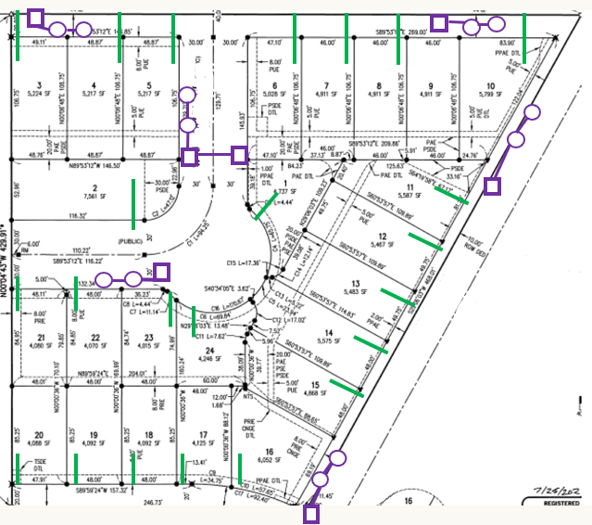
Neighborhood Pathway (Underground Injection Control [UIC])
Public UICs
Presumptive Approach: Combined system.
Private laterals daylight through curb (green).
All drainage is collected in the curbline and conveyed to the public system (purple).

Slide 18
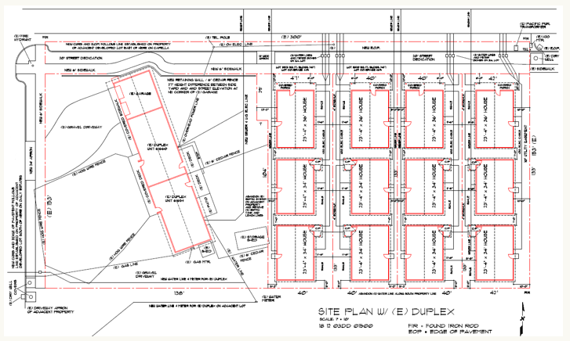
Neighborhood Pathway Middle Housing Example
Land Division:
Dividing 1 lot into 5 lots with ROW improvements.
Drainage Pathway:
Neighborhood scale (2 or more lots)
Presumptive Approach:
Public and private combined.
Deviation 1:
Partially combined.
Deviation 2:
Separate public and private.

Slide 19
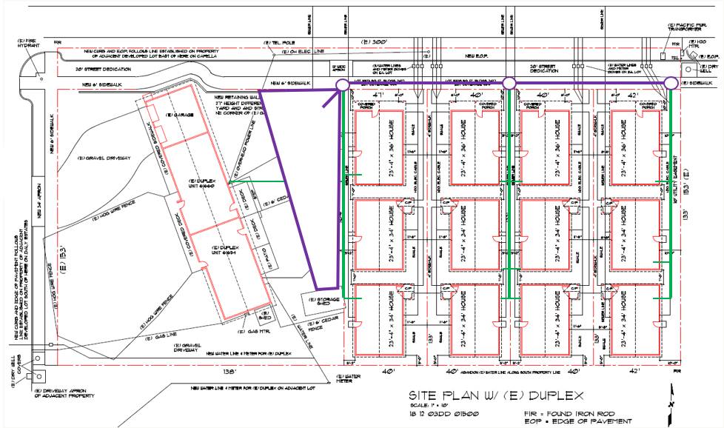
Neighborhood Pathway Middle Housing (Swale)
Public Swale
Presumptive Approach: Public and private combined.
Private lateral tied into public structure.
Public swale infiltrating water from entire development.
Public swale is in an easement or tract.

Slide 20
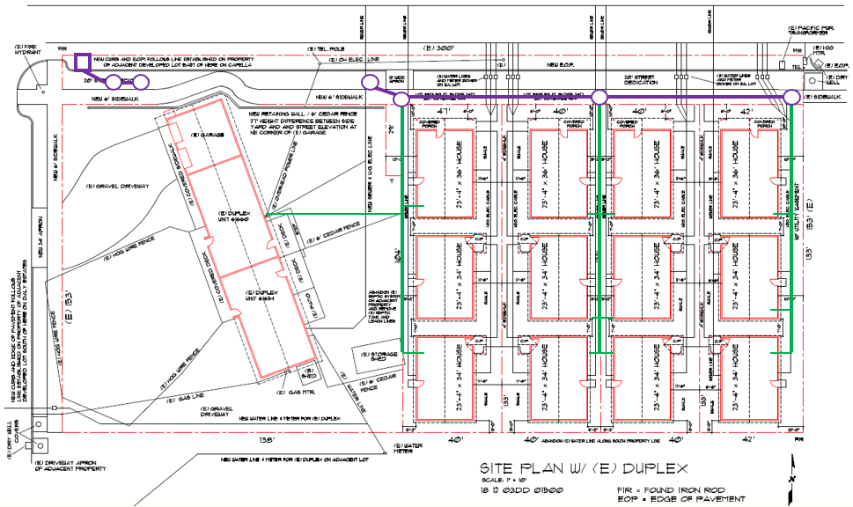
Neighborhood Pathway Middle Housing (UIC)
Presumptive Approach: Public and private combined.
Private lateral tied into public structure.
Public UIC infiltrating water from entire development.
Public UIC

Slide 21
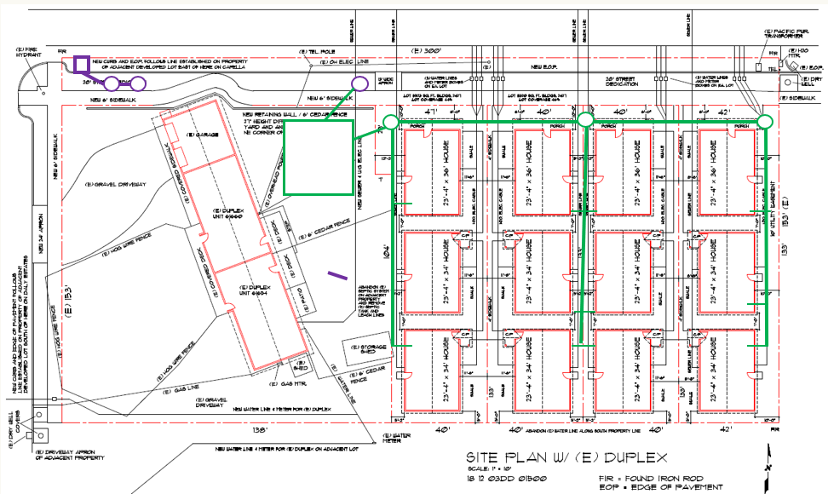
Neighborhood Pathway Middle Housing
Deviation 1:
Partially combined system.
Private laterals tied to private swale.
6-month storm retained in private swale.
Overflow to public UIC.
Alternative deviation scenario:
Separate private swale serving multifamily site, single-family home area send runoff to public UICs in ROW.
Private Swale, Public UIC

Slide 22

WAG Discussion Questions
How can the City encourage developer implementation of neighborhood scale facilities?
If the City maintains these facilities, how should we fund this? Should the City allow for HOA’s to provide “higher level” landscape maintenance?
If a developer chooses not to build neighborhood scale: How can the City better ensure that SF individual lot facilities are of adequate size? Is it feasible to require a deed restriction or similar at Land Use/Land Division to reserve space on each lot?
Notes:
Speaker:

Slide 23
Residential Infill Pathway
Residential “Infill”
1-4 Residential Units (One Lot)
Option 1: Separate public and private systems
All public drainage is managed by a public system.
All private drainage is managed independently on private property.
Option 2: Partially comingled system.
Some public and private drainage is collected and discharged into a combined system.
Some private drainage is managed independently on private property.
Feasibility analysis may be used to direct drainage to existing public system.
Fee In-Lieu:
Would the City collect a fee in-lieu for use of existing system?
Option 3: Fully comingled system.
Public and private drainage is collected and discharged into a combined system.
Feasibility analysis may be used to direct drainage to existing public system.

Slide 24
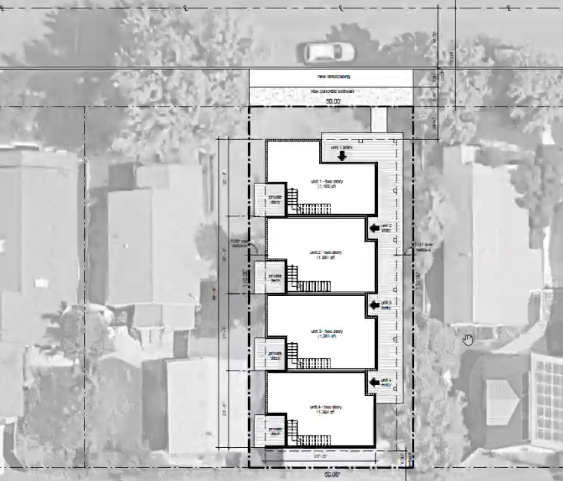
Residential Infill Single Lot Development (1-4 units)
Infill:
1 Lot Development
Drainage Pathway: Residential (1 Lot)
Option 1:
Separate Public and Private.
Option 2:
Partially Combined.
Option 3:
Combined.
Issue: runoff to neighboring properties
Issue: runoff to neighboring properties
Notes:
Speaker: Elisabeth O’Keefe

Slide 25
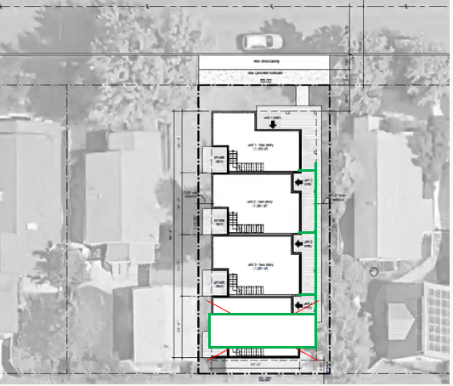
Residential Infill Single Lot Development (1-4 units)
Option 1: Separate public and private.
Existing standard (template): 25-year storm retained on site.
This site design may not be feasible for this option. Potential removal of 1 unit or downsizing of building footprints due to setback and lot size constraints.

Slide 26
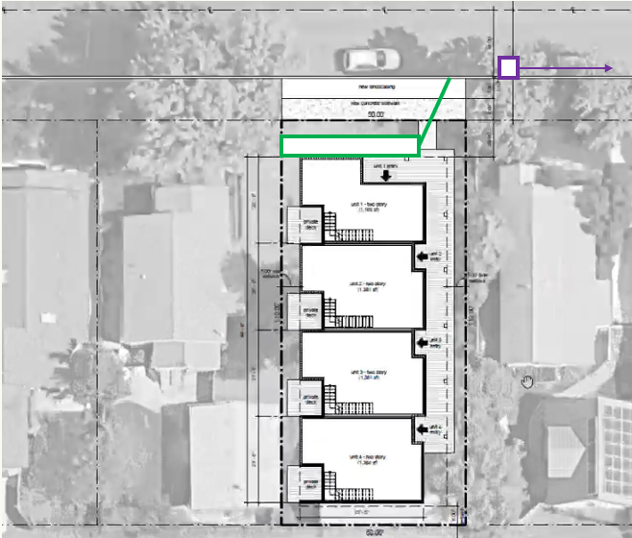
Residential Infill Single Lot Development (1-4 units)
Option 2: Partially combined (within MS4).
New Standard Proposal: 6-month storm retained on site with private swale.
Drainage overflows to adjacent street for conveyance to Public MS4 (piped storm system).
Feasibility Assessment: Only if City confirms conveyance is available/existing in ROW and not in a known flooding area.

Slide 27
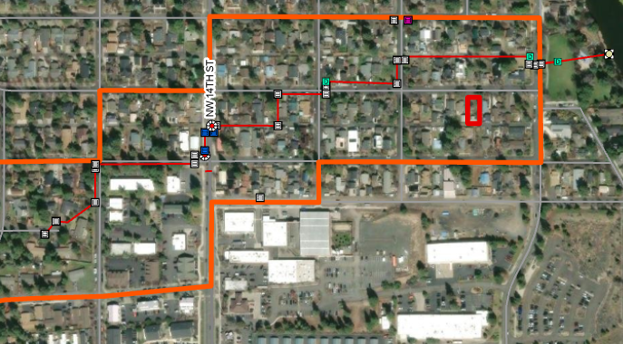
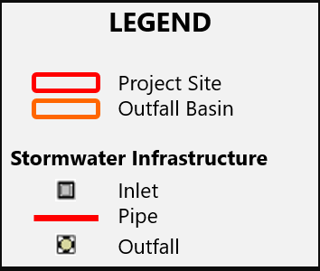
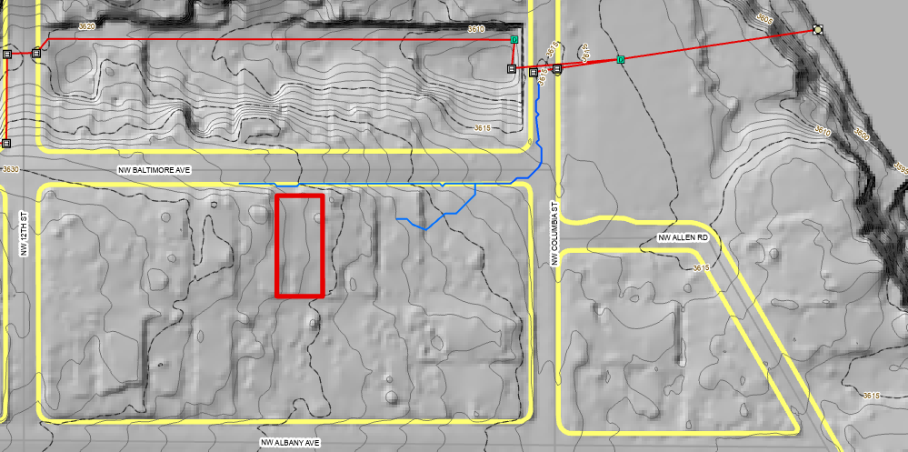
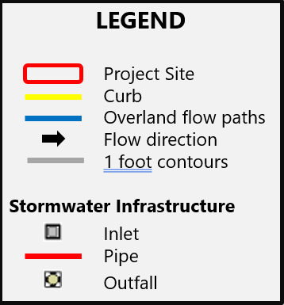
Residential Pathway (MS4) Feasibility
Feasibility assessment: City confirm if conveyance is available/existing in ROW and not in a known flooding area.
Project Site
Project Site

Slide 28
Residential Infill Pathway (UIC)
Option 2:
Partially combined, in UIC area.
Minimum storm retained on site with private swale.
Drainage overflows to adjacent street for conveyance to public UIC if the City confirms there is existing capacity.

Slide 29
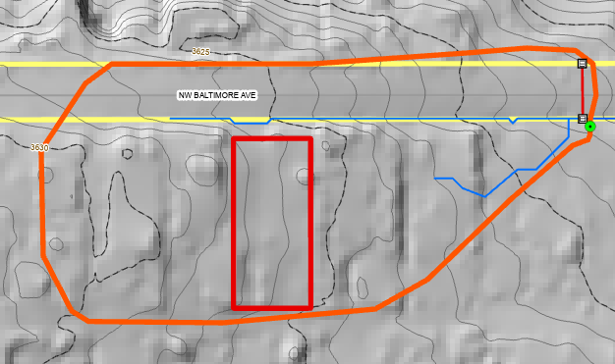
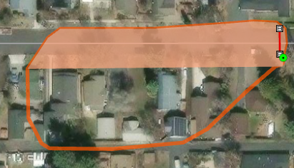
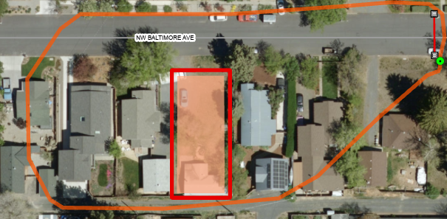
Residential Pathway (UIC) Feasibility
Project Site
City confirm existing system has capacity: drainage basin and UIC designed storage can be calculated and compared to drainage needs of planned development to measure if there is available capacity in the existing public system.

Slide 30
Residential Pathway (UIC)
Option 3:
Public and private drainage combined. ROW improvements included as part of development.
Public drainage improvements designed to the 25-year storm for frontage and onsite impervious (purple).
Each unit has a private lateral connection (green).

Slide 31
WAG Discussion Questions
Should the City require a minimum amount of on-lot storm storage if the development is allowed to discharge the remainder to the ROW to an existing storm system?
Is it reasonable to charge developers for City staff time to determine if there is available capacity in existing ROW storm system?
How to ensure that small infill lots with onsite storm management install adequate facilities?
Notes:
Speaker:

Slide 32
WAG Discussion Questions cont.
What type and degree of stormwater drainage and density issues are you seeing? (during permitting, design, construction, post-construction)
How should the City best explain:
The problems/issues
Proposed solutions and impacts
How should the City fund additional staff time:
For permitting/inspections
For maintenance

Slide 33
- Discussion and Feedback - Next Steps
Notes:
Speaker:

Slide 34

Look ahead
May 6, 2026: Stormwater Program Update and WaterWise/FireWise Discussion 11 a.m.-12:30 p.m. Hybrid Meeting (new Headquarters Building or MS Teams)
June 3, 2026: In-person Tour!
Notes:
Speaker:

Slide 35
Thank you!
Notes:
Speaker:

Slide 36
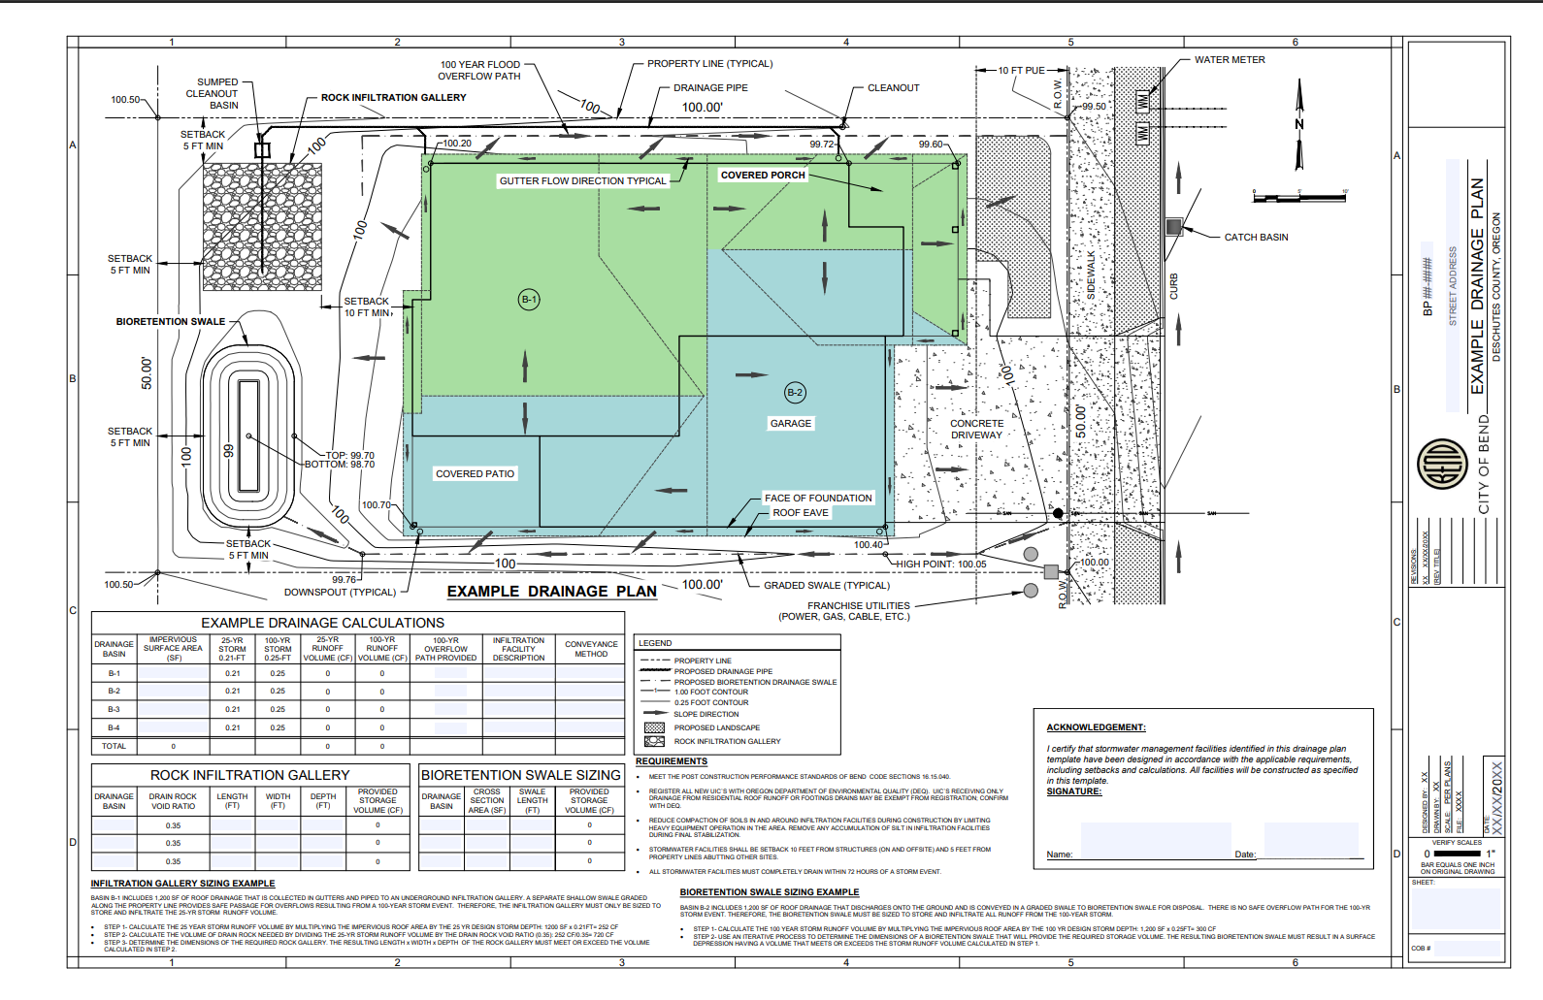
Existing Stormwater Drainage Template

Slide 37
Accommodation Information for People with Disabilities & Language Assistance Services You can obtain this information in alternate formats such as Braille, electronic format, etc. Free language assistance services are also available. Please email accessibility@bendoregon.gov or call 541-693-2198. Relay Users Dial 7-1-1. All requests are subject to vendor processing times and should be submitted 48-72 hours in advance of events.
Servicios de asistencia lingüística e información sobre alojamiento para personas con discapacidad Puede obtener esta información en formatos alternativos como Braille, formato electrónico, etc. También disponemos de servicios gratuitos de asistencia lingüística. Póngase en contacto en correo electrónico accessibility@bendoregon.gov o número de teléfono 541-693-2198. Los usuarios del servicio de retransmisión deben marcar el 7-1-1. Por favor, envíe sus solicitudes con 48-72 horas de antelación al evento; todas las solicitudes están sujetas a los tiempos de procesamiento del proveedor.
Notes:
Speaker:

